Slide 1
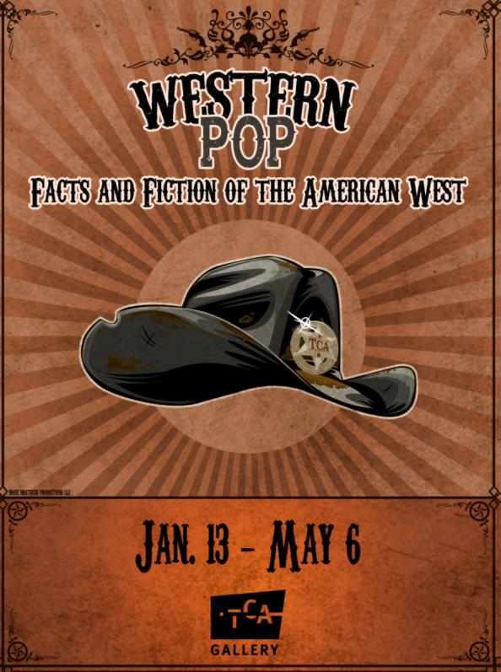
Exhibition
Preview

Slide 2
Big blue skies, rugged canyons, loyal horses, damsels in distress, ruthless gunslingers, savage Indians and handsome but tormented men wearing cowboy hats. Yep, that just about describes the premise for many western films and televisions shows of Hollywood’s golden age. This exhibition peels back some of the history, mythology and popular culture layers to reveal the Western genre as ongoing narrative source for scholars, artists and film makers. The artworks, memorabilia, music and historical displays celebrate the nostalgia tied to the western genre and expose the facts and fiction about morality, race relations and economics in a complicated story that is the history of the American West.

Slide 3
Featured Artists: Dick Ayers, Thomas Hart Benton, Charles Braden, Brose Brothers Productions, Anne Coe, Rita Consing, Dwayne Hall, Luis Alfonzo Jimenez, Richard Lillis, Lon Megargee, Ed Mell, Douglas Miles, Mark Newport, William Clinton Schenk and Fritz Scholder.
Thank you: ASU Art Museum, ASU Center for Film and Popular Culture, Rolf Brown, Michael Collier Gallery, Michael Ging, Mesa Contemporary Arts Museum, Phoenix Film Festival, Tempe History Museum and Dr. Larry and Holley Thompson.

Slide 4
The following slides highlight some of the contemporary Arizona-based artists in the exhibition.

Slide 5
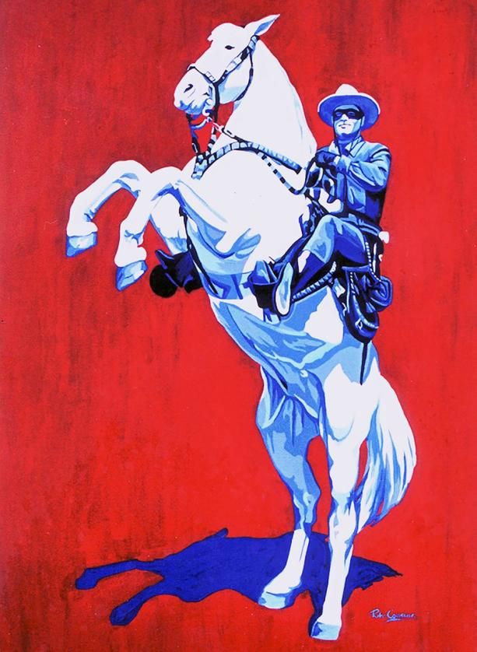
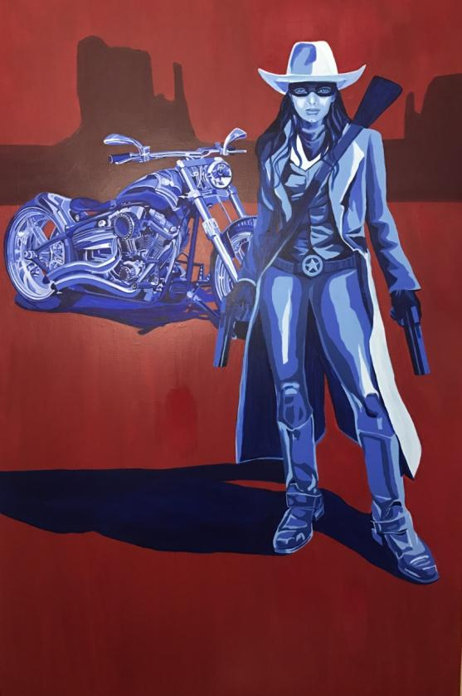
Rita Consing, Phoenix
Rita Consing The Lone Ranger and The Lone Ranger 2, 2017
acrylics on canvases

Slide 6
Consing is a Philippine American artist. Her father was an artist and the family spent a lot of time traveling the world. She was exposed to a lot of different cultures and recalls being influenced images of Ninjas, Samurais and Bruce Lee in Asia while enjoying the American comic books and western reruns like “The Lone Ranger” in the West. The first time she painted an image of “The Lone Ranger” was the day after 9/11. Consing says “It was my reaction to the attacks on innocent Americans…. I needed to go back to an era when heroes were good. They lived to protect the innocent and helpless. The good versus evil was black and white, not shades of gray.” Today, Consing is continuing to explore ideas and social issues associated with heroes, race and popular culture. (www.ritaconsing.com)

Slide 7
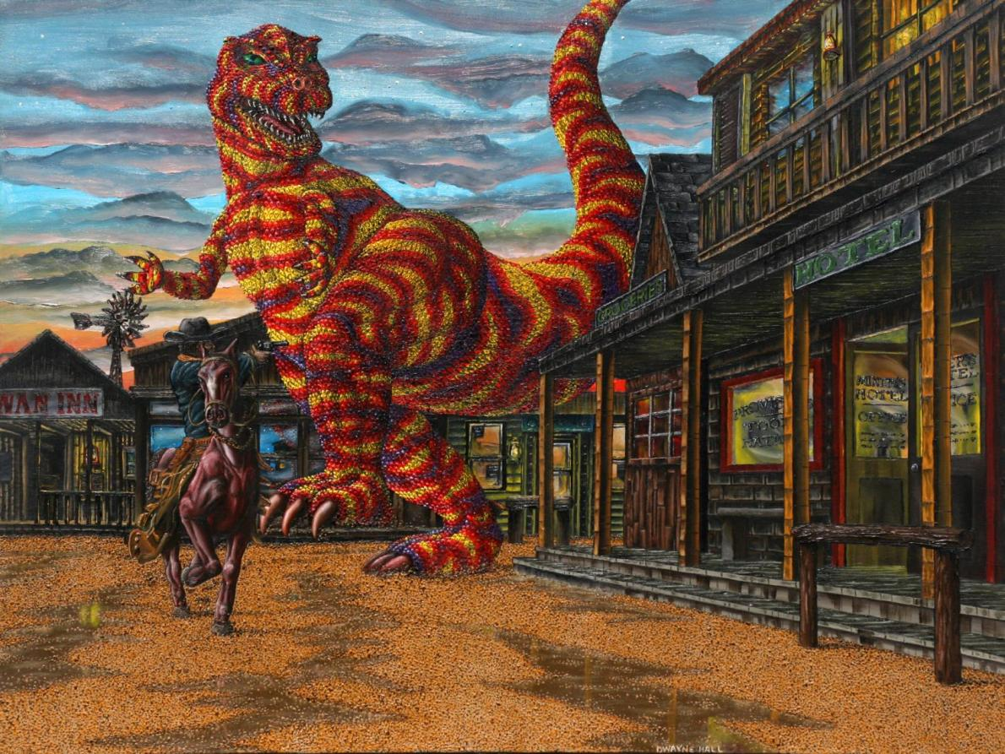
Dwayne Hall, Scottsdale
Dwayne Hall, Chase
oil on canvas

Slide 8
Hall says he’s been “drawing and painting his whole life.” He describes his art making as partially “self-taught” and partially absorbed through the various skills he’s picked up from elementary school all the way through college. Hall graduated from Northern Arizona University in 1994 and has been displaying in exhibitions around the Valley at places such as Phoenix Sky Harbor Airport Museum and Burton Barr Library in Phoenix. The oil painting “Chase” is especially reminiscent of the themes in Western POP because it combines science fiction and western. Hall says “Ever since I saw publicity still from the movie ‘The Beast of Hollow Mountain’ when I was very young, and later saw Ray Harryhausen's film ‘The Valley of Gwangi,’ I always liked the idea of combining genres.”

Slide 9
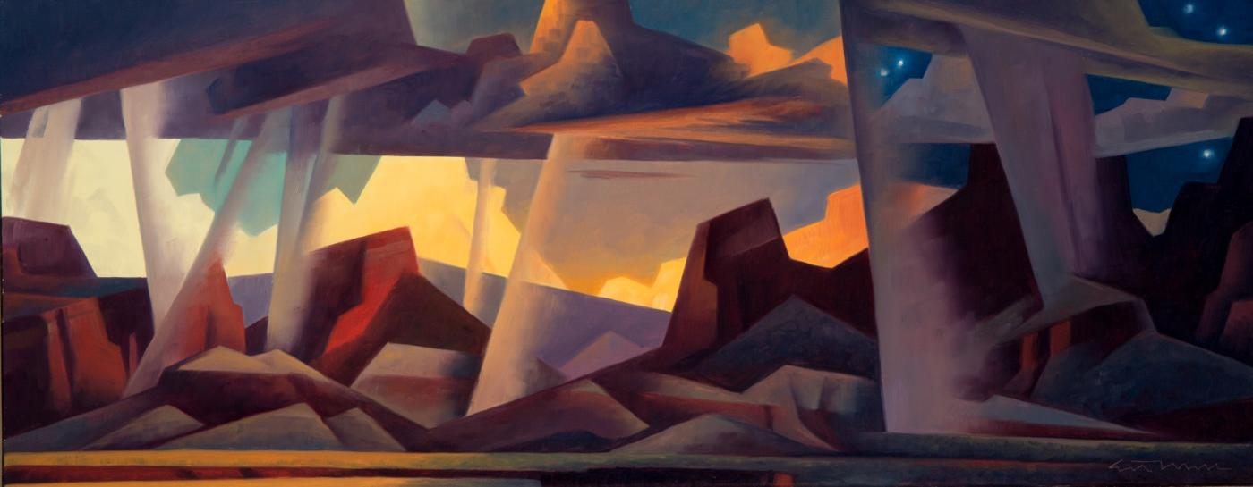
Ed Mell, Phoenix
Ed Mell Veils of Time, 2006
oil on linen

Slide 10
Mell was born in Phoenix and began drawing at an early age and was inspired by the automobiles and futuristic designs of the late 1940s and 50s. After college he went to work at major advertising firms in New York City, but found that the work smothered his creativity. After struggling with the fast-paced and high-stress lifestyle of New York City, Mell jumped at the opportunity to teach summer art classes on the Hopi Reservation at Hotevilla. Afterwards, he decided to return home to Arizona’s Sonoran desert. Today, Mell is well known for depicting the Southwest landscapes and culture in his own recognizable style. His paintings have been exhibited nationally and internationally and his work is in many private, museum and corporate collections, including Diane Keaton, Arnold Schwarzenegger and Phoenix Art Museum, (www.edmellgallery.com)

Slide 11
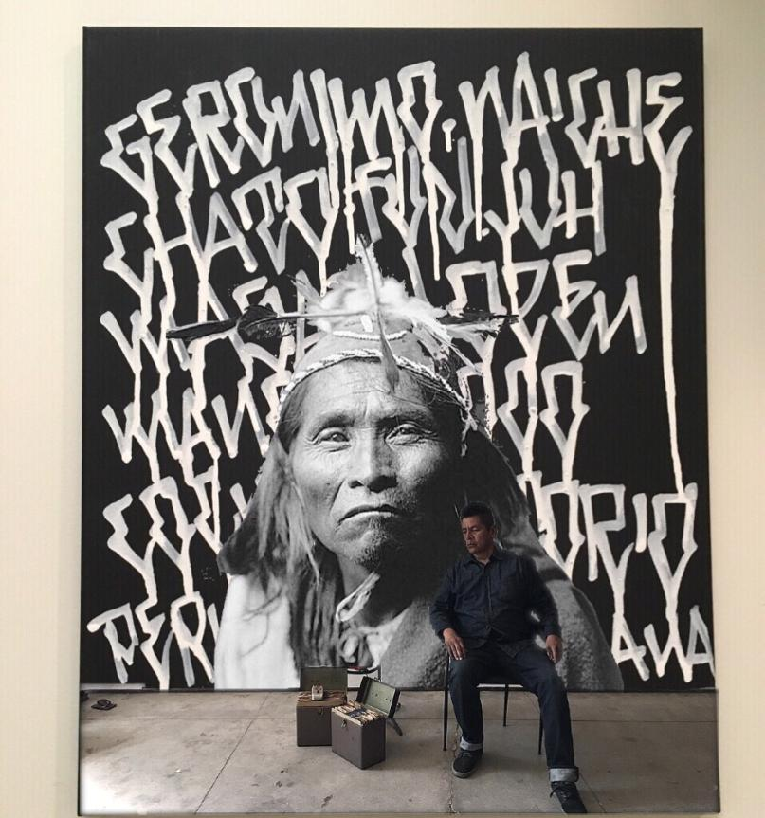
Douglas Miles, San Carlos, AZ
Douglas Miles The Apache Declaration of Independence, 2017 mixed media on canvas

Slide 12
Miles is a San Carlos Apache-Akimel O’odham painter, printmaker, muralist, film maker, photographer, entrepreneur and activist. He is perhaps best known for founding Apache Skateboards. Today, Apache Skateboards is a company that has collaborated with national organizations like iPath and Volcom to create skate decks and clothing, with actor/writer Ethan Hawke and artist Greg Ruth to create limited edition decks inspired by their graphic novel “Indhe” and with Amnesty International to create a mural in New Orleans. For the last 25 years, Douglas Miles has worked to create a body of work that reflects the realities and hardships of life on the reservation while equally celebrating its culture. (www.apacheskateboards.com)

Slide 13
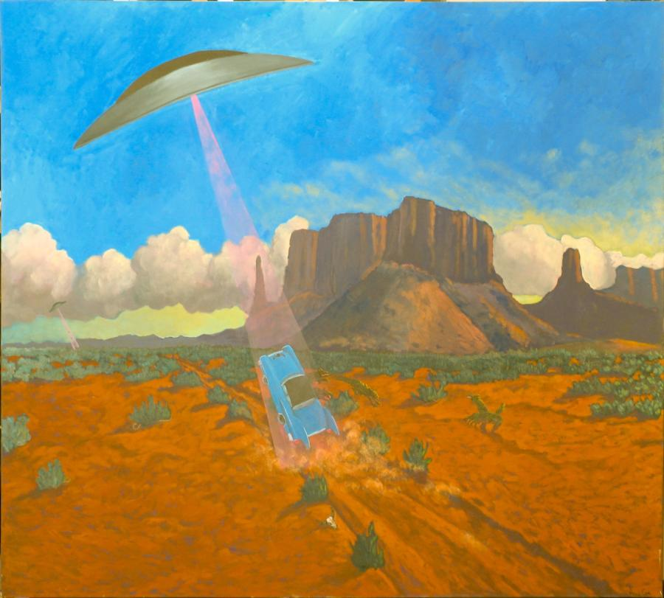
Anne Coe, Apache Junction, AZ
Anne Coe, Road Hazards: Alien Attack
acrylic on canvas
On loan courtesy of ASU Art Museum

Slide 14
Coe is a fourth generation Arizonan who finds much of her inspiration from the western landscape. She was born and raised on a ranch and then later studied art in both Europe and Latin America. She earned Bachelor of Arts and Master of Fine Arts degrees from Arizona State University. It is not unusual to see satirical and surrealistic scenarios in her work such as bears having a birthday party or an alien spaceship beaming up a classic car in the desert. Her works have been included in institutions such as the Whitney Museum of Western Art in Cody, WY and the Smithsonian Institution in Washington, D.C. Today, Coe works out of her studio in Apache Junction and teaches at Central Arizona College. She is also an active environmentalist and has served on several conservation boards. (www.annecoe.com)

Slide 15
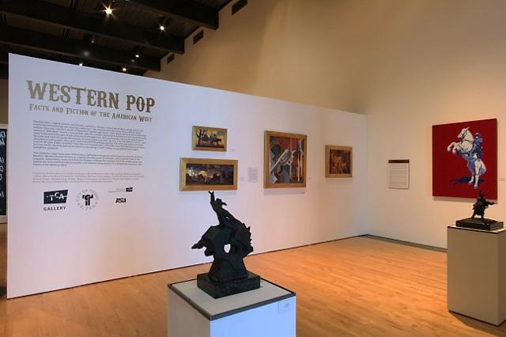

Slide 16
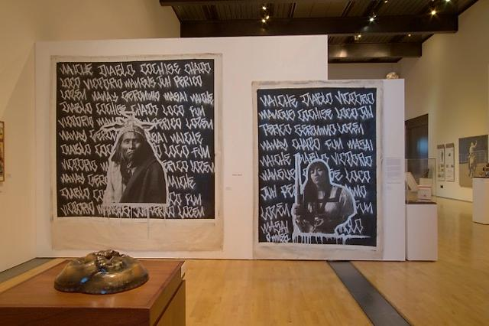

Slide 17
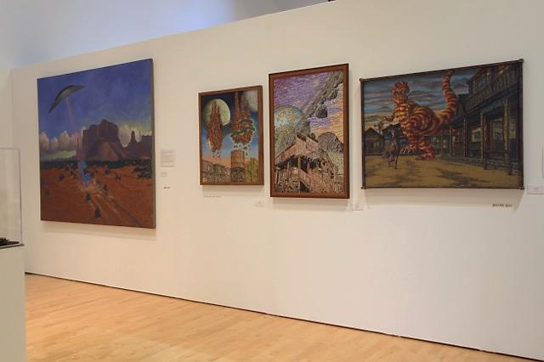

Slide 18
