Slide 1
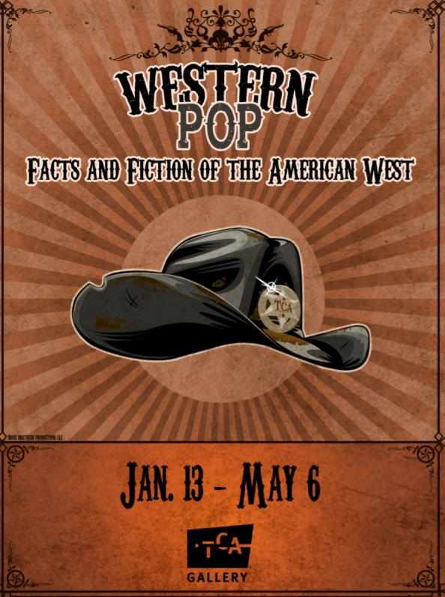
Old West Vs New West
by Mary Erickson, Ph.D. and Arizona art teacher Laurie Eldridge, Ph.D.

Slide 2
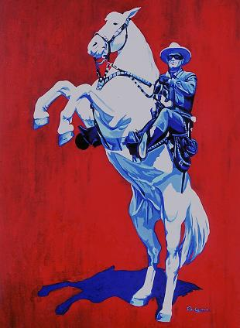
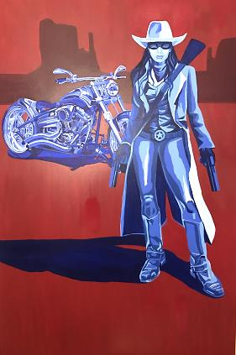
Rita Consing The Lone Ranger & The Lone Ranger 2 2017
acrylics on canvases
Many people enjoy “Old West” themed films and TV such as the Lone Ranger that was popular in the 1950s and 60s. However, new generations sometimes interpret history and popular culture differently.

Slide 3
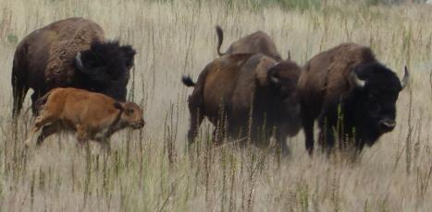
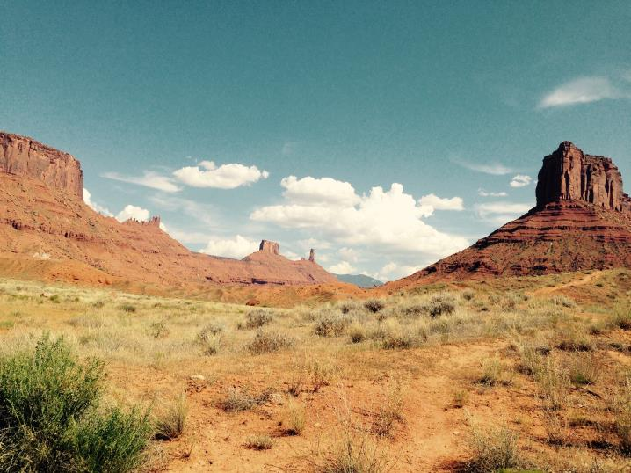
Have you read a story or seen a movie or TV show about the old west? Have you studied what happened as the
United States grew westward from the Atlantic Ocean all the way to the Pacific? What people, places, things and/or activities do you think of as “Western?”

Slide 4
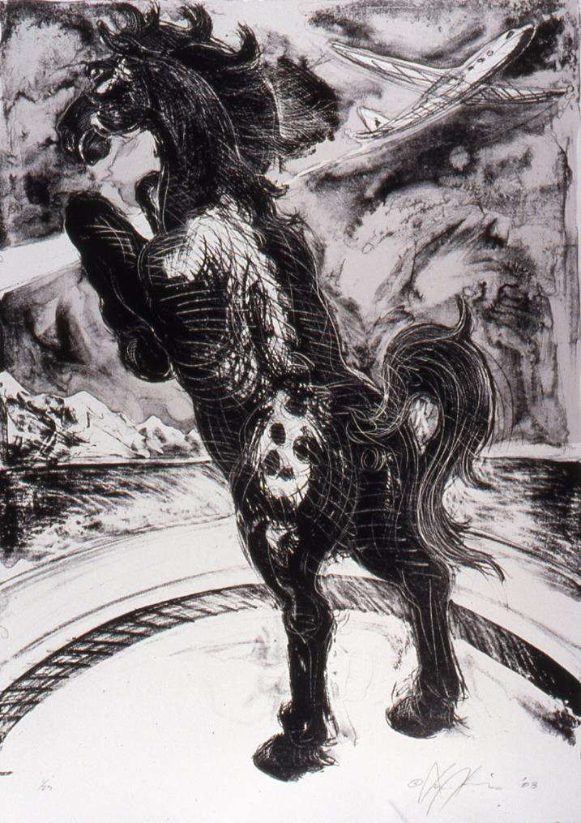
This is a lithographic print by artist Luis Jimenez called Denver Mustang.
Is Jimenez showing us the Old West or the New West?
What do you think?
Why?

Slide 5
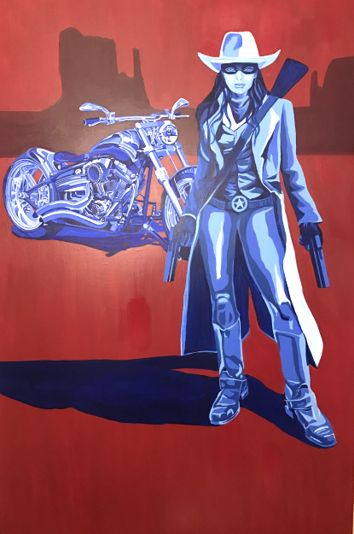
Artist Rita Consing’s painting Lone Ranger 2 takes its name from an old comic book and TV/film hero. Her painting mixes old and new ideas about the West and about heroes.
What do you see that seems like the Old West and what seems New?

Slide 6
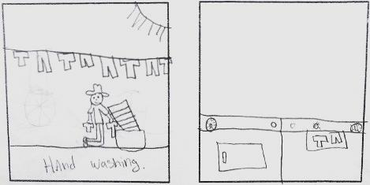
Your first challenge is to make two sketches that contrast the old and the new west. Begin by sketching old and new versions of a western person, place, object or activity. This seventh grader has sketched old and new ways to wash clothes. What differences will you show in your artwork?

Slide 7
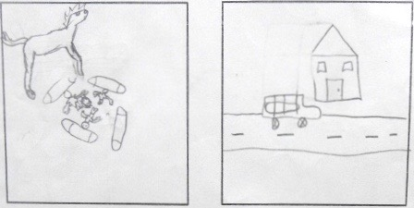
This seventh grader’s drawings contrast transportation and places to sleep in the old west and today.

Slide 8
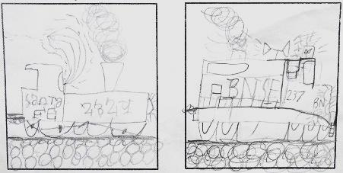
This student’s drawings show that he knows a great deal about differences between locomotives today and in the past.
Hint: Today’s Burlington Northern Santa Fe Railroad used to be called just the Santa Fe Railroad.

Slide 9
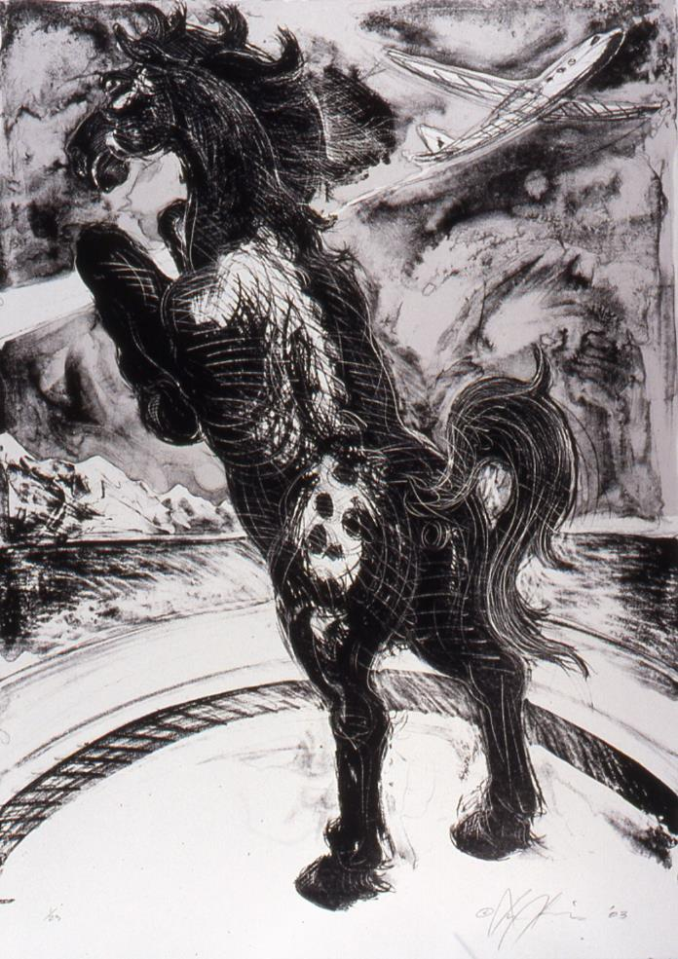
Jimenez used two kinds of contrast in his print. He contrasts new and old but also values (black, white and grays). Find:
the darkest black
the purest white
a dark gray
a light gray
How does he mix light and dark in the horse?
In the background?

Slide 10
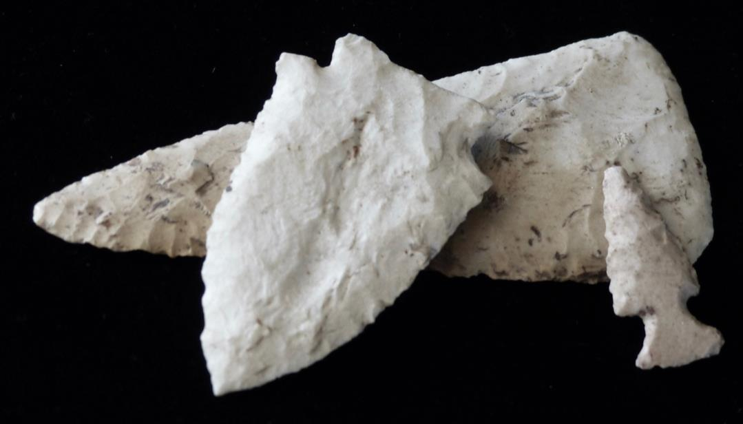
Shading is gradual change from light to dark. Shading helps us see that objects are not flat, two-dimensional shapes but are solid, three-dimensional forms.
The light and dark areas along edges of the spear point show that it was chipped. The shading in the center of the larger arrowhead shows an indentation for a wooden shaft.

Slide 11
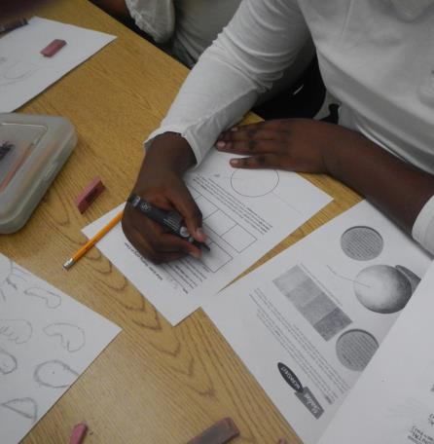
Your final artwork will mix two kinds of contrasts. You will:
Combine images of the old and new west.
Use shading of black and white values to make things look solid.

Slide 12
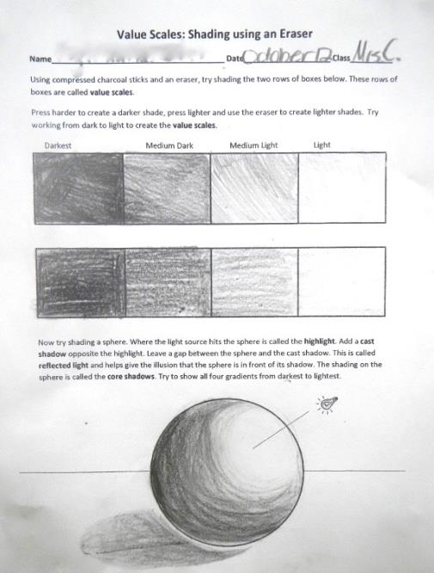
Practice making dark and light values.
Use values to show:
Highlights
Cast shadow
Reflected light and
Core shadow

Slide 13
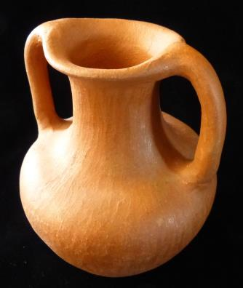
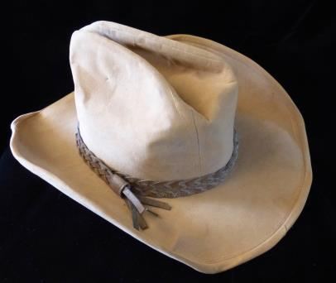
Both the jar and hat are lit from the upper left. What parts of each are lightest, because they get the most direct light?

Slide 14
What parts of the jar and hat face away from the light, so they are darker?

Slide 15
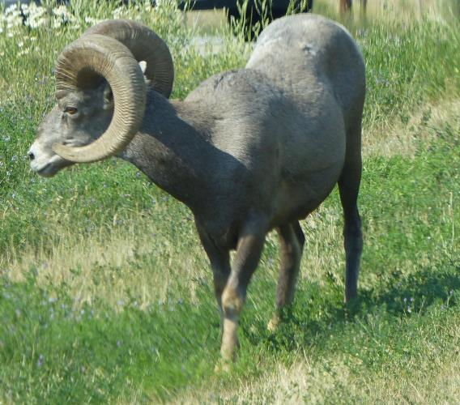
What are the lightest areas of this bighorn sheep? Which areas are darker because they face away from the sun?

Slide 16
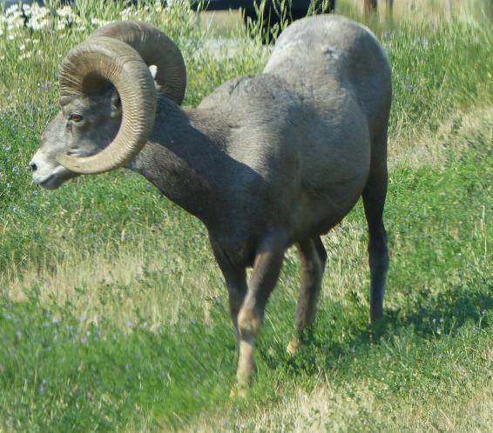
See the cast shadow in the grass? Can you find a shadow cast by the sheep’s horn on his body?

Slide 17
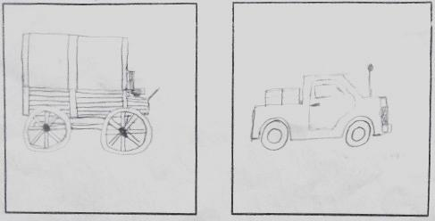
Your assignment is to:
1. find contrast between the old west and the new.
2. plan a way to contrast or combine the old and new in one drawing.
3. finish your drawing by using contrasting values to shade objects to make them look solid.

Slide 18
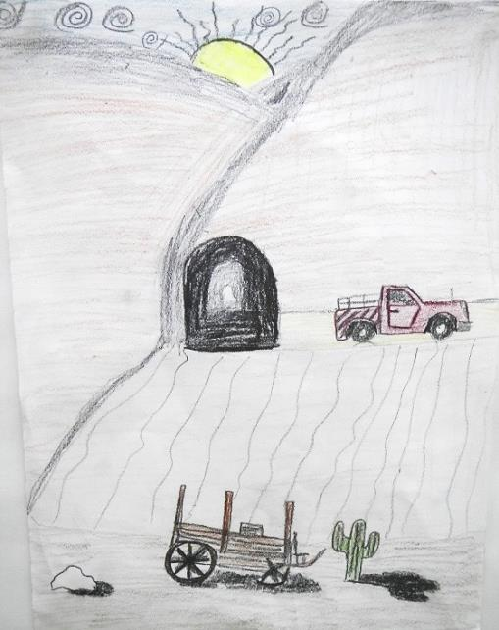
How did this student mix old and new subject matter in his drawing?
Where did he use shading?

Slide 19
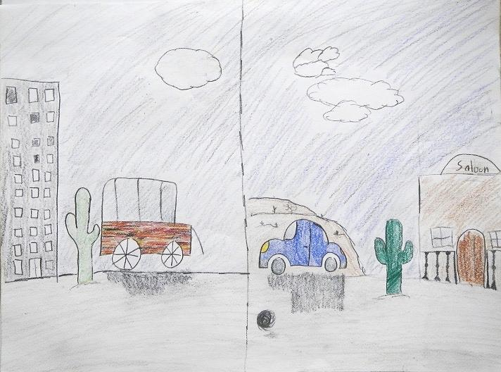
How did the student combine old and new in the two sections of his drawing?

Slide 20
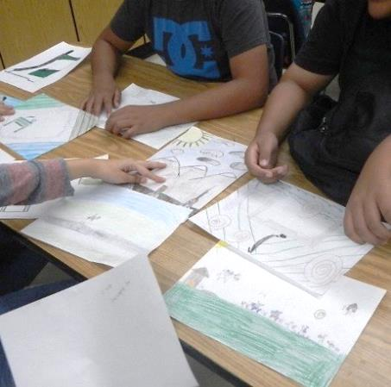
When your drawings are finished, you will work together to plan two presentations. You will analyze and organize your presentations so one showcases contrast and the other showcases mixing or combination.

Slide 21
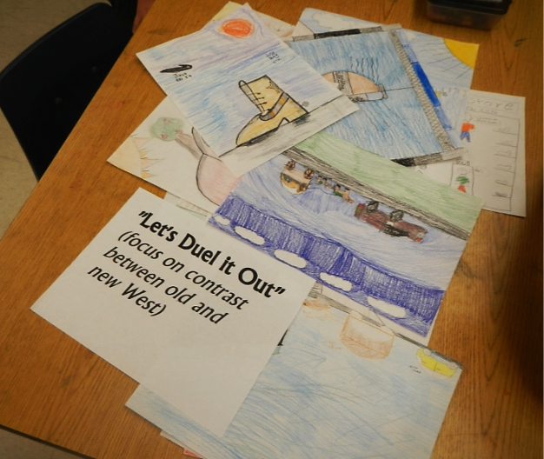
In your “Let’s Duel it Out” presentation, show how some drawings contrast the old and the new.

Slide 22
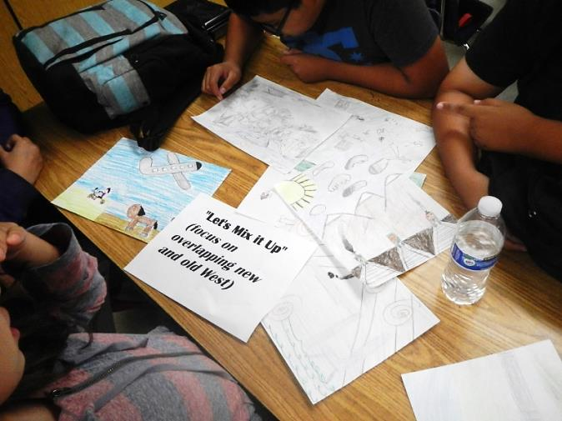
In your “Let’s Mix it Up” presentation, show drawings that focus on how the old and new west combine or overlap.

