Slide 1
My Body Works Elementary
By Mary Erickson, PhD,
Based on a workshop taught by Arizona artist, Monica Aissa Martinez,
adapted for elementary by Michelle Nichols Dock

Slide 2
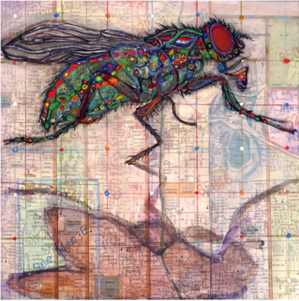
Monica Aissa Martinez is an artist who thinks systems are cool.
A system is a set with many parts that work together.
In this artwork, Monica shows us the parts of a fly and a map of a neighborhood.
Monica Aissa Martinez, Anatomy of a House Fly: Una Mosa, 2015, 8” x 8”, mixed media (Photograph by Monica Aissa Martinez)

Slide 3
The fly has wings, legs, a head and a body. Monica shows us the small parts inside the wings, legs, head and body.
The neighborhood has big streets and small streets, parks, stores and schools. Monica shows us how they all fit together.
Monica Aissa Martinez, Anatomy of a House Fly: Una Mosa, 2015, 8” x 8”, mixed media (Photograph by Monica Aissa Martinez)

Slide 4
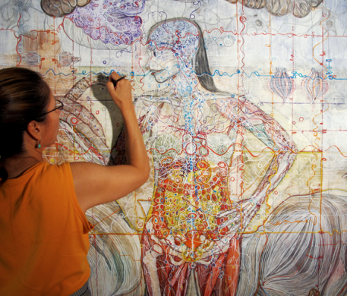
This photo shows Monica Aissa Martinez making a self portrait. Her artwork shows us bones, muscles, organs and other parts that make her body work.
Monica Aissa Martinez adding color to her self portrait
(Photograph by Eddie Duran)

Slide 5
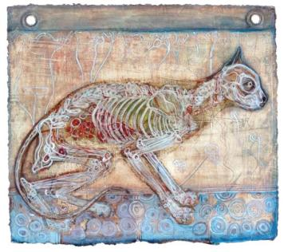
A cat can run, play, eat, purr, jump and do lots of other things. A cat’s body has a …
set of bones
set of muscles
brain and a set of nerves
heart and a set of blood vessels
All these sets work
together in a system of
systems. That’s how a
cat can do so many
different things.
Monica Aissa Martinez, Gato, 2013, 11” x 12”, mixed media (Photograph by Monica Aissa Martinez)

Slide 6
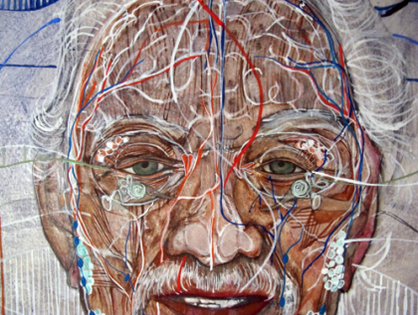
Your body’s systems keep working throughout your life. Bones of the skull protect our eyes. Muscles move them, and nerves tell our brains what we see. What systems in your body do you use everyday? For example, what systems do you use to read, run, think, and play?
Monica Aissa Martinez, detail of A patrilineal Study, 2016, mixed media, 39” x 45” , mixed media (Photograph by Monica Aissa Martinez)

Slide 7
Monica mixes different art materials in her work. She used both pencil and paint to make this picture of her father. What colors can you find? What different kinds of lines?
Monica Aissa Martinez, detail of A patrilineal Study, 2016, mixed media, 39” x 45” , mixed media (Photograph by Monica Aissa Martinez)

Slide 8
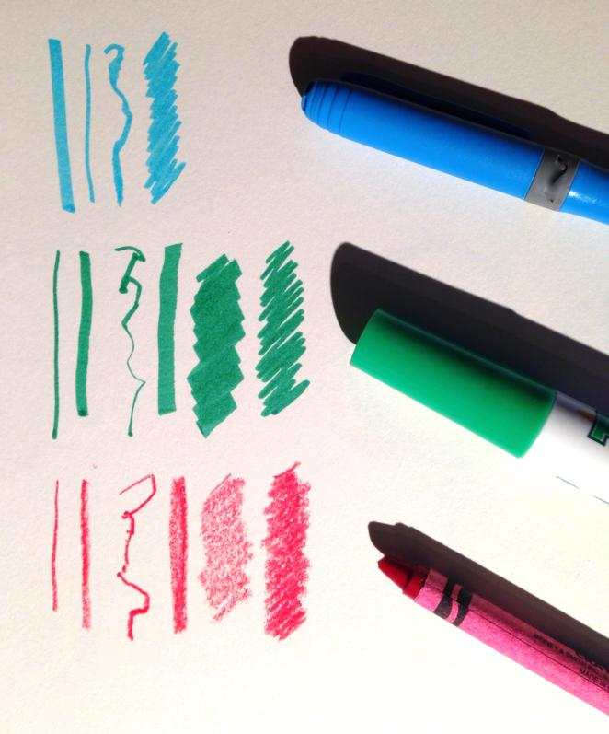
Different art materials do different things.
Compare the lines and colors made with markers and crayons.
You will be making a drawing of systems in your body using:
Colored markers
Crayons

Slide 9
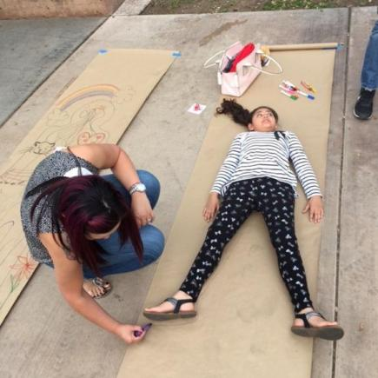
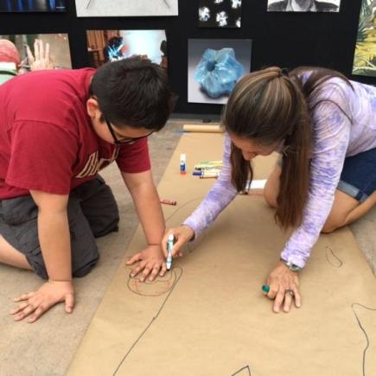
1). First, you will lie on a large piece of paper.
Your teacher will trace around your body.

Slide 10
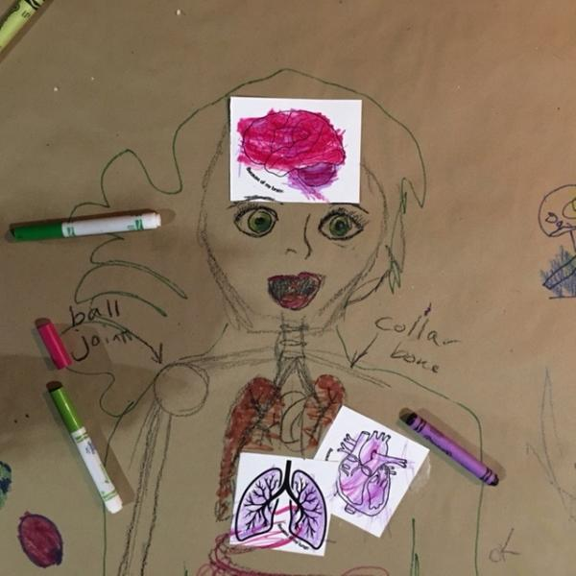
2). Use markers or crayons to color in three really important parts of your body.
Your brain
Your lungs
Your heart
You may use realistic
colors or colors you like.

Slide 11
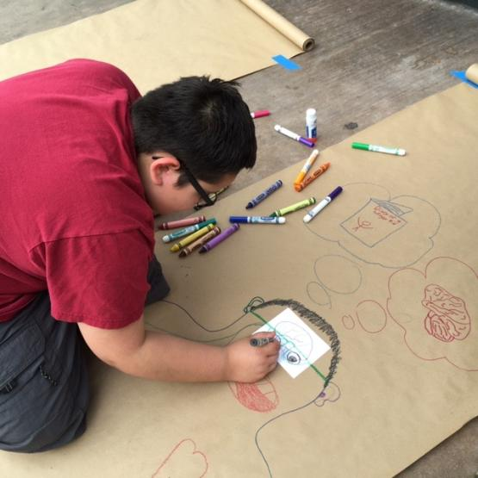
3). Place the brain, heart and lungs where they belong in the tracing of your body.
4). Add details to the drawing.
5). Think about whether a crayon or a marker will work best.
This boy’s drawing shows that he uses his brain to read.

Slide 12
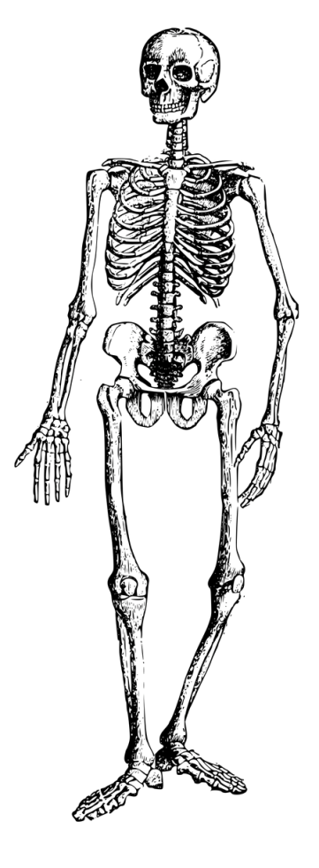
Your system of bones is your skeleton.
Do you want to add bones to your drawing?

Slide 13
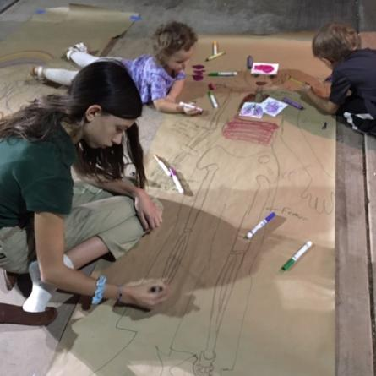
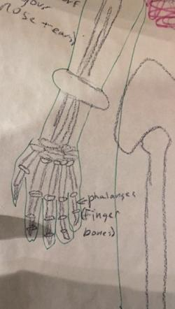
These siblings visited a science and technology festival in their town. They worked together on one body.

Slide 14
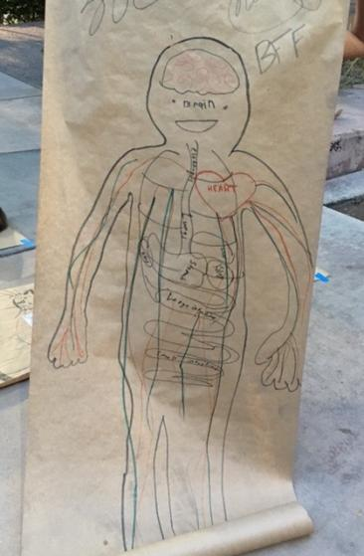
The two girls who made this drawing are holding it up to show visitors at the festival.
All the parts of the person’s body work together so that person can:
Get to know the people and things in their world
Work and play with the people around them.

Slide 15
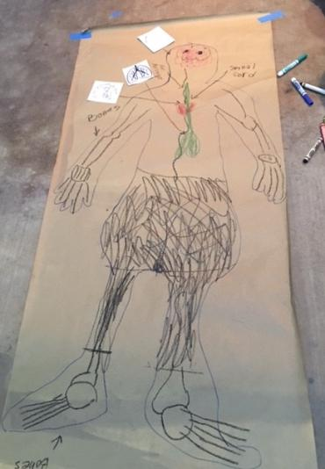
How do different systems work together in your body?
What can you do because your body works?

