Slide 1
My Body Works High School
By Mary Erickson, Ph.D.
Based on a workshop taught by Arizona artist, Monica Aissa Martinez

Slide 2
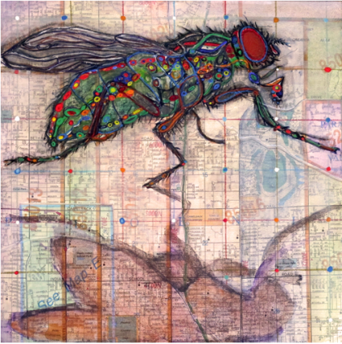
Monica Aissa Martinez is an artist who is fascinated by systems.
In this mixed media work, she mixes natural and built systems. She combines systems within the body of a fly with systems in a Phoenix, Arizona neighborhood.
Monica Aissa Martinez, Anatomy of a House Fly: Una Mosa, 2015, 8” x 8”, mixed media including casein, micaceous iron oxide, dache crayon and graphite on panel covered with a collages map (Photograph by Monica Aissa Martinez)

Slide 3
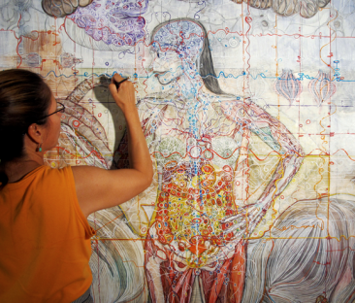
Martinez says: “The body is like a landscape of intricate structures, complex and full of variety. It is a whole organization, made up of systems and connecting parts.” She works with mixed media on a variety of surfaces including paper, canvas and panel.
Monica Aissa Martinez adding color to her mixed media self portrait made with casein, gouache, and gesso on acid-neutral good quality paper (Photograph by Eddie Duran)

Slide 4
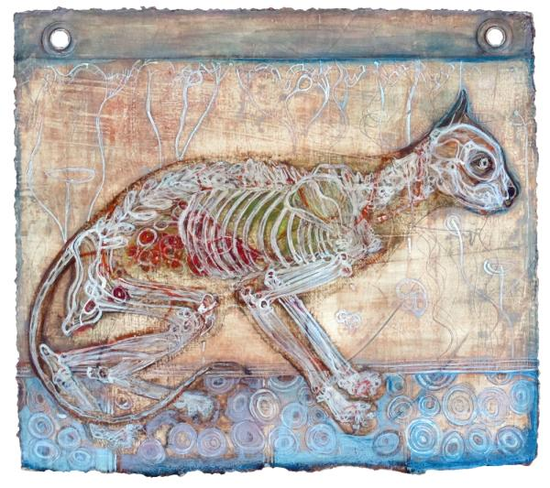
Like a person, a cat has skeletal and muscular systems that make up its basic structure.
Inside and around that structure are many other systems including:
organs and glands
brain and nerves
arteries and veins
Each of these is
made up of tiny systems of cells.
Monica Aissa Martinez, Gato, 2013, 11” x 12”, mixed media including casein, egg tempera, gesso and graphite on paper.(Photograph by Monica Aissa Martinez)

Slide 5
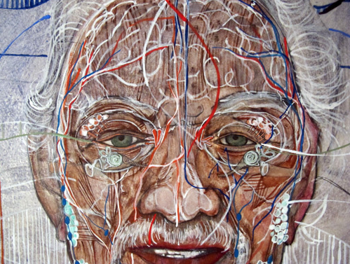
Martinez searches among the nooks and crannies of the human body for stories her artworks can tell.
She writes: “I am interested in both the physical body and subtle body. I draw on the language of myth and symbol.”
Monica Aissa Martinez, detail of A Patrilineal Study, 2016, 39” x 45”, mixed media including graphite, casein, gouache, and gesso on paper (Photograph by Monica Aissa Martinez)

Slide 6
She used both realistic and symbolic colors in her portrait of her father. She used two kinds of paint (casein and gouache) as well as graphite and gesso on high quality (Arches) paper to make this work.
Monica Aissa Martinez, detail of A Patrilineal Study, 2016, 39” x 45”, (Photograph by Monica Aissa Martinez)

Slide 7
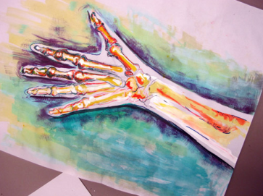
You will create an image of an important part of your own body on paper. Like Martinez, you will work with mixed media on paper.
Why do you think the high school student who made this work chose to focus on her arm?
What do you imagine her artwork means to her?
How does her use of colored and white ink over graphite make her artwork especially expressive?
Photograph by Monica Aissa Martinez

Slide 8
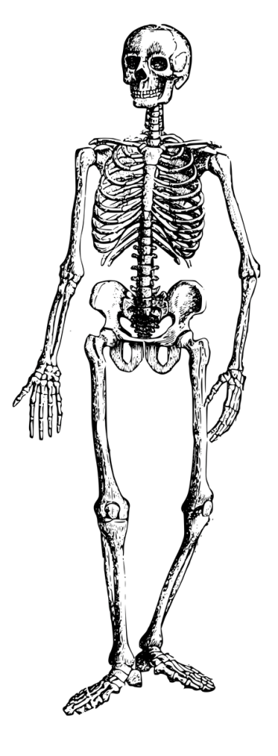
As you develop your ideas, you will:
Keep a log of your ideas and decisions.
Select 2-3 body parts that are especially important or meaningful to you.
Consult online or print sources to examine the systems that make each of those parts.
Assemble reference images.

Slide 9
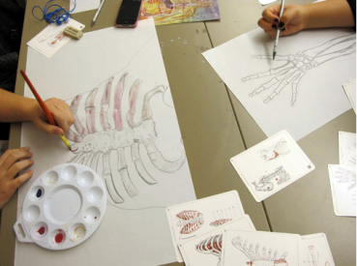
Then you will share your images and ideas with classmates.
You may wish to keep a private, personal log to share, only if you choose. Your classmates’ perceptions and thoughts about your choice of body part can be useful to you.
Decide whether you will draw your body part on a horizontal or vertical format.
Photograph of high school students at work by Monica Aissa Martinez

Slide 10
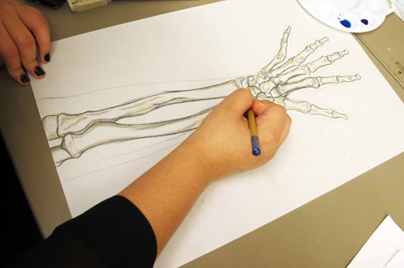
Ask a classmate to lightly trace around your body part with graphite on vellum, a strong, smooth, heavy paper.
Consult your reference images as you use graphite to draw the bones of your body part.
Photograph of a high school student at work by Monica Aissa Martinez

Slide 11
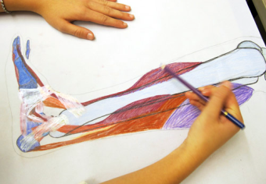
How will you choose your body part?
Is it dependable, beautiful, strong, fragile?
Does it allow you to do something important? (run; think; use tools; play games; see, hear or touch people and things you care about)
What colors will help you show what the body part means to you?
Remember to document your reflections in your log.
Photograph of a high school student at work by Monica Aissa Martinez

Slide 12
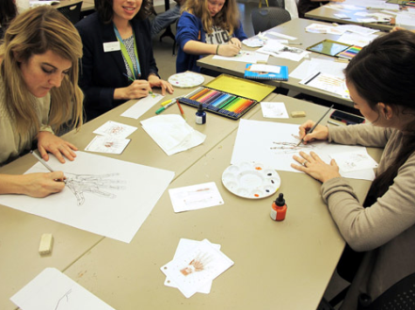
What medium will you use to add color to your work? You may choose realistic colors or symbolic colors that have personal meaning for you.
Colored inks Colored pencils Colored markers
Make a few marks in your log to see what each medium can do.
Photograph of high school students at work by Monica Aissa Martinez

Slide 13
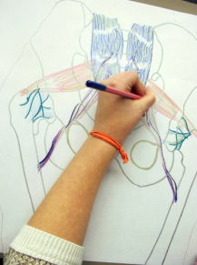
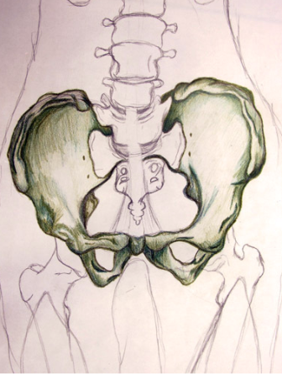
When your work is complete you will collaborate with several classmates to curate and present your work in a mini group show.
You might find others whose works:
Feature the same body part
Show different parts of one body
Use media in similar or different ways
Identify some other idea or theme for your show
Photographs of high school students’ work by Monica Aissa Martinez

Slide 14
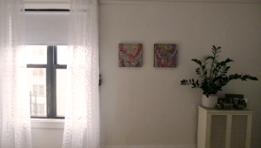
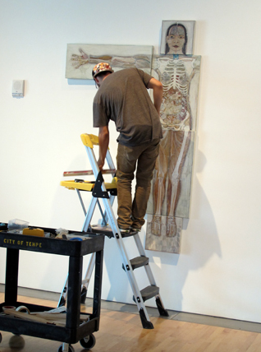
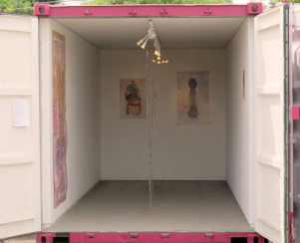
Monica Aissa Martinez has presented her work in many venues (locations).
(All photographs by Monica Aissa Martinez)
Hers & His!, 2014, 13” x 13 ” in home of collectors
Vlada Yaneva and Mathew Harrison
Cella, installation in shipping container, part of the Unloaded Project of the Phoenix Institute of Contemporary Art, March, 2016
James Sulak assisting with installation of What do your need? … a copy of Vitruvian Man? Okay in the Gallery at the Tempe Center for the Arts, 2011

Slide 15
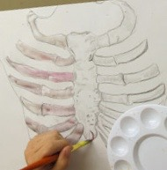
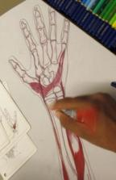
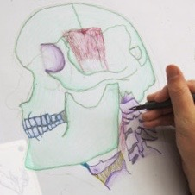
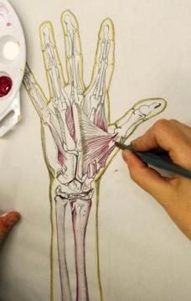
How will you present your group exhibition?
How will you title the show?
How will you identify artworks and artists?
What text will you include on a text panel to help viewers appreciate your group’s work?
Details of photographs of high school students at work by Monica Aissa Martinez.

