Slide 1
Systems Everywhere
By Mary Erickson, Ph.D.

Slide 2
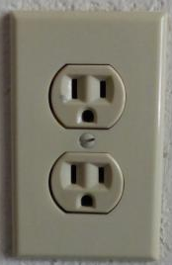
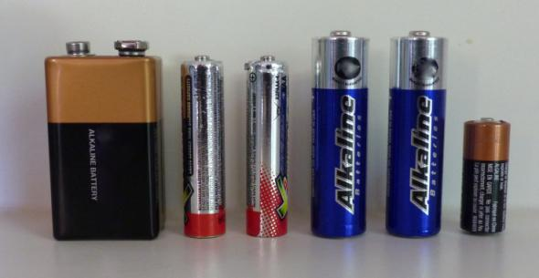
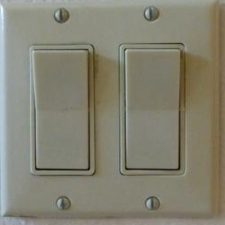
A system is a set of parts that work together,
such as the electrical system you use everyday.
How do you use the electrical system?
By plugging into an outlet?
By using electricity stored in batteries?
By flipping a switch?

Slide 3
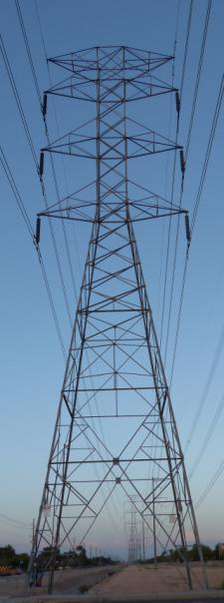
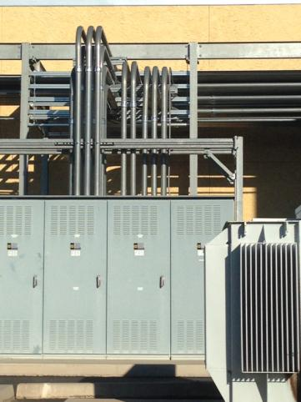
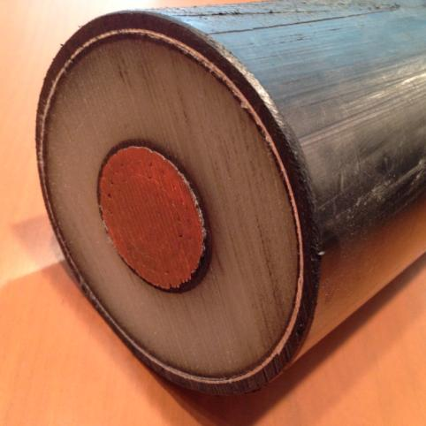
All that electricity is delivered through a system of cables and wires underground or above ground on poles and towers. Where do you think all that electricity comes from?

Slide 4
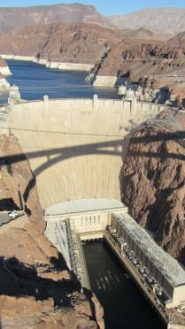
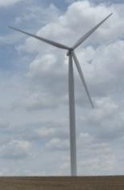
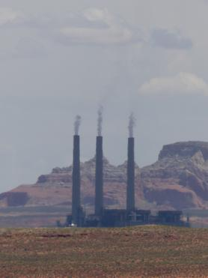
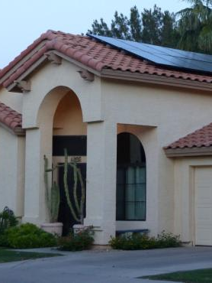
Electricity is generated in a variety of ways, including:
Dams or wind turbines
Coal, oil, gas, or nuclear power plants
Solar panels
How would your life be different if all these systems did not work together to bring you electricity?

Slide 5
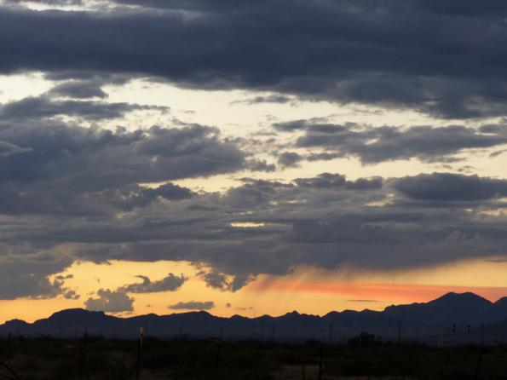
The electrical system gets its power from nature:
from flowing water
from wind
from the sun
or from resources in the earth itself
The earth gets its power
from a much larger
system – the universe.

Slide 6
Cities require some of their police officers to wear uniforms, so they can be quickly identified.
On a dark, cloudless night away from city lights, you can see a tiny part of the universe. The Big Dipper is a group of seven stars; this is a tiny fraction of the billions of stars in our Milky Way galaxy. The Universe has billions of systems of stars, also known as galaxies.

Slide 7
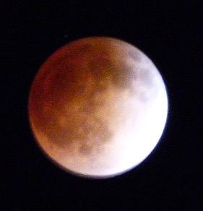
Cities require some of their police officers to wear uniforms, so they can be quickly identified.
We call our star the sun. It is the center of the solar system. The sun seems to rise in the sky as the earth rotates in its orbit around the sun.
Sometimes the earth is between the
sun and the moon, casting a shadow
on the moon. This is called a lunar eclipse.

Slide 8
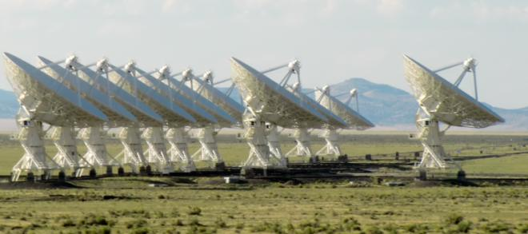
There is a lot we don’t know about the universe, but scientists are using technology to further their research and make new discoveries. These are 27 huge radio antennae in New Mexico. They work together as a system to make a huge telescope. Scientists move the antennae around on railroad tracks to explore the universe.

Slide 9
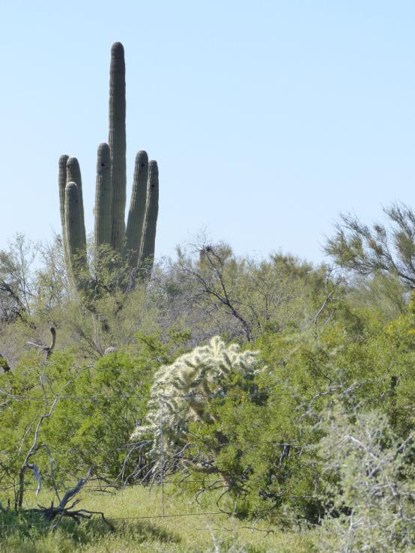
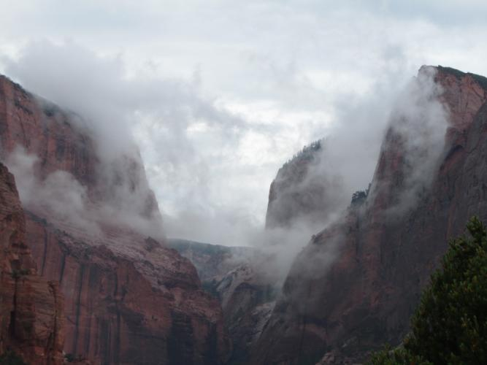
Scientists also study natural systems closer to home such as:
Volcanoes and earthquakes
Climate and weather
Rainforests and deserts

Slide 10
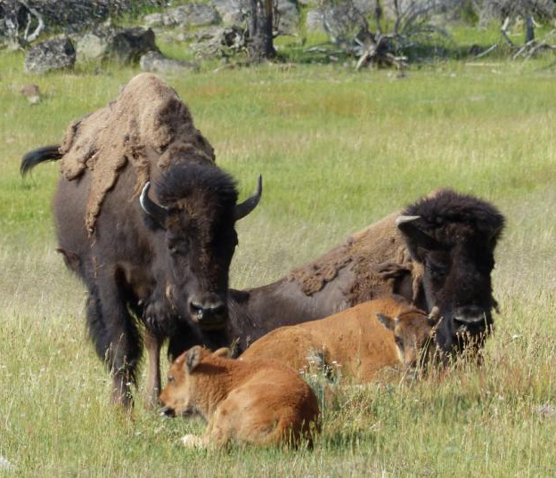
All earth’s living things depend on natural systems that work together to give them:
Warmth
Air
Water
And much more.

Slide 11
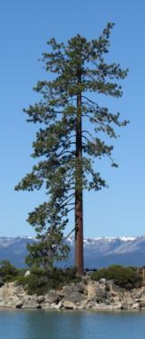
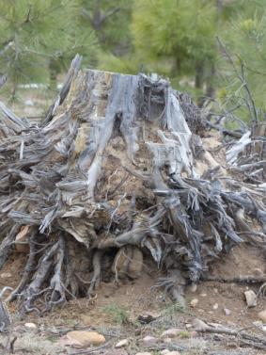
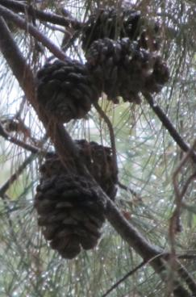
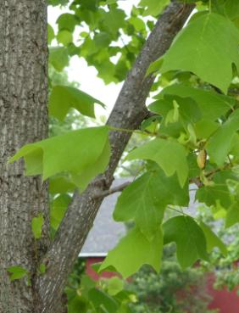
Each living thing also depends on its own systems that work together. For example a tree has:
A trunk and branches to reach sunlight
Roots to gather nutrients (food) from the soil
Seeds (like flowers and pinecones) to start new trees
Leaves or needles to get energy from the sun

Slide 12
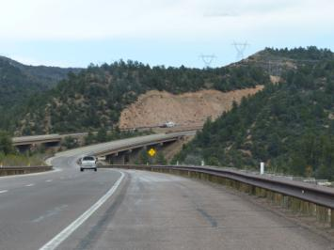
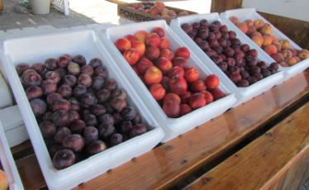
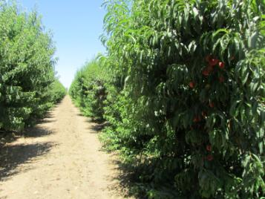
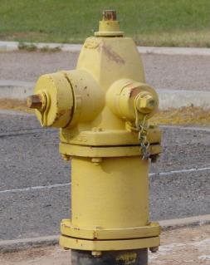
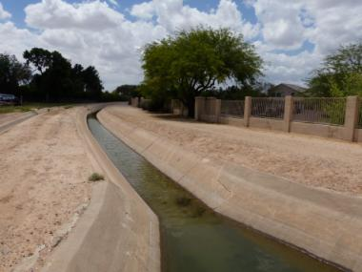
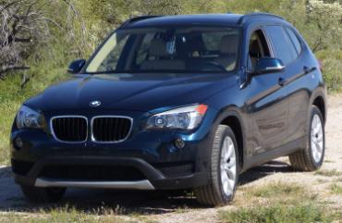
Our lives are filled with systems within systems.
Which two photos show parts from each of these systems?
Agricultural system
Transportation system
Water system
How do these three systems work together?
Fruit stand
Highway bridge
Orchard
Fire hydrant
Irrigation canal
Car

Slide 13
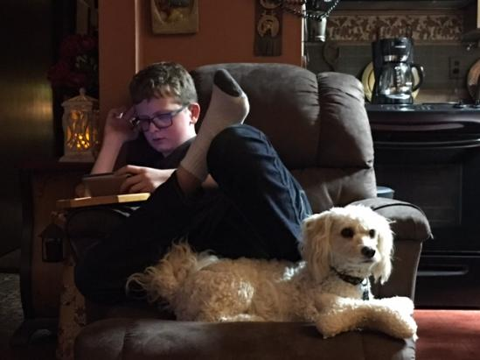
Your body has its own electrical system.
Electricity powers our brains and makes our muscles work.

Slide 14
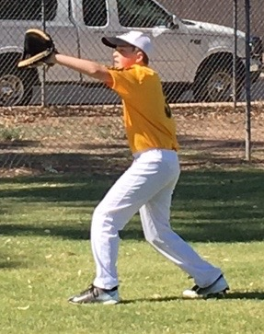
What do you know about other systems that act together to make your body work?
Pulmonary [breathing] system
Blood system
Digestive system
Muscular system
Nervous system
Skeletal system

Slide 15
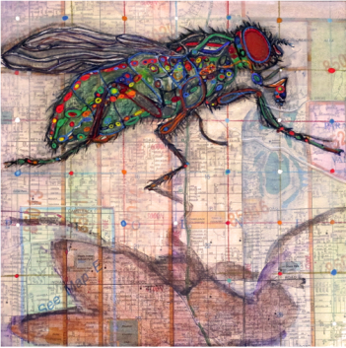
Artist Monica Aissa Martinez got her idea from the systems in a house fly, as well as the systems in a neighborhood.
What systems in your own body would you like to learn more about and then show in your own art?
Bones
Heart
Muscles
Lungs
Brain
Monica Aissa Martinez, Anatomy of a House Fly: Una Mosa, 2015, 8” x 8”, mixed media (Photograph by Monica Aissa Martinez)

Slide 16
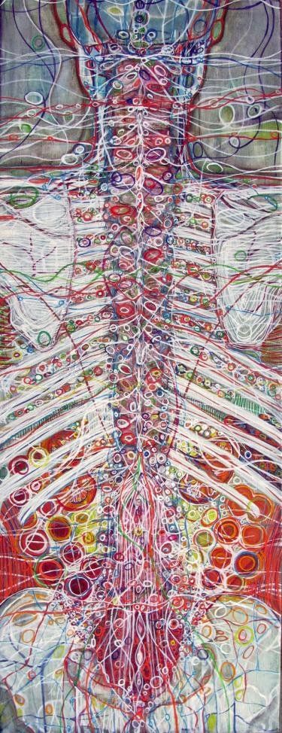
You are invited to visit the STEAM exhibition at the Tempe Center for the Arts.
The show features visual art and interactive science displays that explore creative connections between the disciplines of science, technology, engineering, “the arts” and mathematics.
Monica Aissa Martinez, Back Body, mixed media

