Slide 1
Exhibition Preview

Slide 2
STEAM science | technology | engineering | ARTS | mathematics
“You may believe that architects and designers are paid to be creative thinkers, but CEOs, lawyers, and doctors are not. “Or you may feel that being creative is a fixed trait, like having brown eyes- either you’re born with creative genes, or you’re not. “The creativity myth…. It is a myth that far too many people share.”
From Creative Confidence: Unleashing the creative potential within us all by Tom and David Kelley

Slide 3
Creative problem solving is around us every day. Take for example a store-bought coffee mug. It takes a variety of skills to produce and sell even this most ordinary of objects. It took an artist to design the look, a scientist to formulate the material, an engineer to mechanize the factory, a mathematician to analyze supply and demand and a computer programmer to code the website that advertises the mug.
Today’s employers and innovators agree that “to be competitive,” tomorrow’s workforce must be dynamic. The STEAM movement was initially inspired by the popularity of STEM-based education (science, technology, engineering and mathematics).

Slide 4
“STEAM,” with the inclusion of the arts, celebrates, incorporates and recognizes the importance of creative problem solving across the disciplines.
This exhibition at the Gallery at Tempe Center for the Arts features visual art and scientific displays from local innovators that explore the creative connections between the disciplines of science, technology, engineering, “the arts” and mathematics. Each display is an example of how the arts are an essential partner, not just a decorative feature of a new world powered by STEAM.
Exhibition dates: May 27-Sept. 17, 2016

Slide 5
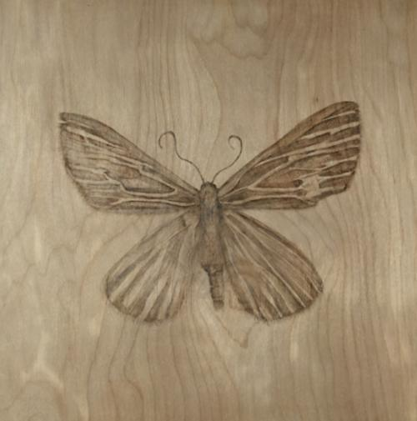
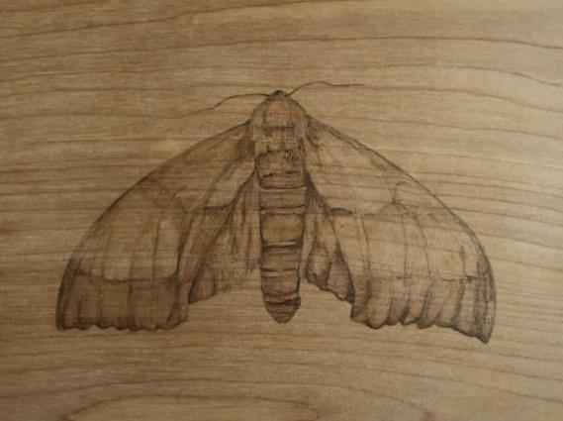
Alexandra Bowers received her Bachelor of Fine Arts from Arizona State University. Inspired by the natural environment, she utilizes data collected while exploring nature to produce wood-burned drawing studies of plants and animals she finds. She created more than 100 wood-burned portraits of moths from all over North America. During her research for the project, she actually studied specimens from the Insect Collection at ASU.
“Many people think of moths as a nuisance…. But despite their bad rep, these extraordinary creatures are pollinators and assist in sustaining ecosystems by providing a source of nourishment to animals higher up on the food chain. www.alexandrabowersart.com

Slide 6
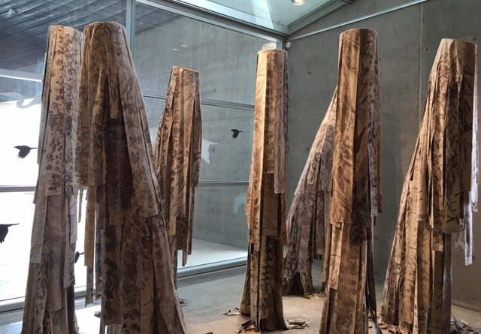
Sometimes good, sometimes bad, potentially invasive, probably harmful mixed media installation
Madison Creech and Molly Koehn who met and became friends at ASU describe their piece: “Our installation uses a combination of bird imagery, eucalyptus leaves and eco prints. Native to Australia, eucalyptus trees were brought to the United States in the late 1800’s.The trees flourished in their new environment, but the rapid growing eucalyptus are continually altering the biosphere by replacing native plants and disturbing habitats for many native bird species. It is causing a drop in species diversity. The installation ‘Potentially invasive, probably harmful’ speaks to both the positive and negative effects of eucalyptus trees on birds in North America.” www.creechers.com | www.mollykoehn.com

Slide 7
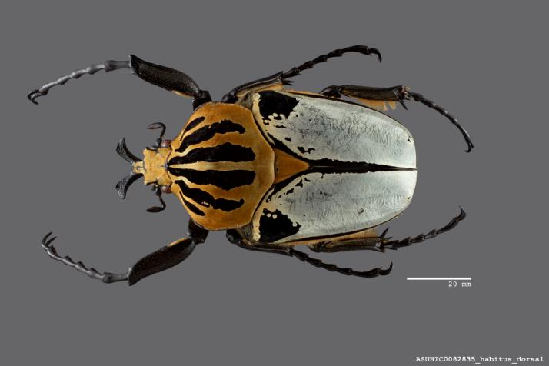
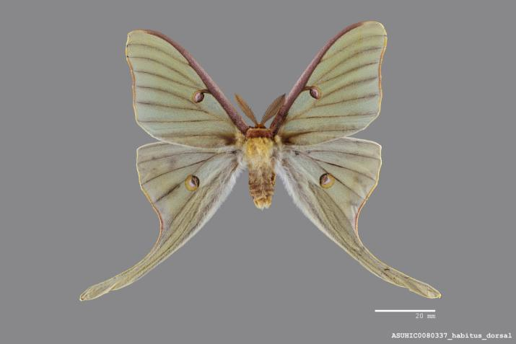
The Hasbrouck Insect Collection from ASU’s School of Life Sciences contains more than 850,000 insect specimens. Although most specimens in the collection are from Arizona and the southwestern United States, a considerable amount is also available from other North American regions, Mexico and Central America. The images displayed in this exhibition are from the Symbiota Collections of Arthropods Network (SCAN), a data portal funded by the National Science Foundation and built to visualize, manipulate and export species occurrences.
www.biokic.asu.edu.
African Goliath Beetle, Scientific name: Goliathus cacicus (Olivier)
Luna Moth, Scientific name: Actias luna (Linnaeus)

Slide 8
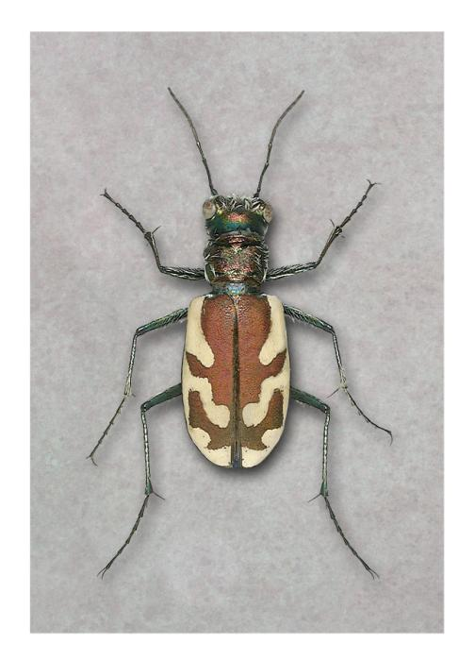
Charles Kazilek is a artist and a scientist. His background is in zoology and today works at ASU specializing in technology, communications and biological imaging. He says “It takes many steps to create these images printed on canvas. Since the specimen beetles were from the ASU collection, they had pins through them, the legs were tucked underneath their body, and sometimes they can have missing parts. [To make these dead specimens look natural ] we soaked them in alcohol, which relaxed the bodies and allowed us to move and position their legs. Then, I photographed them on glass to be sure there was no background image. Once in digital format, I use Photoshop software to create missing segments/parts and clean everything up. Once I have all the parts, I put the beetle back together. These images were created several years ago, so the resolution is not as high as it would be today.”
www.kazilek.com
Cicindela lenji lenji (Blowout Tiger Beetle)
photo illustration

Slide 9
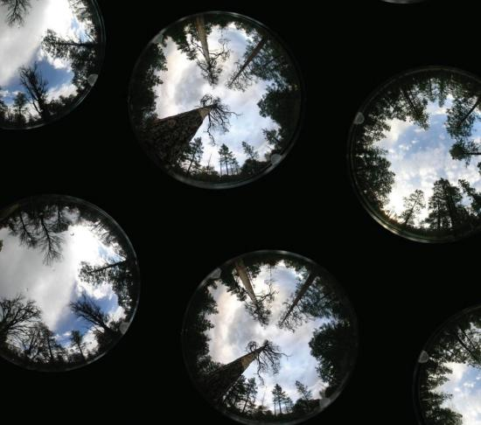
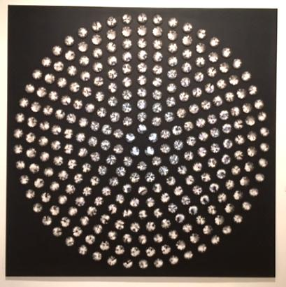
Ellen McMahon is a professor of art at the University of Arizona. For this work, she collaborated with forest mortality researchers from the U of A Laboratory of Tree-Ring Research and architect Beth Weinstein. “In the last decade the Southwestern United States has lost more than 20% of its conifer forests. A group of scientists based at U of A is working to understand why trees are dying so they can better predict what will happen in the future. In 2014, I accompanied this team at one of their study sites in New Mexico where they documented Piñon Pines. I was struck with the jewel-like beauty of these images…. I believe fine art can increase interest and understanding of the scientific information and create a moving and transcendent experience for visitors and researchers alike.”
www.ellenmcmahon.com
detail
Change Over Time
archival digital photography installation

Slide 10
Display by Dr. Anthony B. Falsetti is a professor at Arizona State University in the School of Mathematics & Natural Sciences/Forensic Science Program and his wife Catyana Skory Falsetti is a forensic artist who also teaches at ASU.

Slide 11
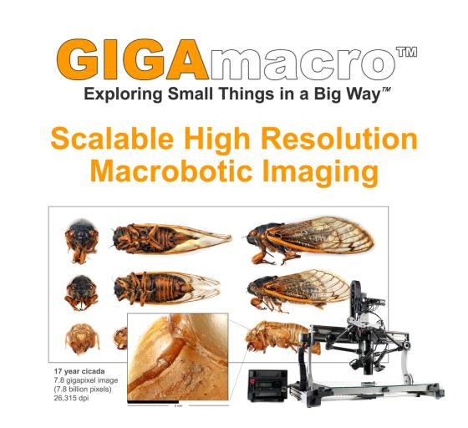
Gene Cooper is a creative innovator and developer with a passion for developing scientific tools, exhibits and educational programs. He seeks to provide new ways of exploring the world both literally and figuratively. Cooper is a graduate of ASU and is the founder of a California company called GIGAmacro which builds robotic camera devices capable of capturing gigapixel photographs with microscopic detail for use in laboratories, museums and schools. The core technology is a robotic camera system that takes thousands of digital images (of any small object) and automatically combines them into an ultra-high-resolution photograph or printable 3D model. The concept is to provide access to objects that are not portable, are too small to examine with conventional means, or must not be damaged during examination.

Slide 12
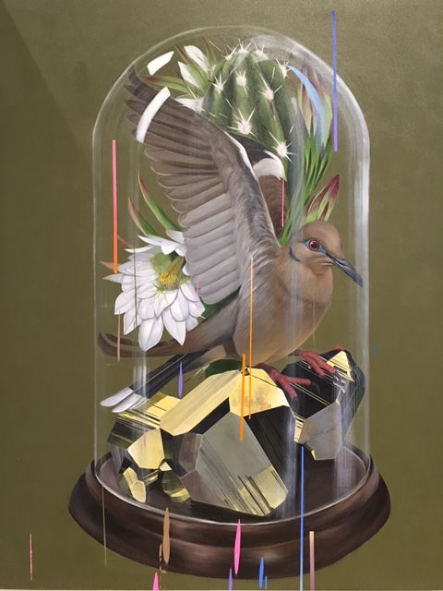
Frank Gonzales was born in Mesa and grew up in Tempe. He received his Bachelor of Fine Arts from Laguna College of Art and Design in CA in 2003. His work explores several of the sciences including ornithology, geology and botany. Gonzales says “In my work, I take references from various sources including nature, books, the internet and photos to comprise and create my own images. By creating my paintings through reference or made-up elements, there becomes a play between artificiality and realism. I like to combine elements that may seem believable, but wouldn’t normally thrive or be seen together in real life. My various marks and color glitches mimic this uncertainty resulting in a visual stillness and movement.”
www.frankgonzales.net
Specimen
acrylic on canvas

Slide 13
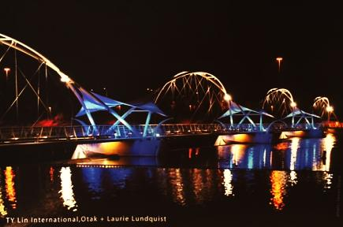
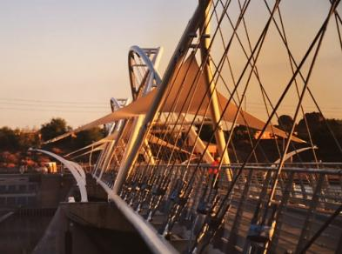
The Art of Engineering by Laurie Lundquist: “The intersection of art, engineering and architecture is exciting terrain. It has filled our landscape with great buildings, bridges and infrastructure. Designers combine an understanding of STEAM principals to create concepts that are both beautiful and functional. As an artist I have had the pleasure of collaborating on many design team efforts, including the Tempe Town Lake Heron Pedestrian Bridge visible outside the Tempe Center for the Arts (pictured above).” Lundquist is an environmental artist with interests in both natural and engineered systems at work in the urban landscape. She loves the collaborative process and has worked as a design team artist on many large scale public art and construction projects both locally and nationally. www.laurielundquist.com

Slide 14
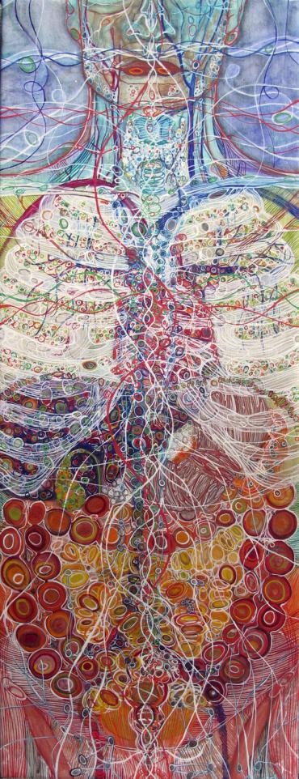
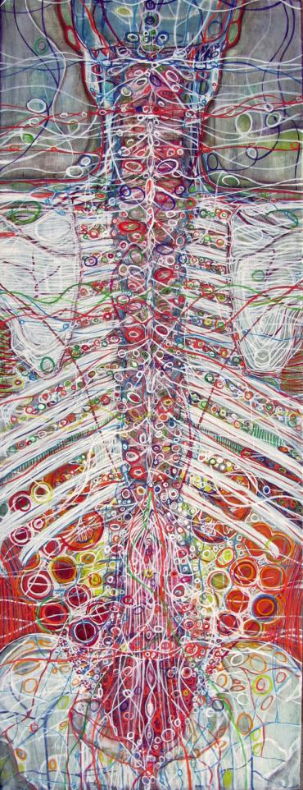
Monica Aissa Martinez works in Phoenix and enjoys researching disciplines such as human anatomy, art history and entomology (study of insects). She is also dedicated to the health of the mind, body and spirit and practices Yoga and Yogic philosophy.
Martinez says “The body is like a landscape of intricate structures, complex and full of variety. I find it beautiful and poetic. I find myself searching deep within its nooks and crannies….I use line, shape, color and space to represent complex connections between body, mind and connecting spirit…. In my studio, art and science connect.”
www.monicaaissamartinez.com
Front Body and Back Body
mixed media on canvas

Slide 15
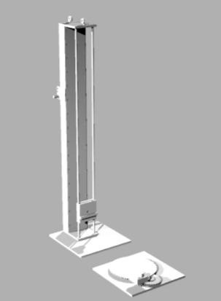
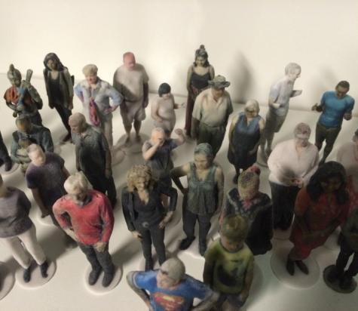
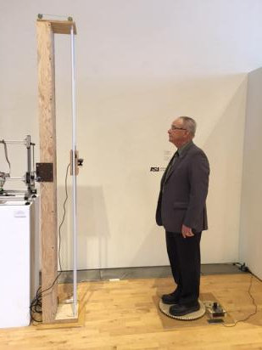
PRISM lab is a 3D modeling and prototyping facility at Arizona State University. It is a place where STEAM concepts play a critical role everyday. Professor Dan Collins and graduate student Andrew Noble describe this 3D body scanner as a low cost solution for creating colored mesh models of live human subjects. The physical set up includes a turntable upon which subjects are rotated, while a Kinect-type infrared gaming sensor moves up and down a vertical column. The sensor sends range values (3D surface geometry) and RGB data (color information) to a computer. A piece of software called Skanect is used to process the files and export (share) the resulting 3D files. Collins says that the scanner has potential benefits for various industries, but that ASU’s interest is primarily fine art applications. prism.asu.edu

Slide 16
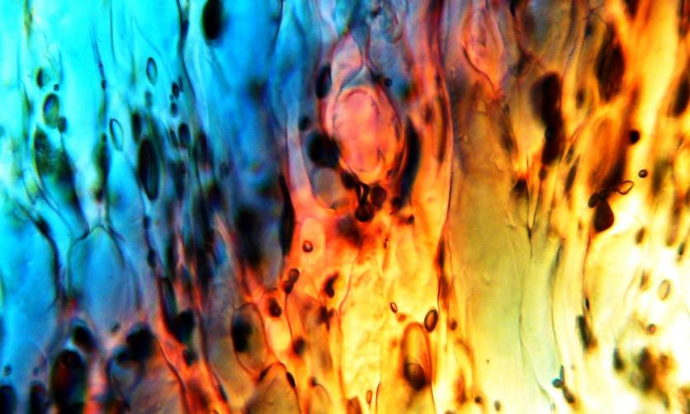
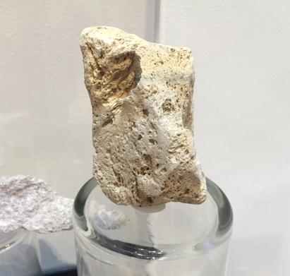
Pumice is an extrusive volcanic rock composed of polymer-like ropes of glass and abundant gas pockets that allow it to float in water.
Fire Woman, photo of pumice in cross-polarized light, 640x magnification on acrylic , specimen from San Francisco Volcanic Fields, Northern AZ
Brad Vance is a geological scientist and artist. While at ASU his research focused on the evolution of mountain ranges and the micro-structures of rocks and minerals Later, Vance launched Planet Red Productions: a multi-faceted company that combines earth science and the arts. He uses the tools of a process called petrography which uses a microscope to magnify and pass light through microscopic thin sections of rocks. Vance says “The brilliant colors are a function not of digital enhancement, but of their individual atomic structures and
the wavelengths of light that each mineral allows through.”
www.planetredproductions.net

