Slide 1
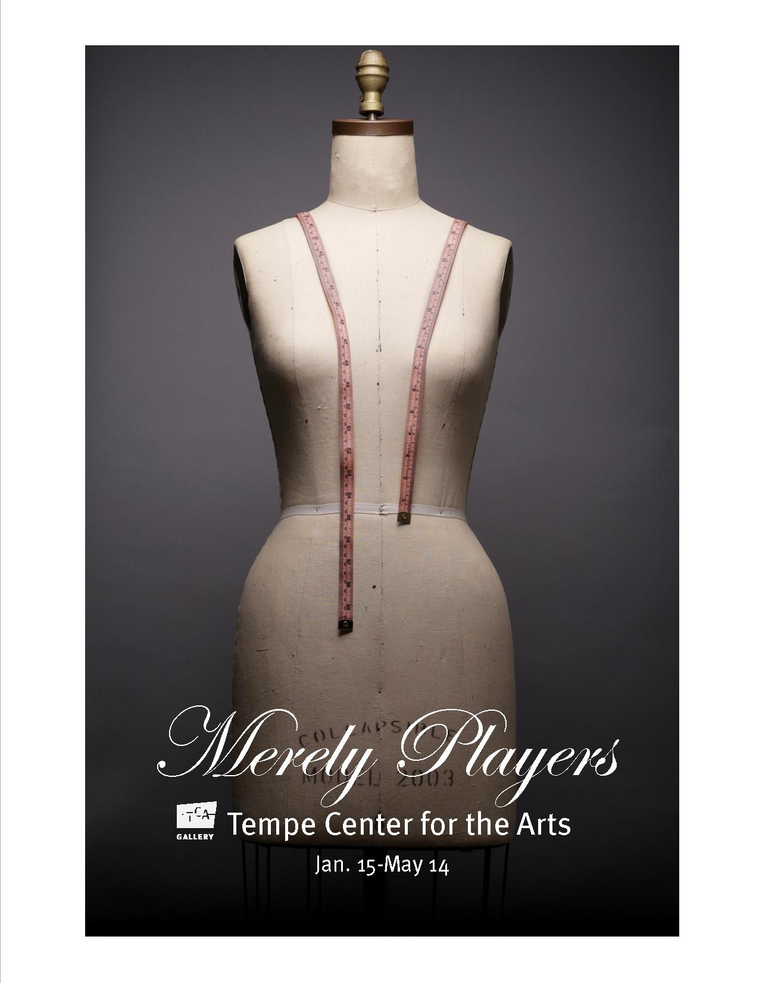
Dressing the Part
By Mary Erickson, Ph.D.

Slide 2
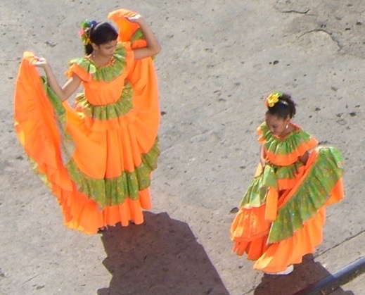
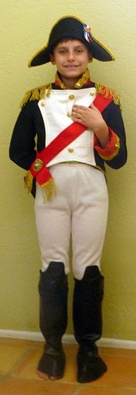
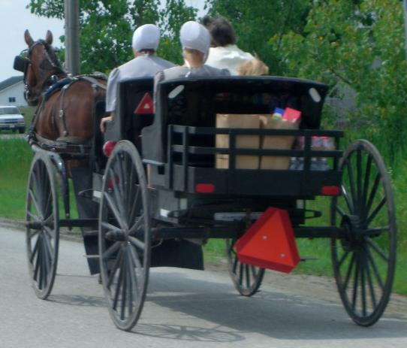
What does how you dress say about you?
Does it say
who you are?
what you do?
what you care about?
how you would like others to see you?
Belize
Indiana

Slide 3
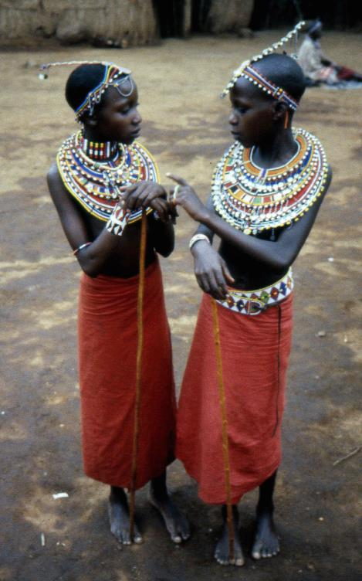
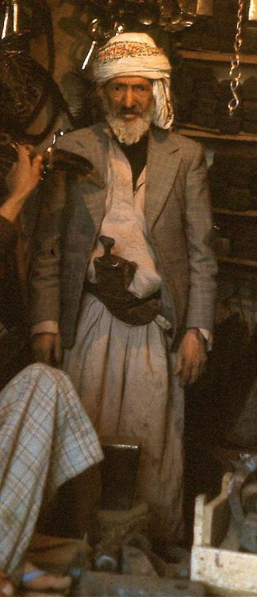
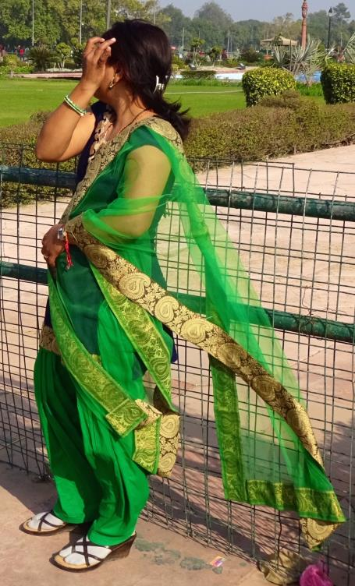
Some people wear traditional clothes every day.
Masai girls
Yemeni Merchant
Indian woman

Slide 4
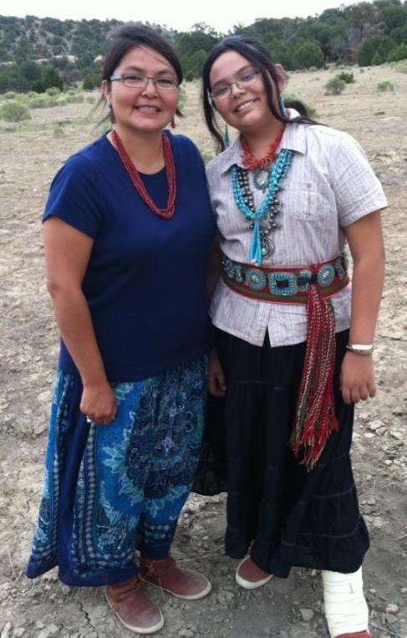
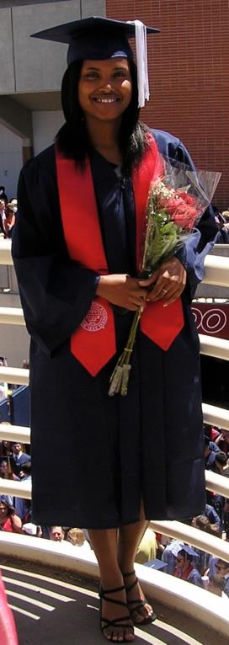
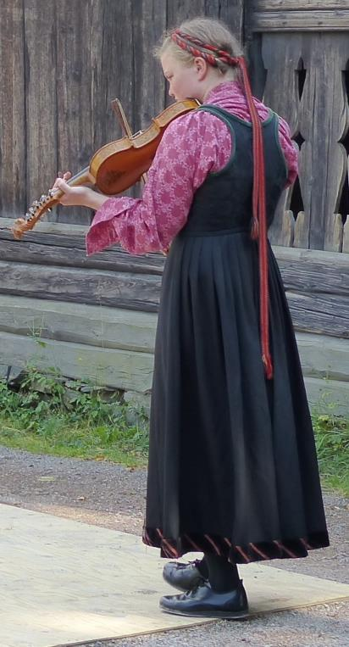
Others wear traditional clothes on special days or to express their cultural identity.
Navajo Kinaalda (womanhood) ceremony
University of Arizona
Commencement
Norwegian Folk Museum,
Oslo, Norway

Slide 5
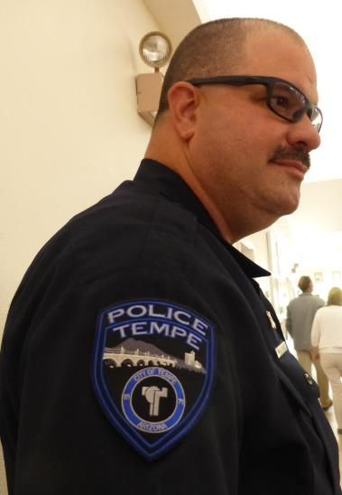
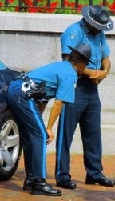
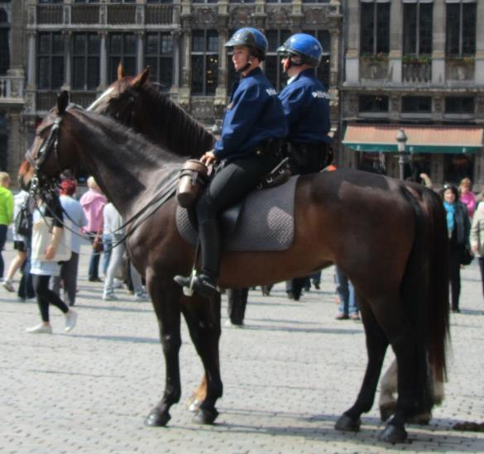
Cities require some of their police officers to wear uniforms, so they can be quickly identified.
Tempe, AZ police commander
Boston, MA officers
Brussels, Belgium mounted officers

Slide 6
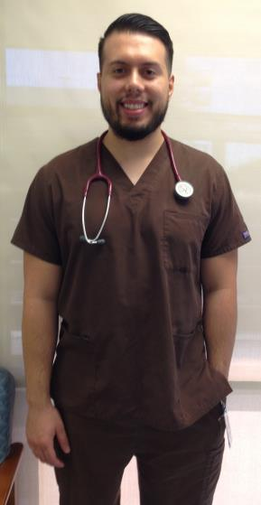
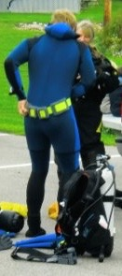
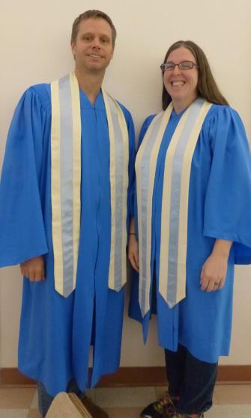
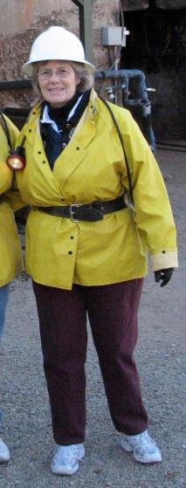
Some people dress for a job, for safety, or to show they are part of a group. Who is dressing for a mine tour? Who is a medical professional? Who sings in a choir? Who is dressing to go under water? How can you tell?

Slide 7
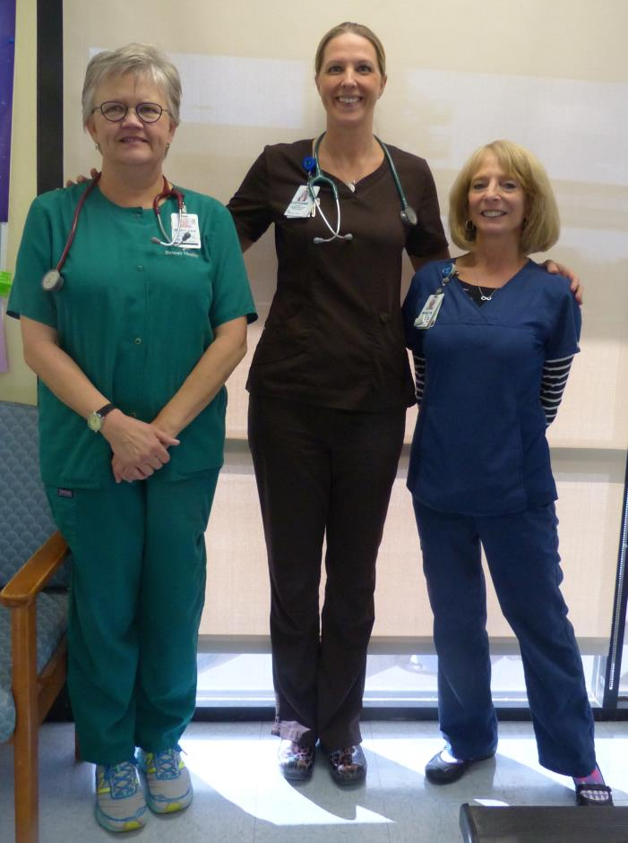
Some people are required to dress a certain way for their work. The colors of these women’s “scrubs” indicate their special training
Green = respiratory therapist
Brown = exercise therapist
Blue = registered nurse
Banner Desert Hospital, pulmonary rehabilitation unit

Slide 8
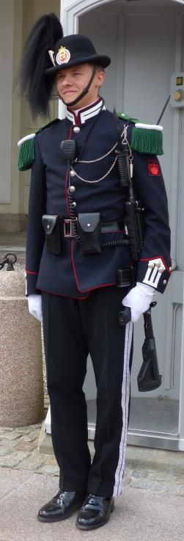
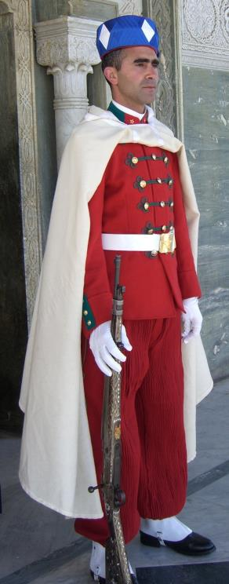
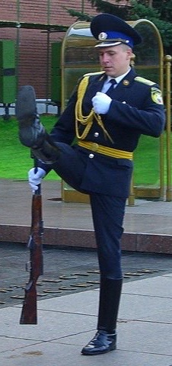
Military personnel around the world wear distinctive clothing. Like the medical professionals, the guards wear solid colored uniforms.
Norweigian Guard
Moroccan Guard
Russian Guard

Slide 9
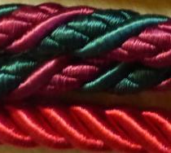
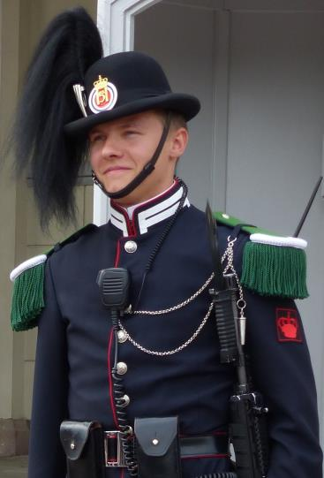
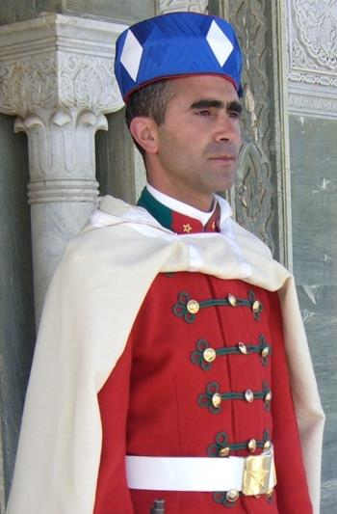
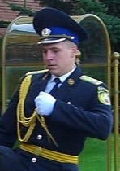
Look carefully at the details of the guards’ uniforms. Compare their headgear, their belts, their buttons, their collars. Each uniform is decorated with braided cord.
Can you find a braid on each uniform?

Slide 10
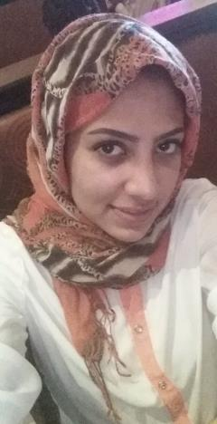
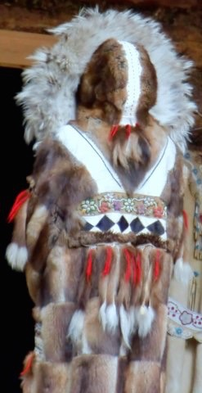
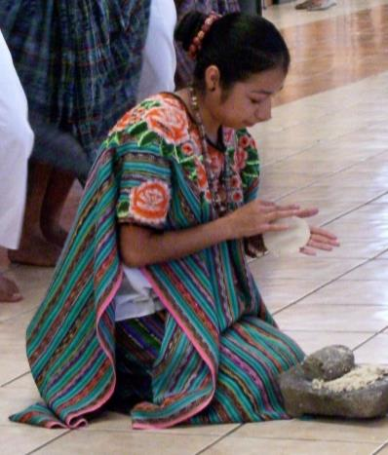
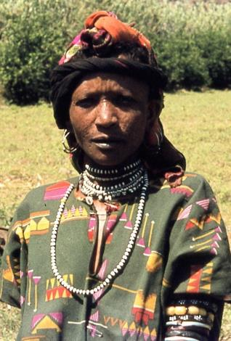
These women wear beautiful patterned clothing.
Which woman’s coat has a pattern of furs?
Which woman’s clothing has embroidered flowers?
Which woman wears beaded necklaces?
Which woman wears a simple white blouse?
Saudi woman Athabaskan woman Guatemalan woman Yemeni woman

Slide 11
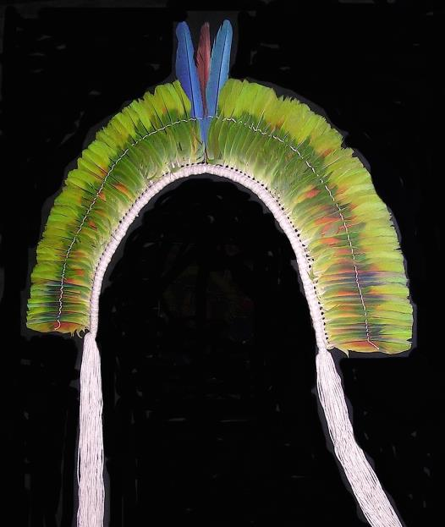
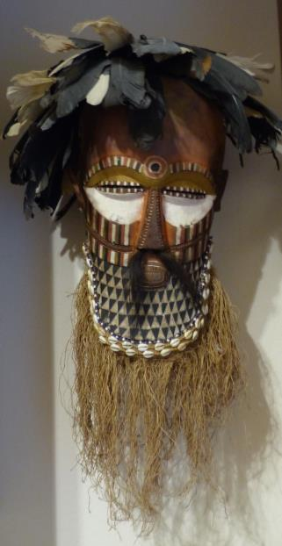
Men also dress for special occasions.
Both the headdress and mask have splendid feather textures.
What else adds texture to the African mask?
Amazonia Feathered Headdress Kuba Mask

Slide 12
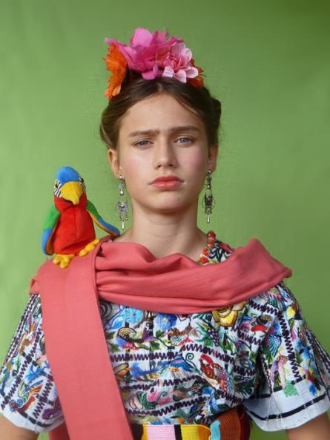
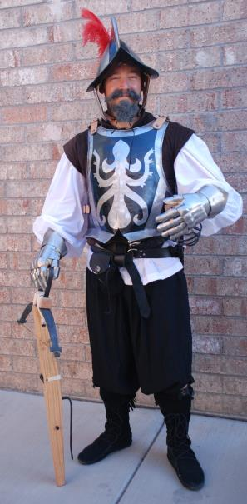
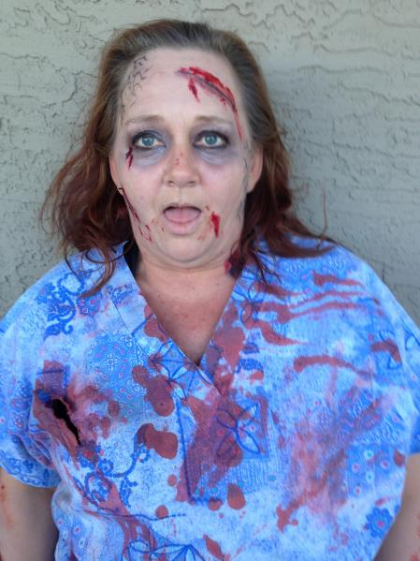
Sometimes people dress to look like someone they are not. Some add props, fake hair, or make-up to help them get into character.
Who do you think is the office worker? The high school teacher? The seventh grader?

Slide 13
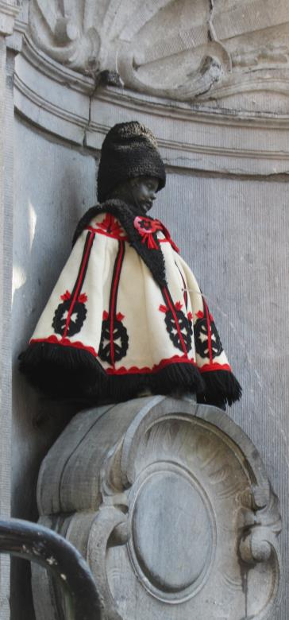
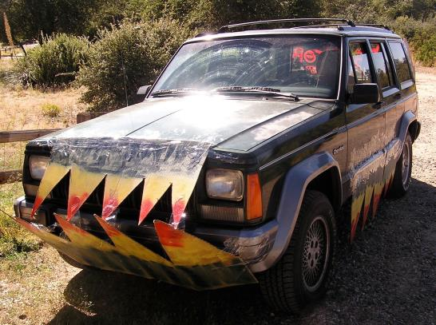
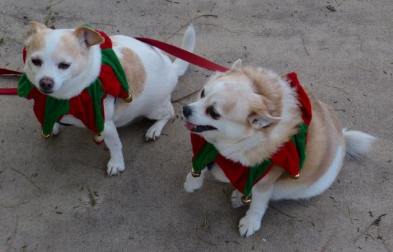
Some people even dress up critters, cacti, cars and statues to change their characters.

Slide 14
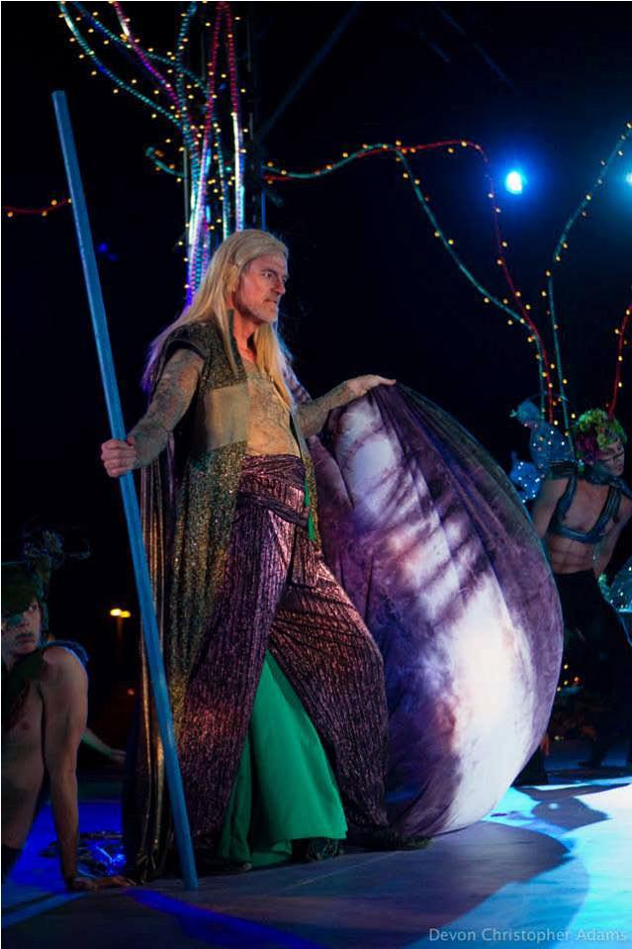
Theatrical costumes are designed specifically to help define characters in a play, an opera, or a ballet.
Image from Southwest Shakespeare Company

Slide 15
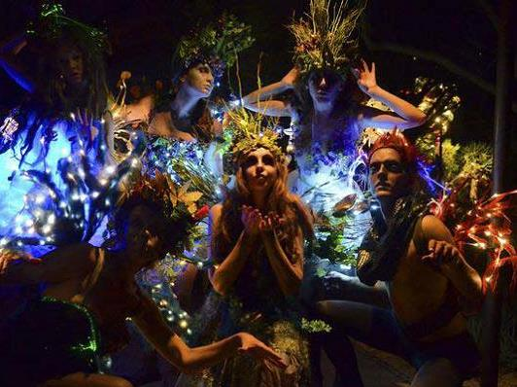
Costume designers collaborate as part of a technical team that includes set designers, lighting designers, property (“props”) designers and sound designers.
Image from Southwest Shakespeare Company

Slide 16
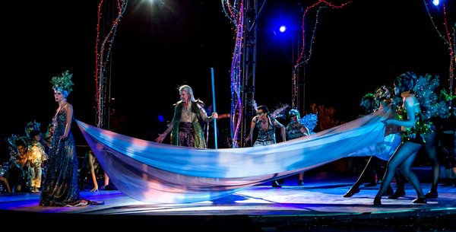
The director provides the concept (big ideas), insights into characters the performers portray, and a vision of how the production should look.
The costume designer and other designers contribute their own ideas to help create a production with a seamless, unified look.
Image from Southwest Shakespeare Company

Slide 17
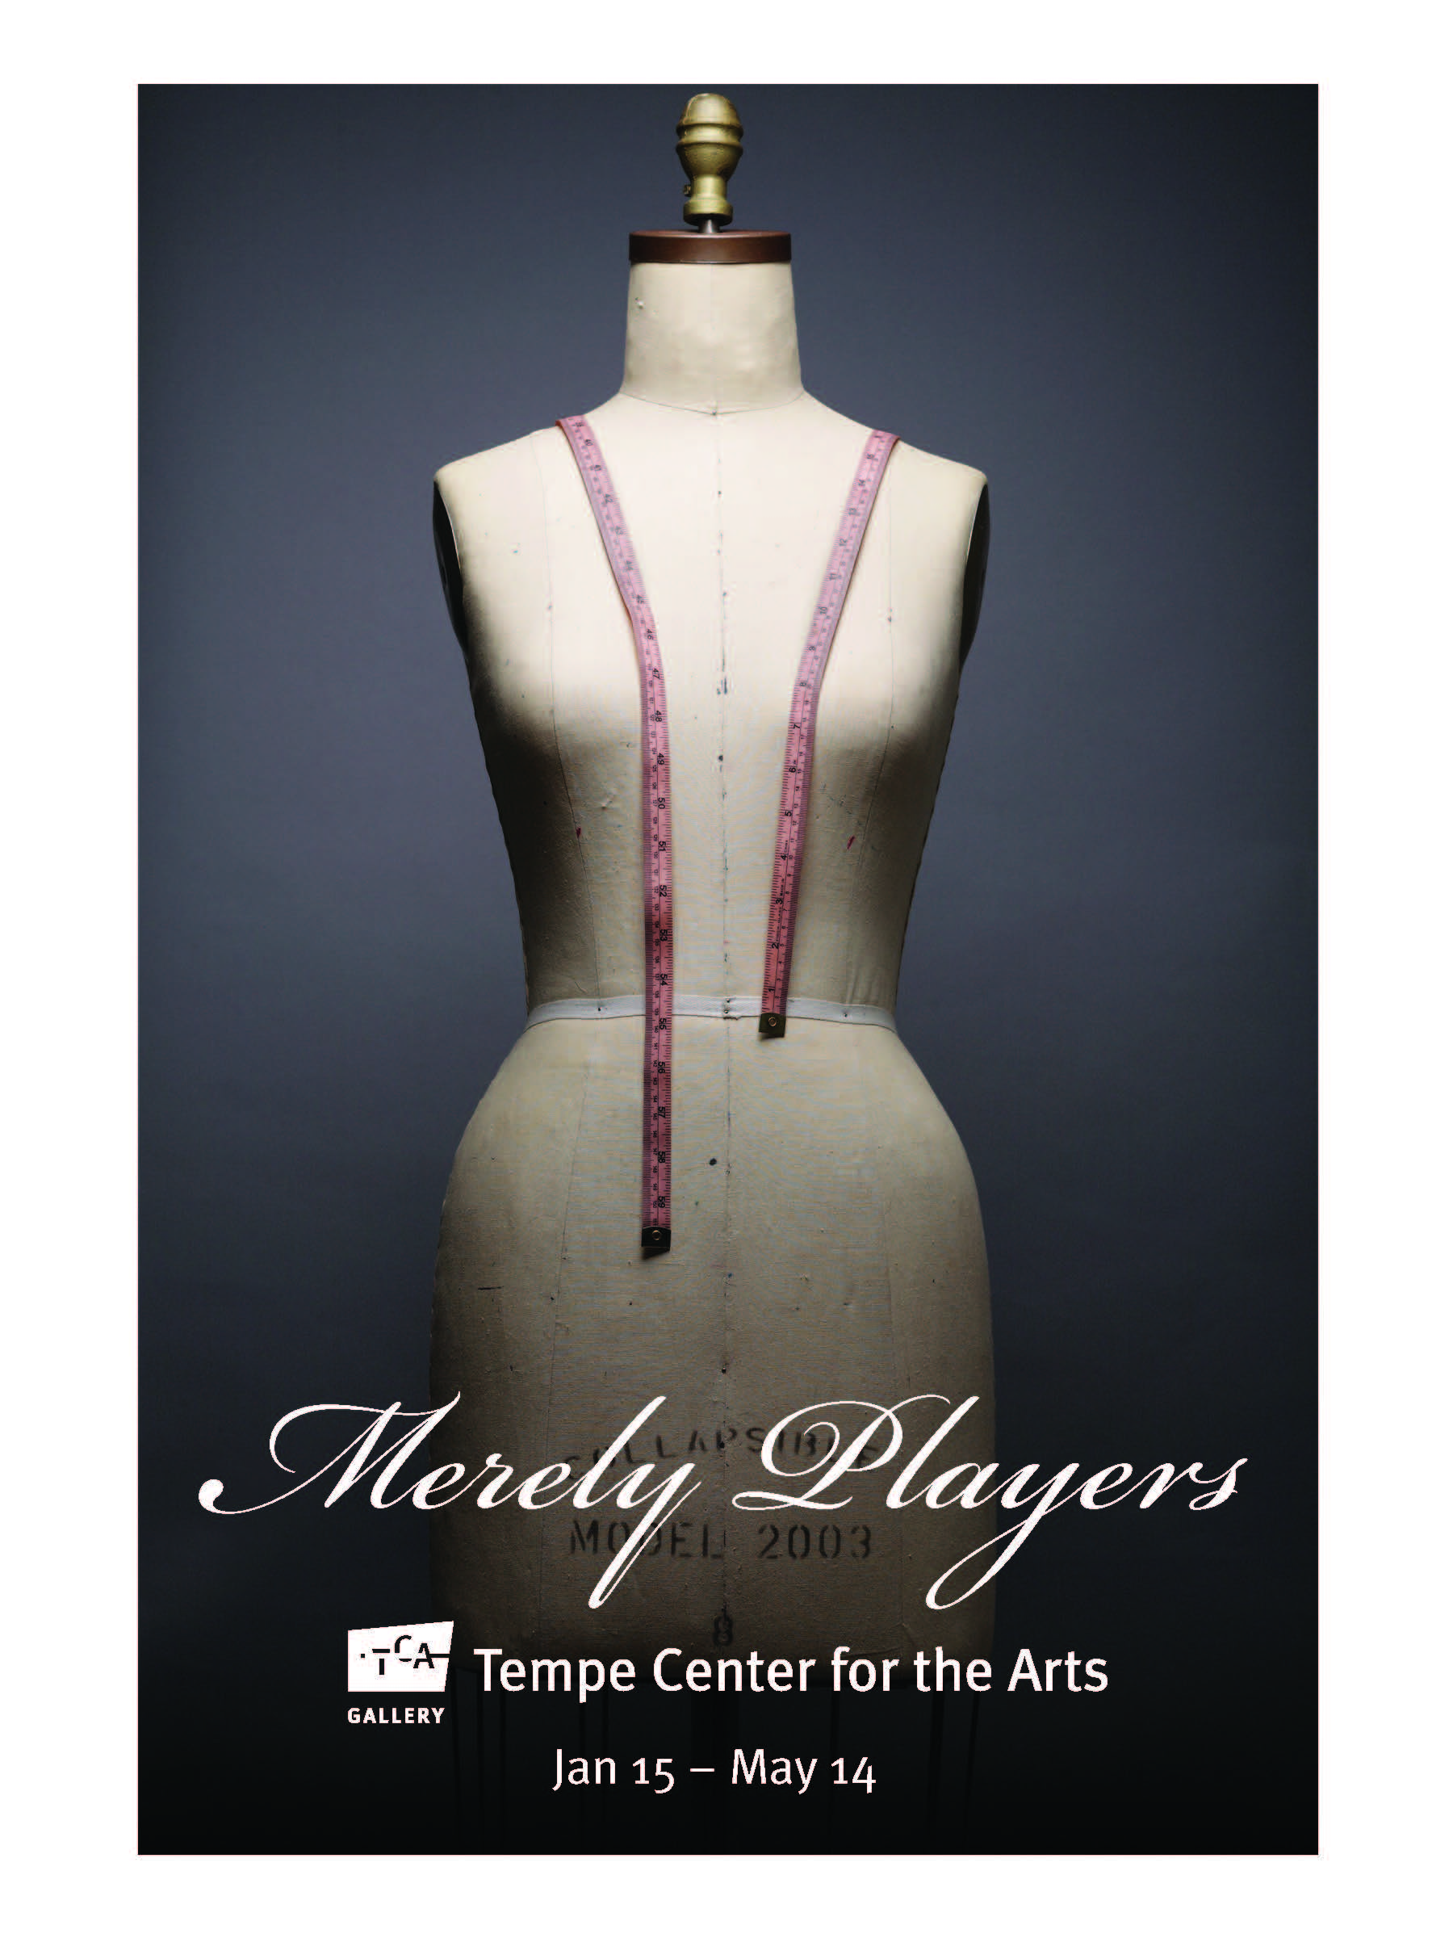
You are invited to visit the Merely Players exhibition at Tempe Center for the Arts.
Explore costumes designed for Childsplay, the Arizona Opera, Ballet Arizona, Southwest Shakespeare Company, Phoenix Theatre, the masks of Zarco Gurerro, and more.

