Slide 1
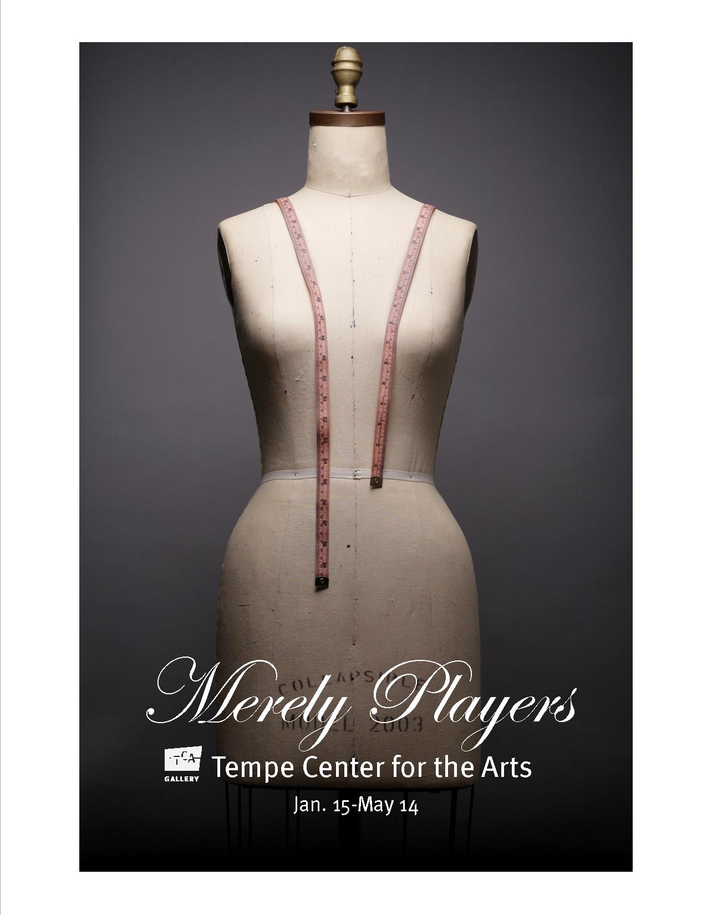
Dressing a Dream (Lesson 3)
By Mary Erickson, Ph.D. and Rebecca Akins, Costume Designer

Slide 2
More than 500 years ago in England, actor and playwright William Shakespeare wrote a play called A Midsummer Night’s Dream. The play tells the story of four young lovers, six actors and the fairies of the forest who control them.
Image from Southwest Shakespeare Company

Slide 3
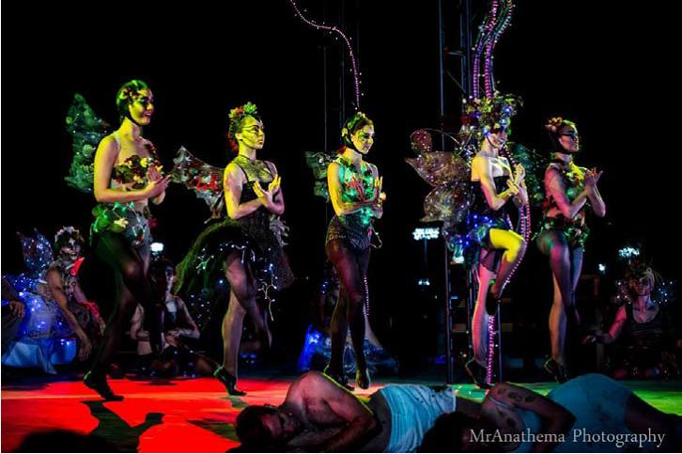
The play has been performed hundreds of times. Each time, a technical team of set designers, lighting designers, property (“props”) designers, sound designers and costume designers work together to create a unified look based on the director’s vision.
Image from Southwest Shakespeare Company

Slide 4
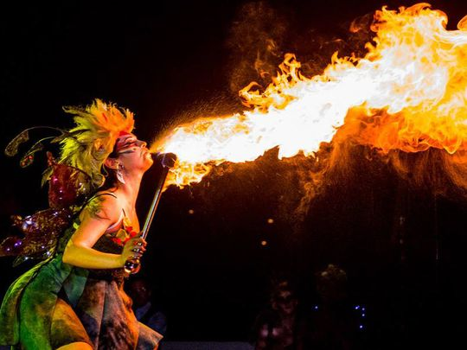
In 2014 the Southwest Shakespeare Company staged their own version of the play but called it “Fairy Worlds” at night in the Desert Botanical Garden in Phoenix, AZ. Imagine this costume lit by firelight in the dark of the night.
Image from Southwest Shakespeare Company

Slide 5
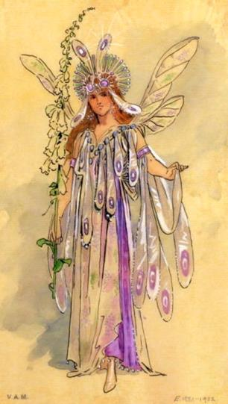
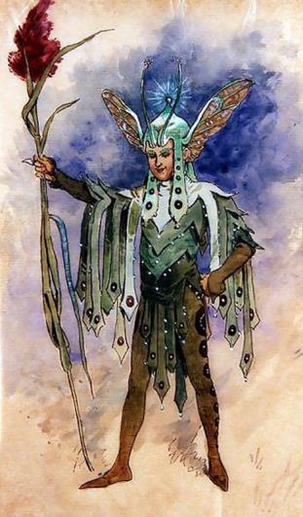
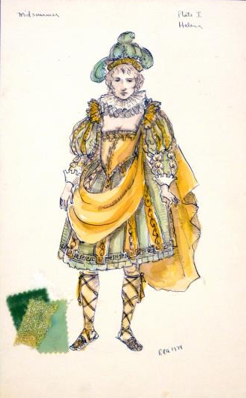
Before making a costume, costume designers make drawings of their ideas called renderings.
The two costumes on the left were designed by C. Wilhelm for a production of A Midsummer Night’s Dream in England in 1904. Rebecca Akins designed the costume on the right for a 1974 production.

Slide 6
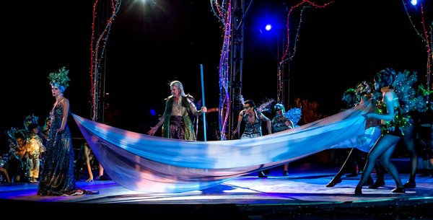
Costume designers Maci Hosler and Adrianna Diaz chose different colors, patterns and textures for each costume in the 2014 production. They collaborated (planned together) so the costumes would tie together to make a unified visual “look.”
Image from Southwest Shakespeare Company

Slide 7
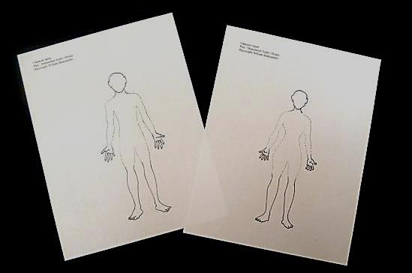
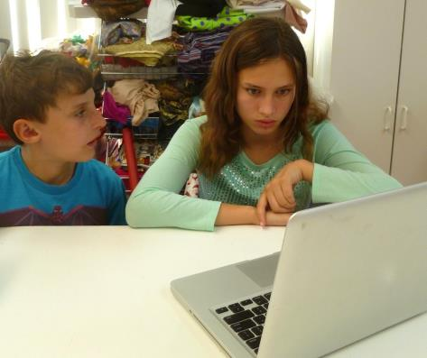
After you learn more about the characters in the play you will collaborate with a classmate. Each of you will design and draw costumes for two fairies.
One will be a boy (Puck, Cobweb or Mustardseed). Make him nice and helpful. The other will be a girl (Peaseblossom or Moth). She should be sneaky and not so nice.

Slide 8
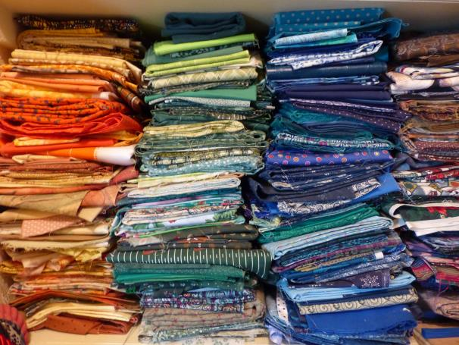
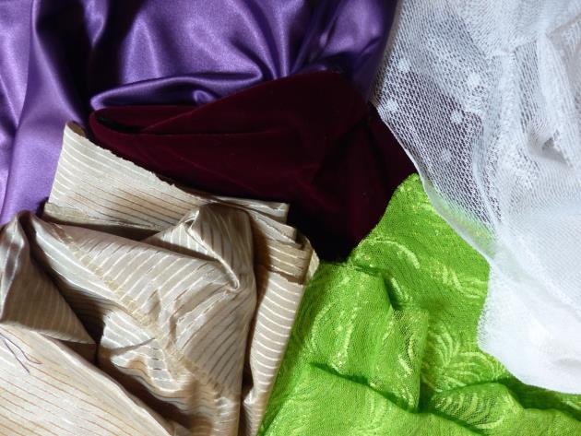
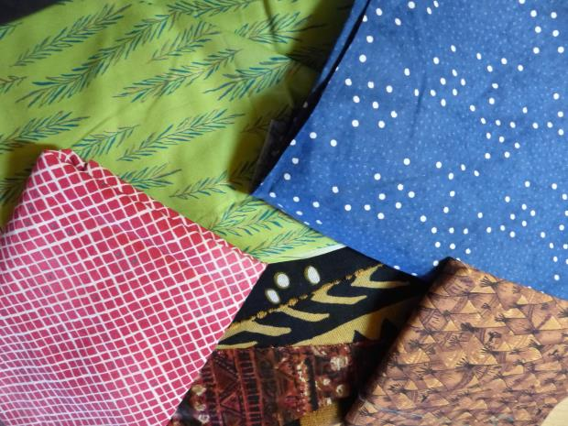
You can give your costumes a unified look by repeating some of the same colors, textures or patterns in both designs.

Slide 9
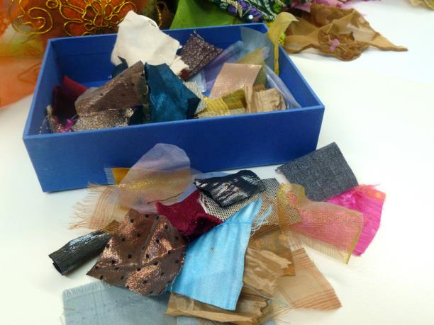
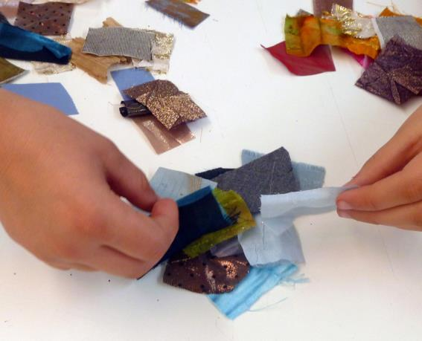
After you’ve chosen your fairies, sort through cloth (or paper) swatches for those you think will give your fairy the character he or she should have.

Slide 10
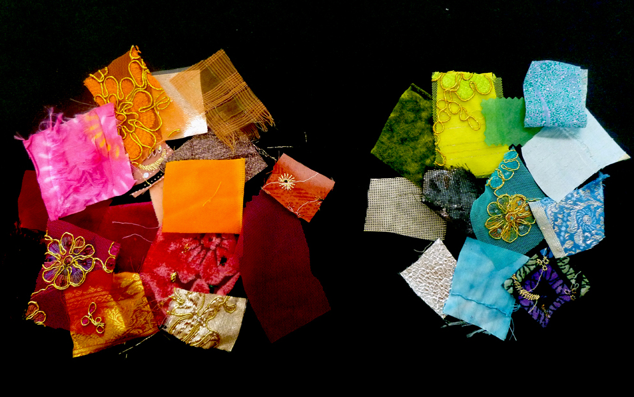
Which collection of swatches has warm colors?
Which has cool colors?
Which swatches in each pile are solid colors?
Which have patterns?
Which have smooth, rough, shiny or other textures?

Slide 11
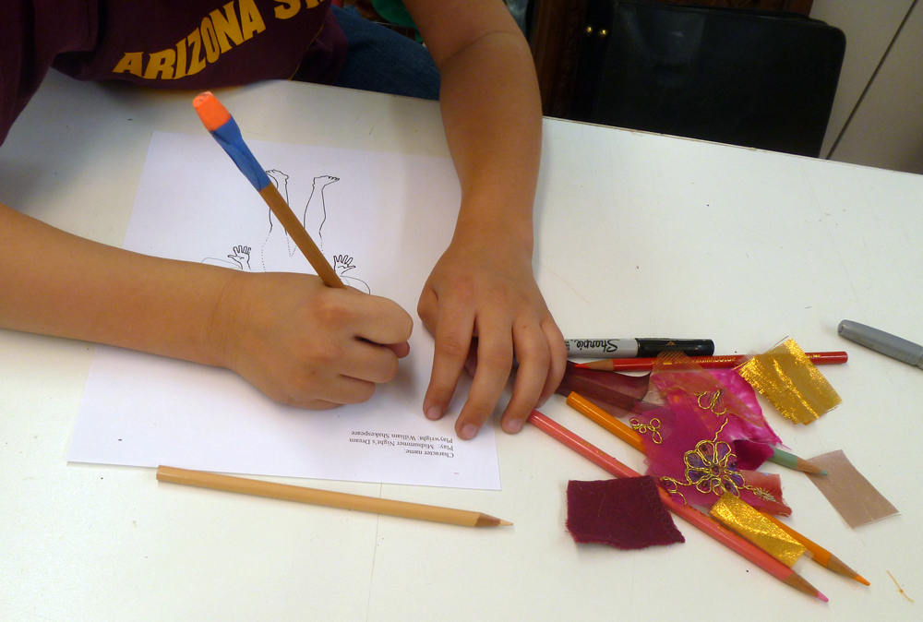
Use your girl or boy template and begin to design her or his costume.

Slide 12
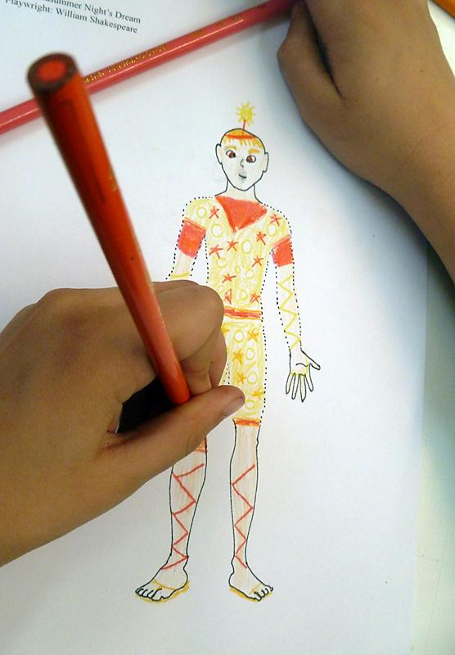
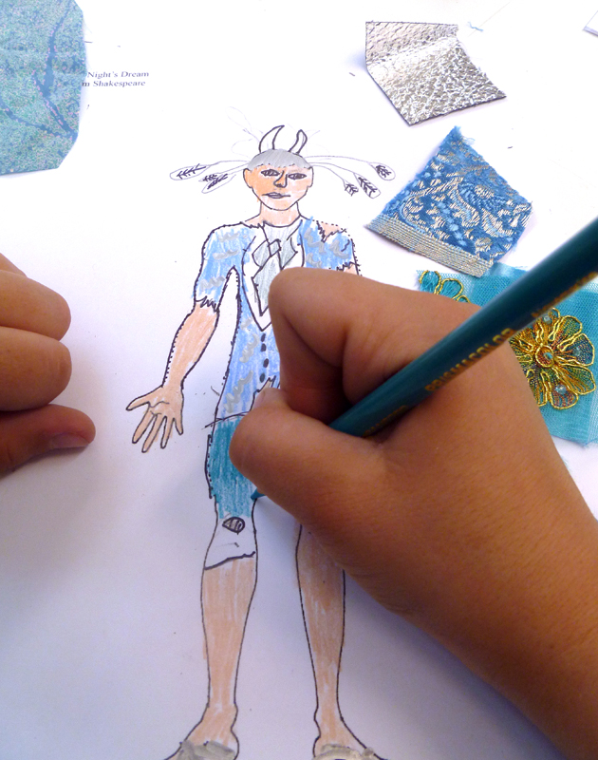
Use colored pencils to add the color, pattern and texture of the cloth to your rendering.

Slide 13
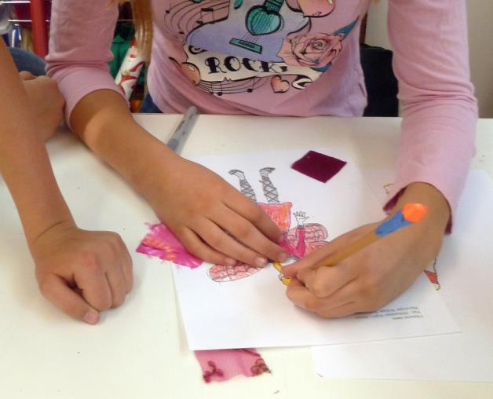
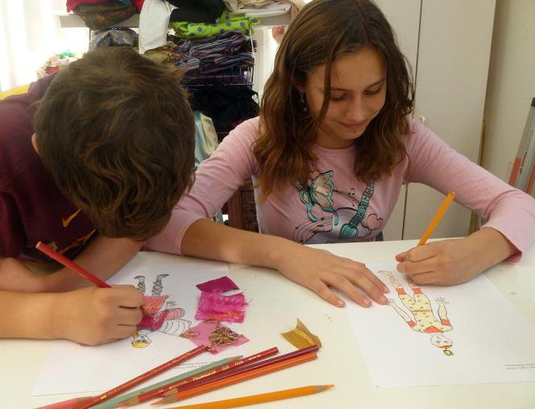
As you work, check in with your classmate to make sure all your costumes will have have a unified look when they are completed.

Slide 14
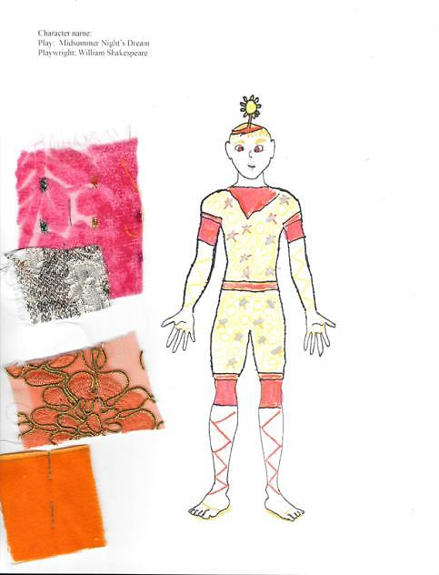
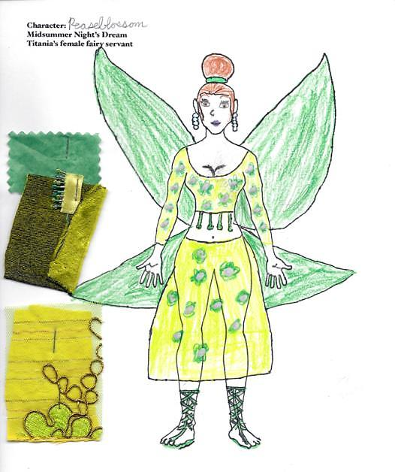
Each classmate should design one boy fairy and one girl fairy. One of these costumes uses cool greens. The other uses warm pinks and oranges. Both designs include yellow and a mix of patterned and solid colored cloth.

Slide 15
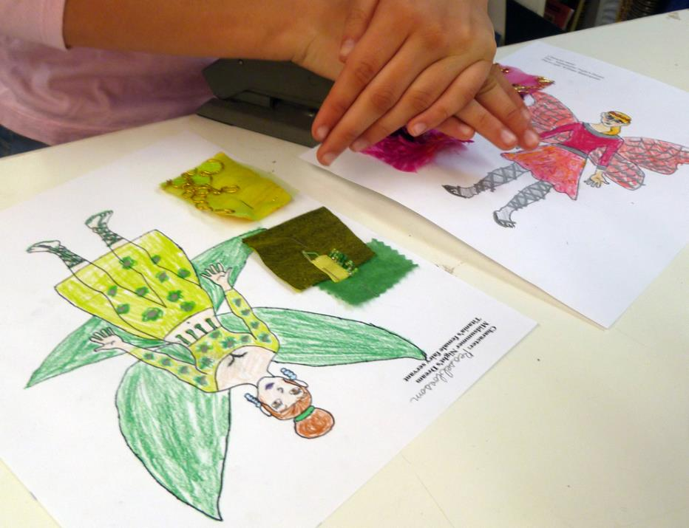
Prepare your renderings for presentation by labeling each with the character’s name and attaching the cloth swatches.

Slide 16
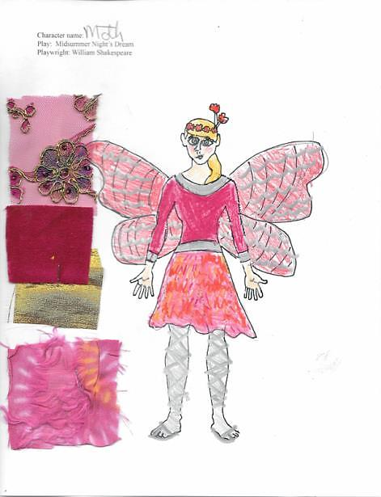
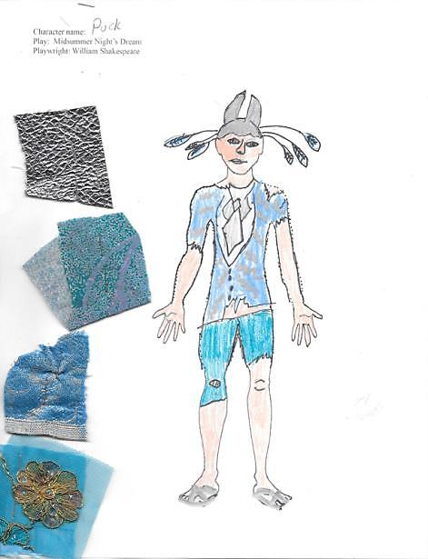
Where do you think a play with these costumes might be performed?
What kind of lighting would best show them off?
What kind of music would help bring their characters to life?

Slide 17
Which fairies for A Midsummer Night’s Dream will you choose?
What costume will express the character of each fairy?
What colors, patterns and textures can you and your classmate use to unify the look of all your fairies?

