Slide 1
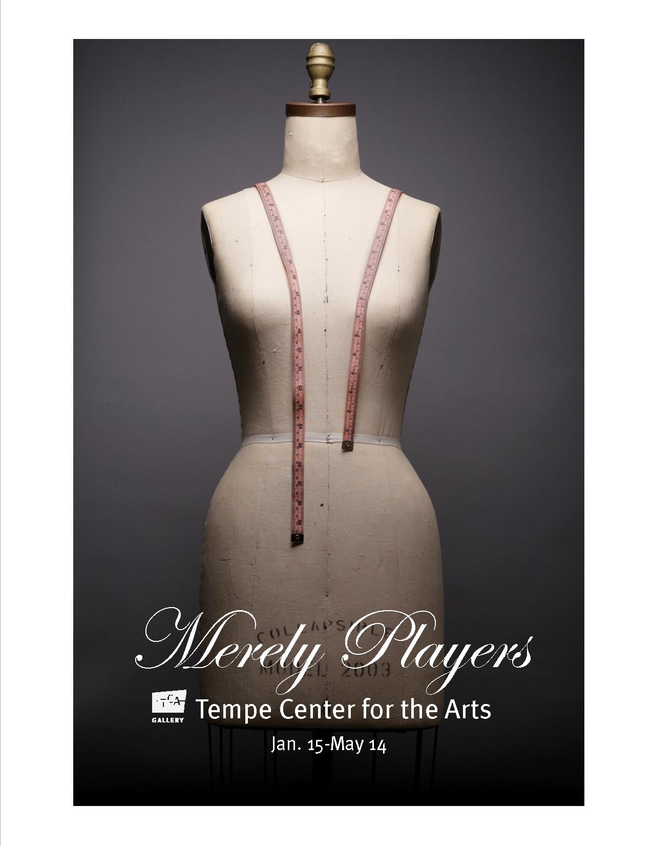
Dressing a Dream (Lesson 4)
By Mary Erickson, Ph.D., and Rebecca Akins, Costume Designer

Slide 2
More than 500 years ago in England, actor and playwright William Shakespeare wrote a play called A Midsummer Night’s Dream. The play tells the story of four young lovers, six actors and the fairies of the forest who control them.
Image from Southwest Shakespeare Company

Slide 3
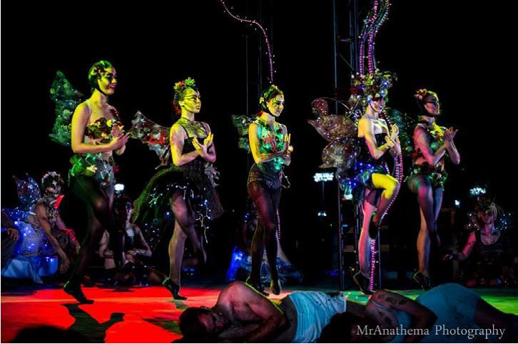
The play has been performed hundreds of times. Each time, a technical team of set designers, lighting designers, property (“props”) designers, sound designers and costume designers work together to create a unified look based on the director’s vision.
Image from Southwest Shakespeare Company

Slide 4
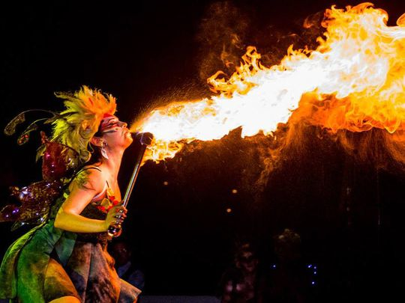
In 2014 the Southwest Shakespeare Company staged their own version of the play but called it “Fairy Worlds” at night in the Desert Botanical Garden in Phoenix, AZ. Imagine this costume lit by firelight in the dark of the night.
Image from Southwest Shakespeare Company

Slide 5
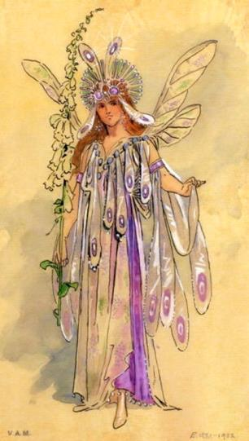
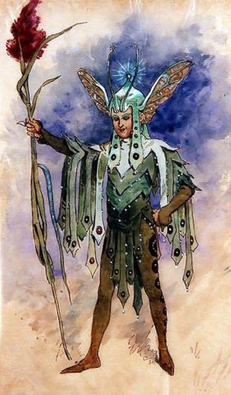
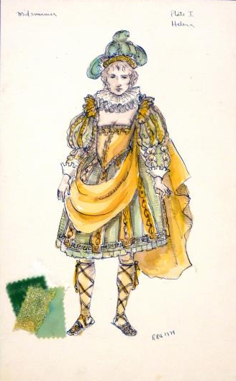
Before making a costume, costume designers make drawings of their ideas called renderings.
The two costumes on the left were designed by C. Wilhelm for a production of A Midsummer Night’s Dream in England in 1904. Rebecca Akins designed the costume on the right for a 1974 production.

Slide 6
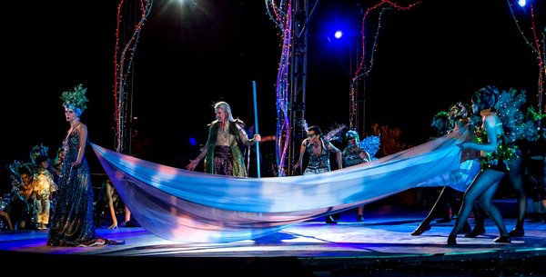
Costumer designers Maci Hosler and Adrianna Diaz chose different colors, patterns and textures for each costume in the 2014 production. They planned together so the costumes would tie together to make a unified visual “look.”
Image from Southwest Shakespeare Company

Slide 7
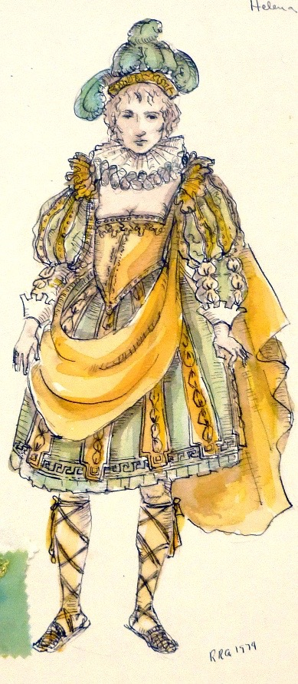
A Midsummer Night’s Dream has been envisioned in many settings.
Rebecca Akins’ rendering of the Greek character, Helena, shows her in a Renaissance costume. The play has been set in many contexts, among them ancient Greece, Victorian times, the jazz age and the counter culture of the 1960s.
Costume designers often research historical photographs and artworks to inform or inspire their designs.

Slide 8
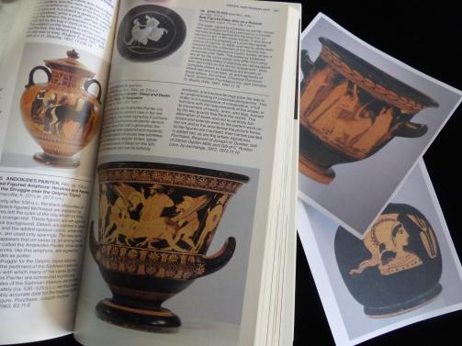
With your team, choose a time period or culture as a setting for A Midsummer Night’s Dream. A director might, for example, envision a new production set in ancient Greece inspired by the look of pottery of that era.
Search for historical photographs or artworks online or in the library. Art museums with large encyclopedic collections can be a good place to begin a search.
The Metropolitan Museum of Art in New York has a strong collection of Greek red-figured pottery.

Slide 9
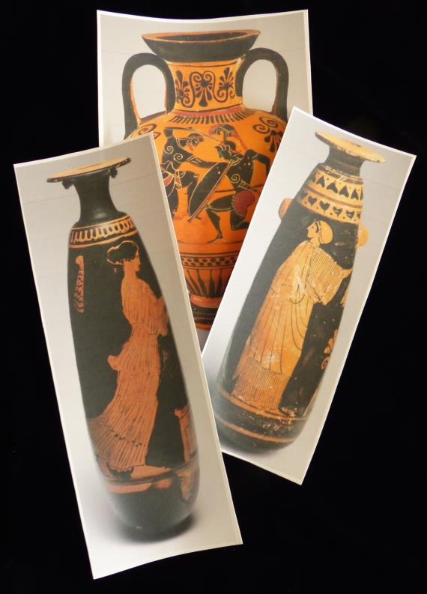
Choose a character for whom to design a costume. Locate related images from your historical sources.
For example, clothing and decorations depicted on pottery might be useful sources for the Athenian lady, Helena.
Be sure to record your sources to help you find them again and so you can credit your sources.
Print-outs of online reproductions from the red-figured Greek pottery collection of the Metropolitan Museum of Art in New York.

Slide 10
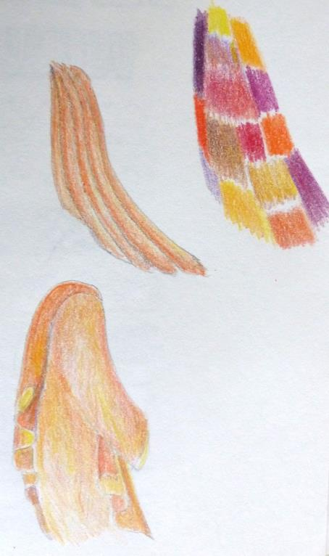
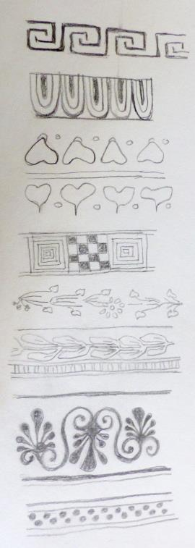
Make sketches to help you think about colors, patterns and textures you might choose for your costume design.

Slide 11
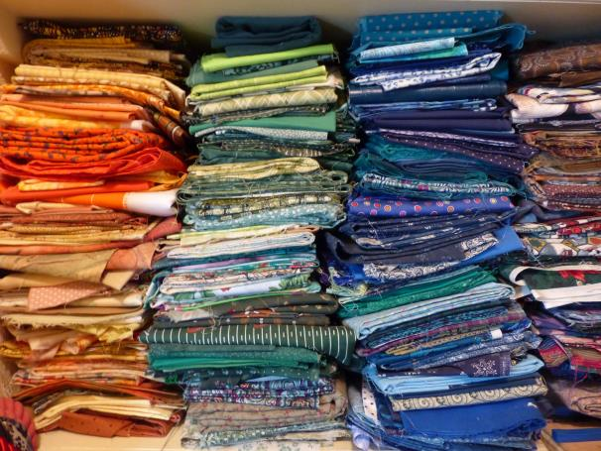
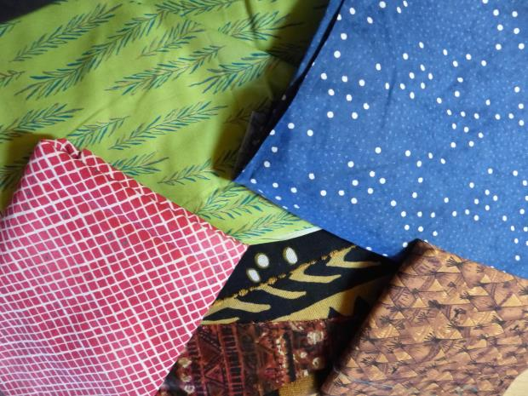
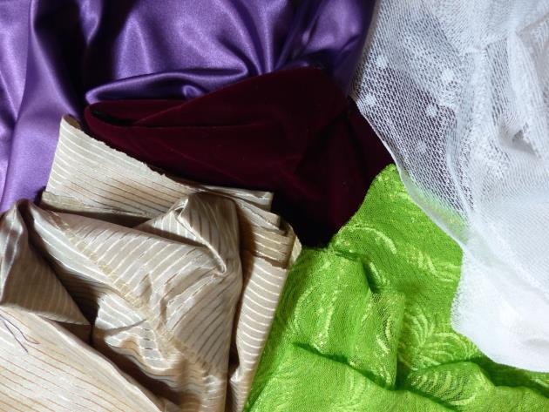
Fabrics that can be used in a costume are available in a huge range of colors, patterns and textures.

Slide 12
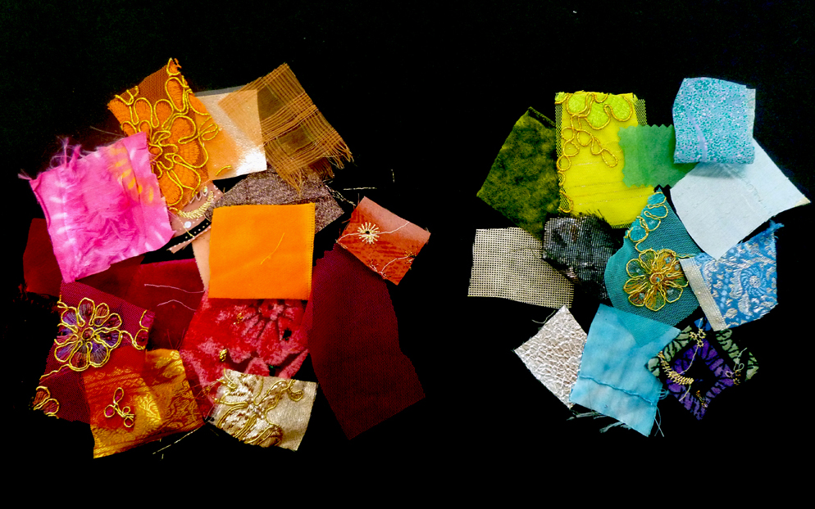
Which collection of swatches has warm colors?
Which has cool colors?
Which swatches in each pile are solid colors?
Which have patterns?
Which have smooth, rough, shiny or other textures?

Slide 13
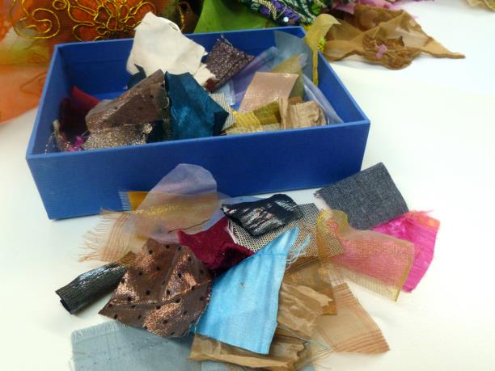
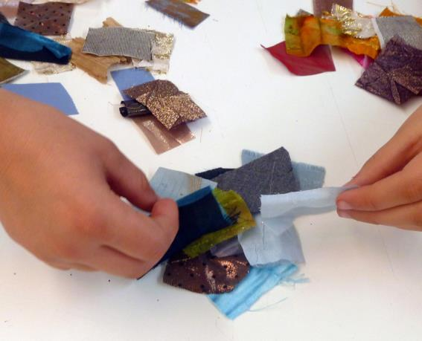
Share your preliminary ideas with members of your team so that, although each costume will be distinctive, it will create a unified look with other costumes designed for the same setting.
You might agree on a key color, pattern or texture for all characters or for all Athenians, all actors or all fairies.

Slide 14
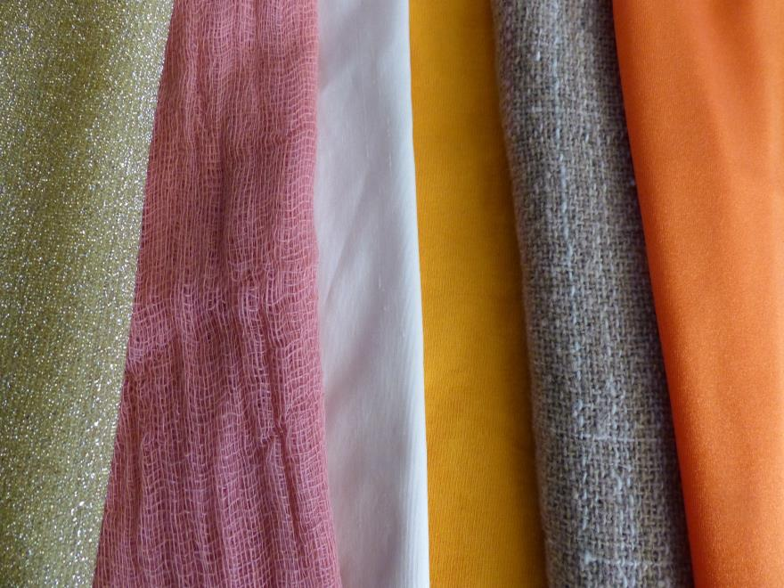
These colors might all be possibilities for a costume inspired by ancient Greek pottery.
Do some textures seem more appropriate then others? Which?

Slide 15
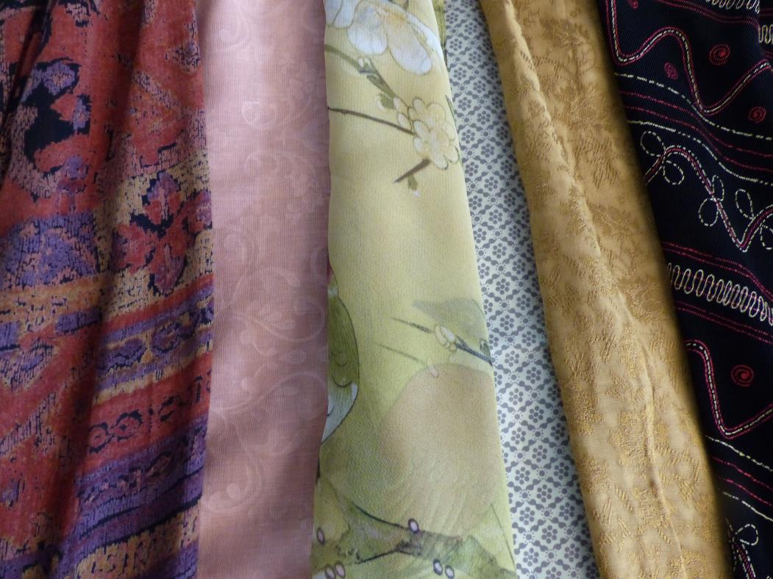
Which of these patterns do you think would enhance the costume of an Athenian lady? Why?

Slide 16
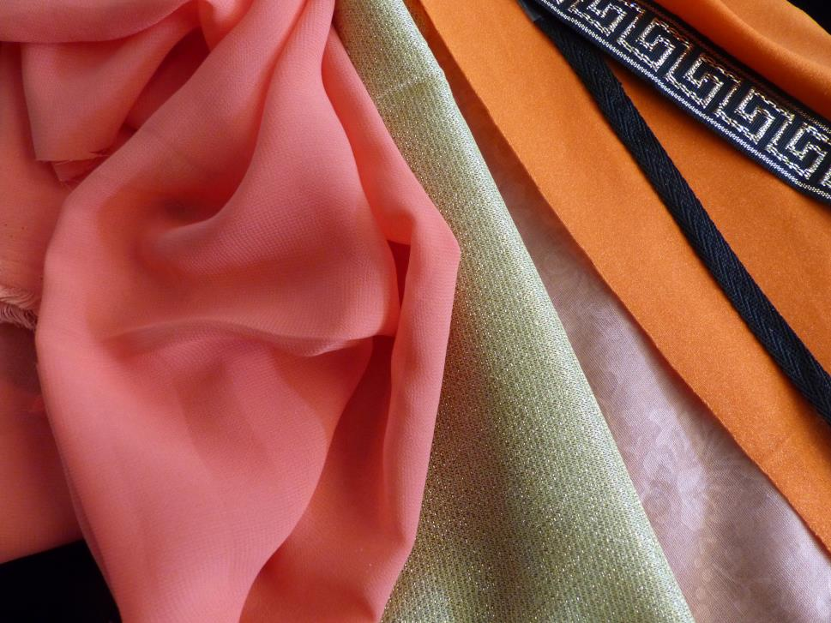
Narrow your selection to a few fabrics and perhaps some trim.

Slide 17
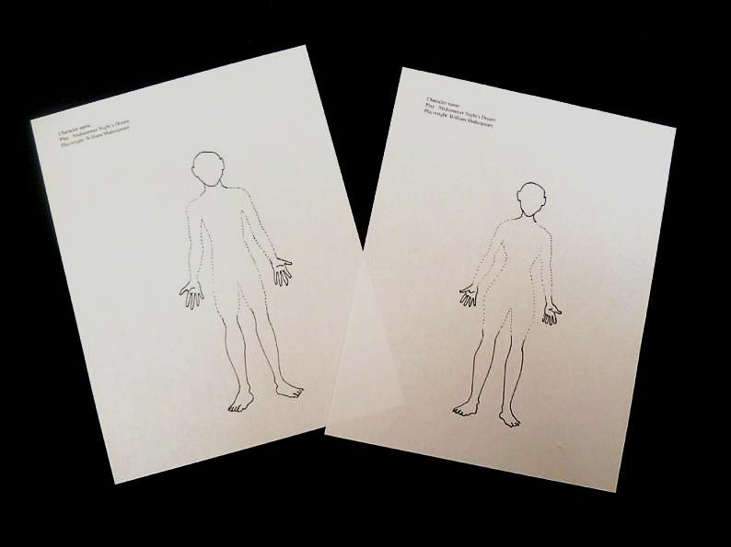
Use a male or female template for your costume rendering or draw your own figure dressed in your costume. Begin with a light pencil drawing of your costume idea.

Slide 18
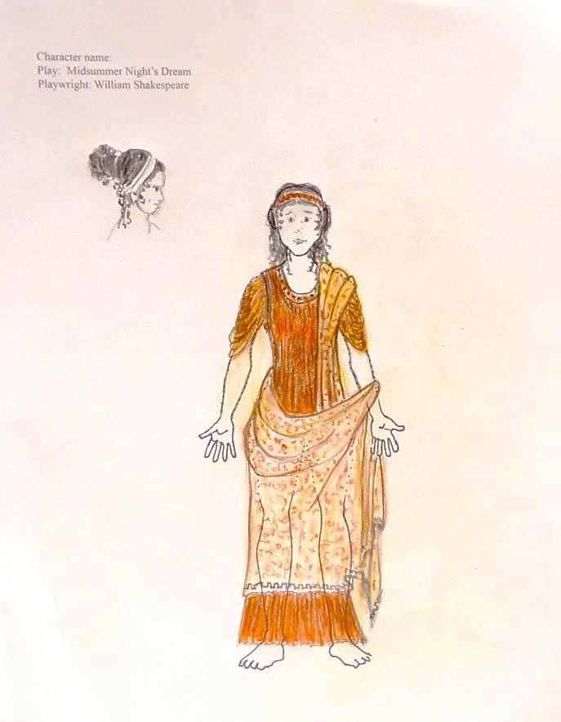
Use colored pencils (watercolor or other colored medium) to add color and to suggest pattern and texture for your rendering.
You might also wish to add accessories or suggest a hair style.

Slide 19
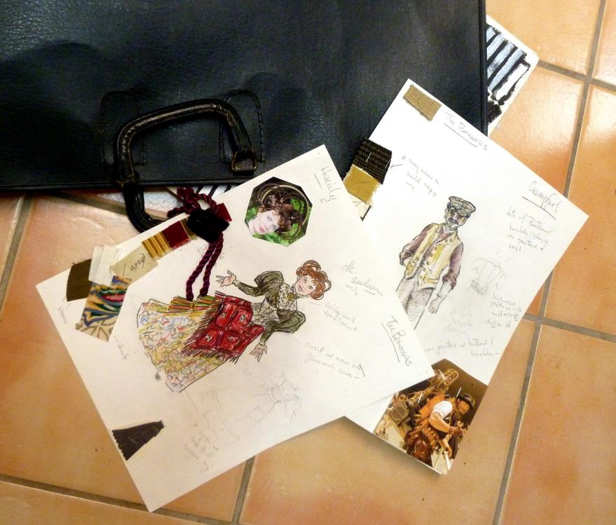
Take care as you manage your in-process drawings. For example, you can transport or store them in a portfolio.

Slide 20
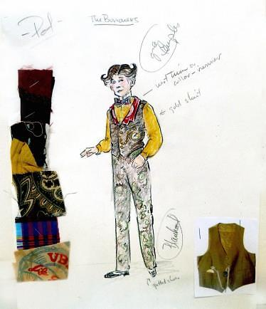
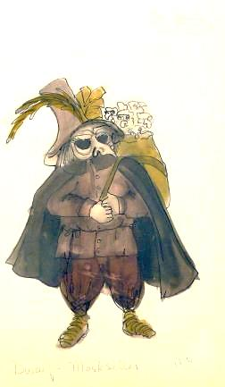
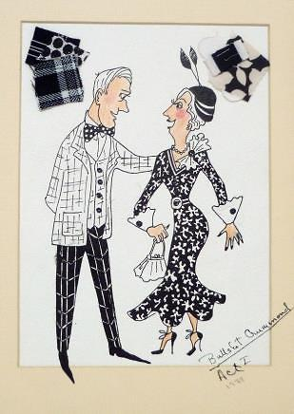
During her long and productive career, Rebecca Akins has designed hundreds of costumes for many plays. More than 100 of her renderings from 1967 through 2015 have been preserved in the Child Drama Collection at the Arizona State University Archives and Special Collections. They are stored flat and protected from direct light.

Slide 21
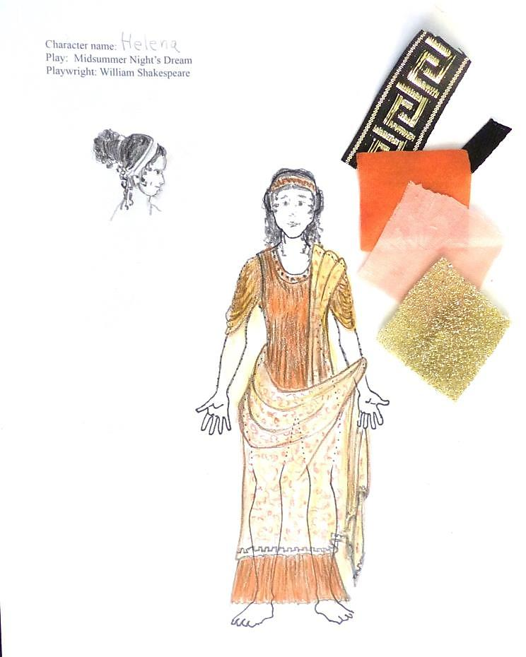
Seek feedback from teammates as you work so your team’s design choices can complement each other.
To complete your rendering, write the name of your character and attach (staple) fabric swatches.

