Slide 1
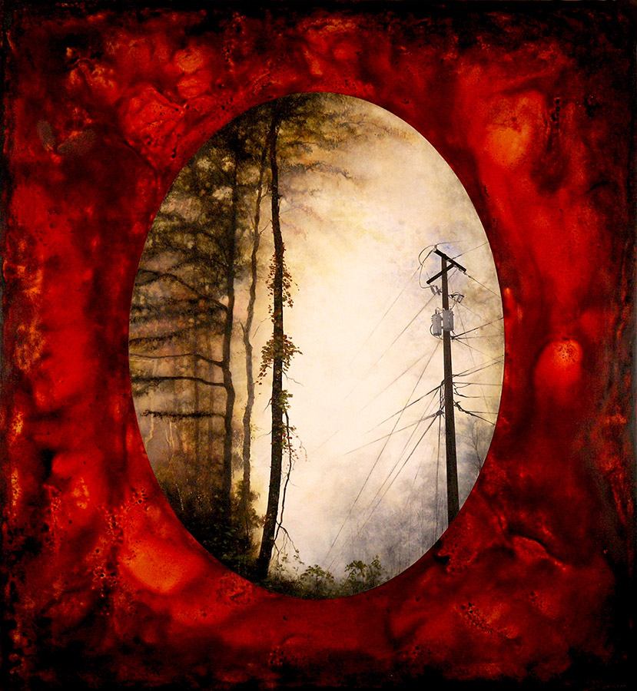
GREEN
and
GRAY
Exhibition Preview

Slide 2
The Fall 2015 exhibition “Green and Gray” at the Tempe Center for the Arts is about the world between the natural landscape and the built environment. People often associate the color green with life and the color gray with coldness. But that isn’t always the case; not all that is green is natural and not all that is gray is man-made. This exhibition explores the blurred lines where these elements merge, converge and/or conflict.

Slide 3
Whether you are taking a walk in your neighborhood or hiking along a canyon trail, odds are good that you’ll encounter examples of people adapting nature to meet their own needs and tastes. For example, a beautiful grass lawn, complete with a plastic pink flamingo, at the foot of a desert mountain. Or vice versa, you may discover examples of the natural world encroaching back into the human landscape, such as the clever coyotes that seem to be at home in our local suburbs.
Some of the connections in this exhibition have a moral story to tell, some are an exploration of the media and still others are an observation of the world. They describe for us a world that is both green and gray at the same time.

Slide 4
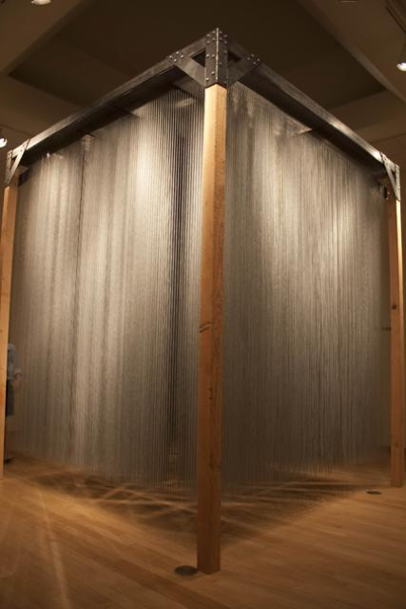
Angela Cazel-Jahn, Phoenix
Cazel-Jahn makes paintings, sculptures and spaces for people to play in and think about. Currently, she is a graduate student and faculty associate in the School of Sustainability at Arizona State University. This particular installation is a collaborative effort between Cazel-Jahn and her husband Robert Larson who is an engineer.
Some fun facts about the piece:
There are 10,380 strands of aluminum ball chains in the piece.
Each strand is 10 feet long.
There are approximately 954,960 little metal balls in the piece.
The entire piece weights about 700 pounds.
www.cazeljahn.net
Ball Chain + Botanical = mixed media

Slide 5
Candice Eisenfeld, Tempe
Eisenfeld studied painting at Bezalel Academy of Art in Jerusalem, Israel and received a Bachelor of Fine Arts from the University of Texas in Austin.
She says of her work: “Exploring issues of identity, memory and the passage of time, I am inspired by the first American art movement (The Hudson River School of Landscape Painting), which explored the wilderness of the ever expanding frontiers of the United States. … In these pieces, I experiment with images of utility poles in order to acknowledge them as elements of the landscape in which we live.” www.eisenfeld.com
Turning Point: Landscape with Utility Pole acrylic on panel

Slide 6
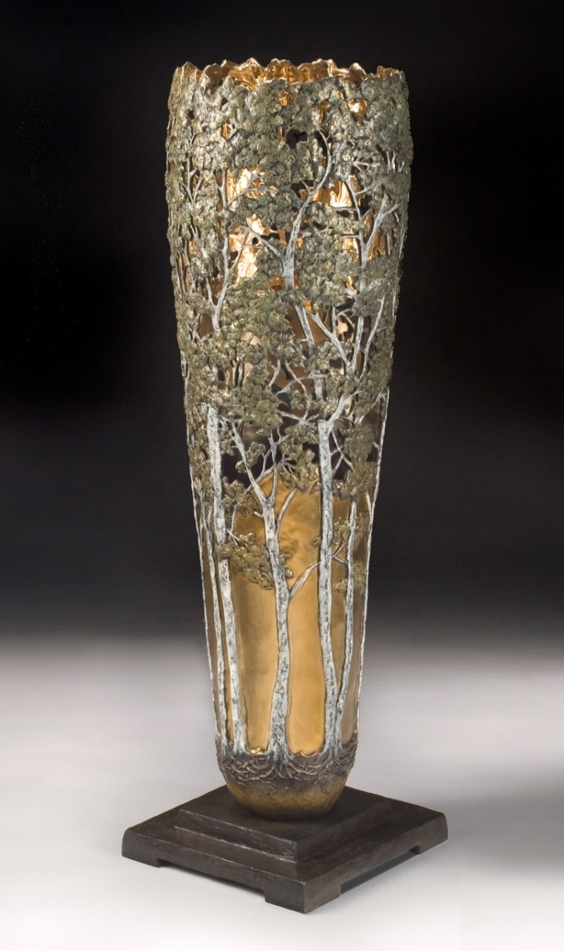
Carol Alleman, Tucson
Born in rural Pennsylvania, Alleman obtained a degree in art education from Pennsylvania State University and continued graduate studies in-state at the Lancaster Theological Seminary. She began her sculptural career by working in clay but later expanded her interests into working with bronze casting which is still her primary focus today.
Alleman says “The interweaving plants and creatures in each of my vessels speak to the sometimes overlooked relationships in nature. www.allemanstudios.com
Woodland Queens bronze

Slide 7
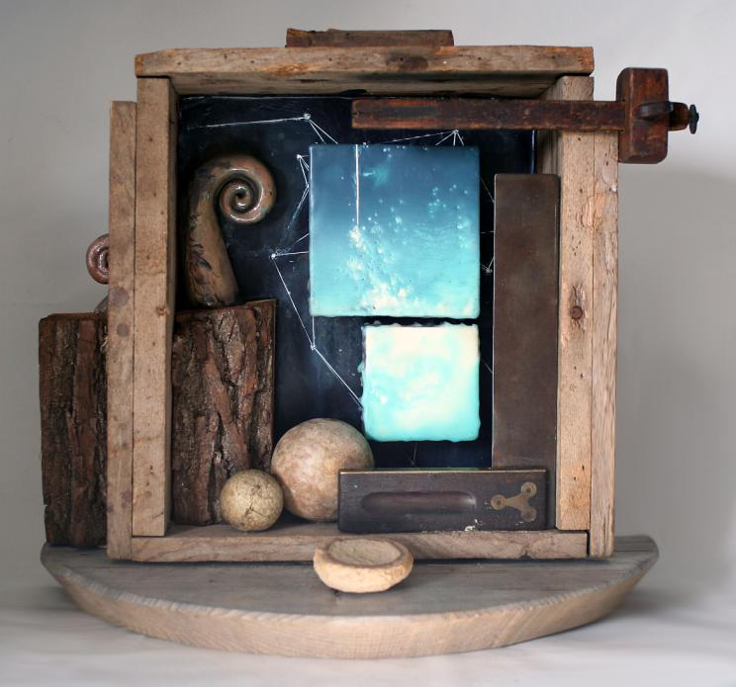
Catherine Nash, Tucson
Nash received a Bachelor of Fine Arts in printmaking and drawing from the University of New Hampshire in Durham and a Masters of Fine Arts in mixed media from the University of Arizona. She has also traveled and studied in Japan twice to learn techniques of woodblock printing and papermaking in depth. Today, she balances her studio work with teaching.
“The vastness of space holds an ultimate touchstone for me: the sky is a window to the infinite.... These recent works are images of skies and bodies of water not intended to portray specific locations as much as to create a dreamlike feeling of place and memory.”
www.catherinenash.com
The Circle Cannot Be Squared mixed media

Slide 8
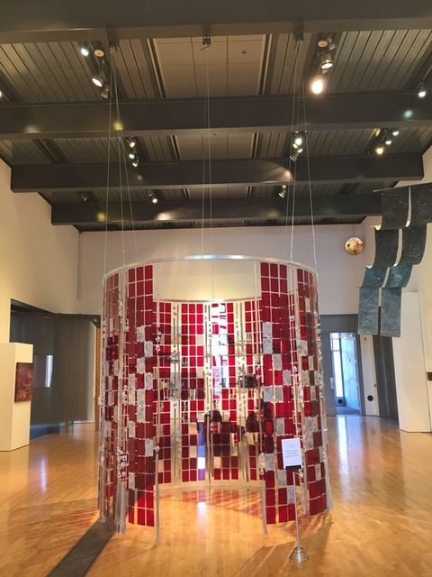
Christine Cassano, Phoenix
Cassano was born in 1974 and raised on the southern coast of Virginia. Today she is a mixed-media artist with a studio space in central Phoenix.
She says this sculpture has “Alternating panels of industrial and organic materials that suspend 9 ft. high and 9 ft. in diameter to create a walk-in installation. The viewer can experience the contrast of the natural and industrial environments, and variations between the external and internal experiences. Sentences engraved into the Saguaro wood are connections and reminders of past personal experiences provided by friends and family about a change that happened during their life.”
www.christinecassano.com
Permeable Facades and Internal Alterations mixed media

Slide 9
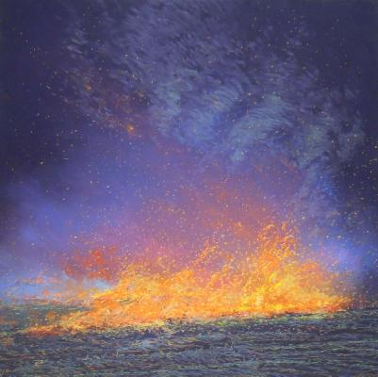
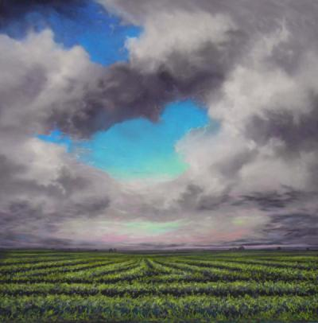
Burn and Re-Birth Form the series: Four Elements in the Green and Gray Contemporary Landscape pastel
Ellen Wagener, Scottsdale
Wagener grew up in Iowa and is still inspired by landscapes such as farms that remind her of her childhood. She received a Bachelor of Fine Arts from the Corcoran School of Art in Washington, D.C. in 1989. Recently, she was chosen to display art in the United States Art in Embassies program and the Capitol Rotunda in Washington, D.C.
She says she is “Inspired by the landscape tradition of the Hudson River School, American Luminism and vintage photography. I am a keen observer of the sky and land. Creating landscape series in pastels and charcoal exclusively, I build my drawings from sketches, memory and my own photographs.

Slide 10
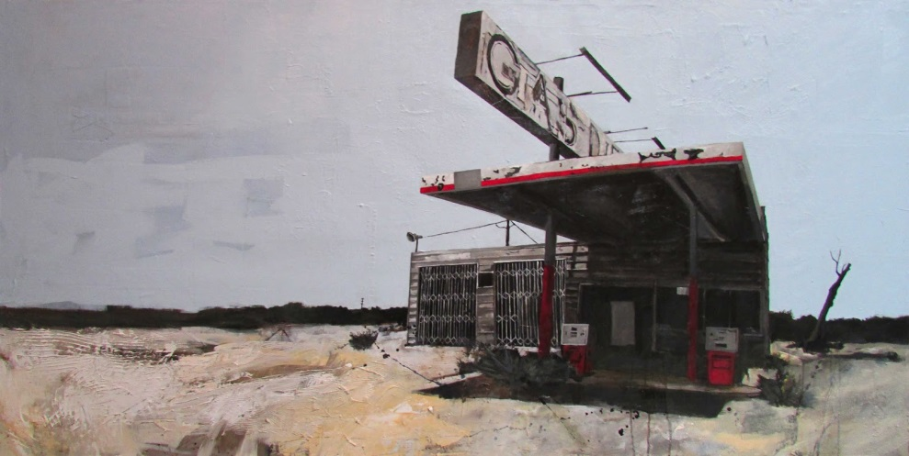
Worn Out Life mixed media
Jonathan Howard, Phoenix
An Arizona native, Howard spent his early childhood in the Phoenix area. He also lived in Hawaii, California and New Mexico before returning to the valley. He attended Scottsdale Community College and transferred to Arizona State University to earn a Bachelor of Fine Arts in painting.
“The abandoned gas station/desert works address a time gone by. When I visit these sites to take reference photographs, I’m always surprised about how they feel- as if the echo of past events still lingers within their walls. Considering that my memories are the only souvenirs left from my childhood of traveling these roadways, the fleeting nature of our existence really hits home to me.”
www.jonathanhowardart.com

Slide 11
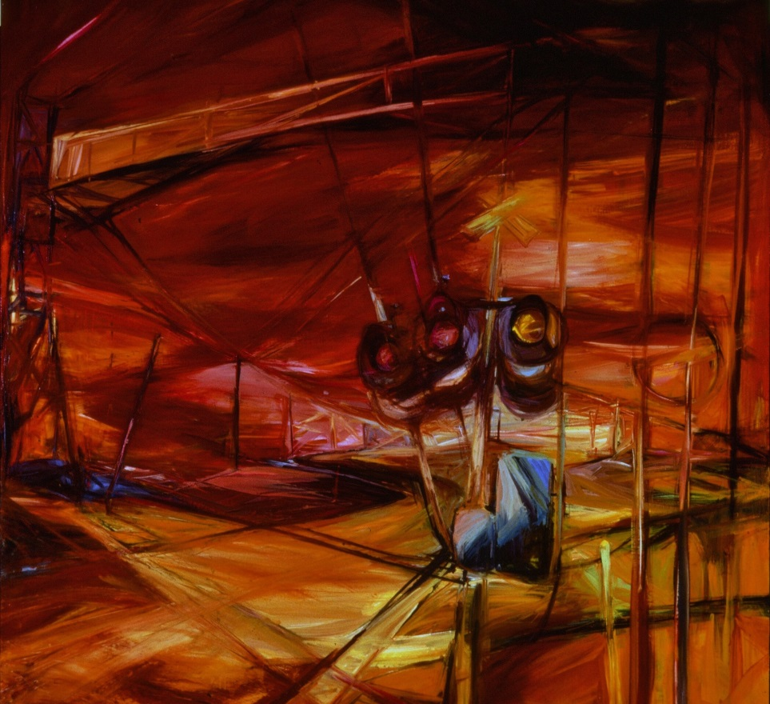
Karen Jilly, Paradise Valley
Jilly’s background is in architecture and design. She received a Bachelor of Arts in design from the University of California, Los Angeles and completed additional studies in painting and drawing at California State University, Long Beach.
Jilly says: “I see the urban landscape as a metaphor for the fragile beauty of life. In my work, I employ architectural elements to provide structure and stability. An exaggerated Gothic perspective is used to convey space and time and a sense of ‘passing through.’ Balancing these contradictions of life continues to be the focus on my work.”
Urban Fringe oil on wood

Slide 12
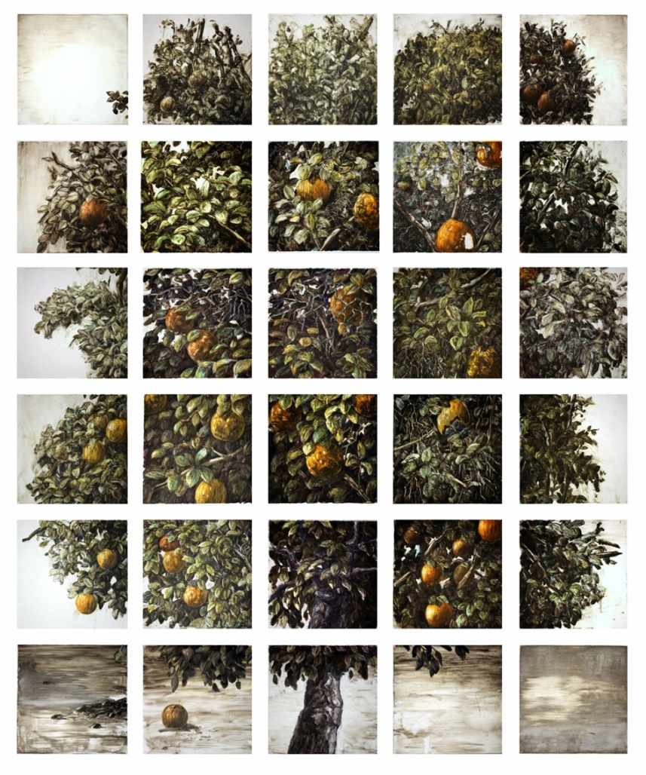
Mohammad Reza Javaheri, Brooklyn
Javaheri was born and raised in Tehran, Iran. He holds a Bachelor of Science in chemistry from Sharif University of Technology in Tehran and received a Master of Fine Arts in drawing and Master of Science in chemistry from Arizona State University. Today he lives and works in Brooklyn, NY.
Javaheri says: “I am interested in painting’s ability to articulate a way of understanding the world through differences. ‘The Orange Tree and Its Double’ consists of thirty individual prints that, together, create the illusion of an orange tree interrupted by a grid. The tree is a force of life, while the grid signifies the structure that regulates our lives.”
www.mohammadjavaheri.com
The Orange Tree & Its Double monoprints on paper

Slide 13
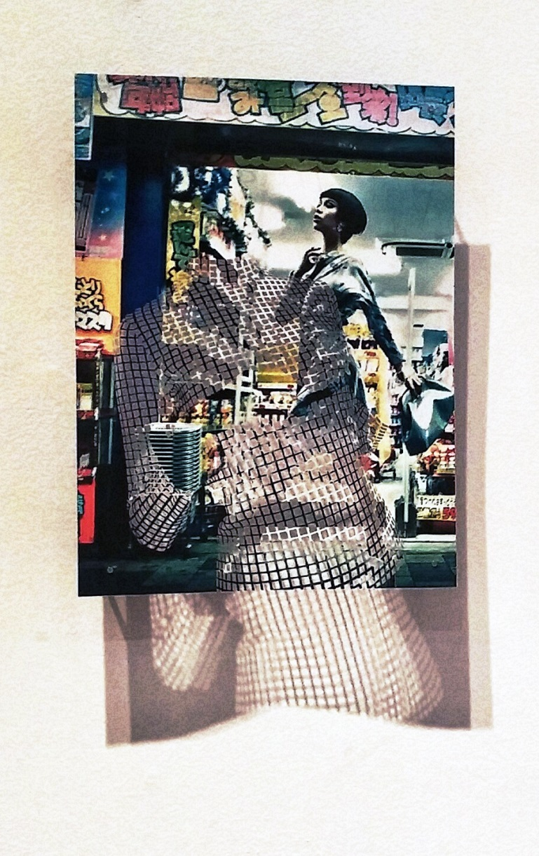
Peter Bugg, Tempe
Bugg, originally from Madison, WI, earned a Bachelor of Arts in economics from the University of Chicago and a Master of Fine Arts in photography from ASU. Since 2011, he has served as the director of the Student Galleries program at Arizona State University where he also teaches.
“In the series ‘Pairings,’ I combine a positive, photographic image with a negative, cut-out image created by selectively removing portions of a pattern featured on the reverse. The patterns found in the clothing and backgrounds of the fashion and advertising photography goes back and forth between the rigid, geometric lines of the city and human made objects, and the curvy, flowing lines of the bodies that the clothing covers, creating a combination of the ‘Green and Gray’ themes of the exhibition.”
www.peterbugg.com
Untitled, Pairings series paper cut-outs

Slide 14
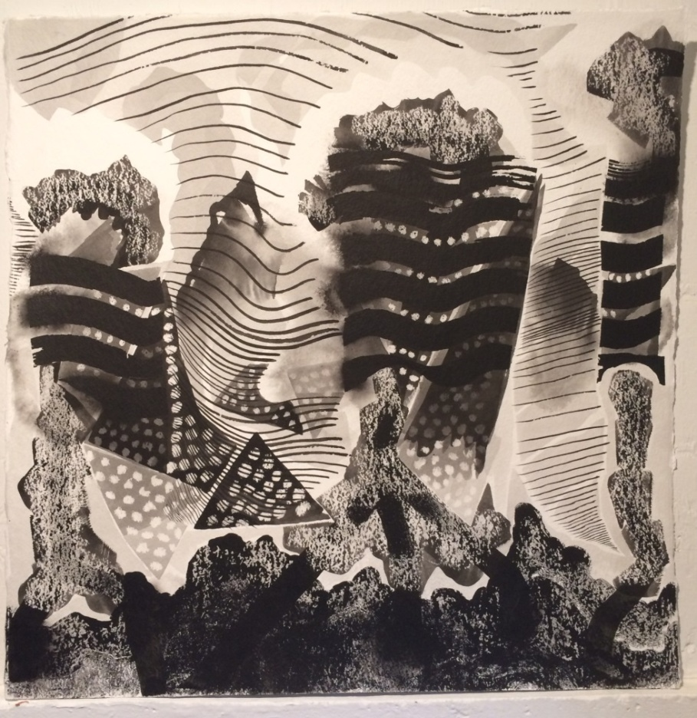
Preston Graves, Seattle
Graves grew up in Tempe. He says that early on, he learned a lot about drawing informally from his Grandma Betty and then formally at Mesa Community College. He went on to earn a Bachelor of Fine Arts from the Art Institute of Chicago and a Master of Fine Arts from the University of Oregon in Eugene.
“My drawings are informed by the biological curiosities I encounter while exploring the forests of the Pacific Northwest. I look for the patterns and growth habits of creatures found there.”
www.prestongraves.com
devil’s churn ink and wax on paper

Slide 15
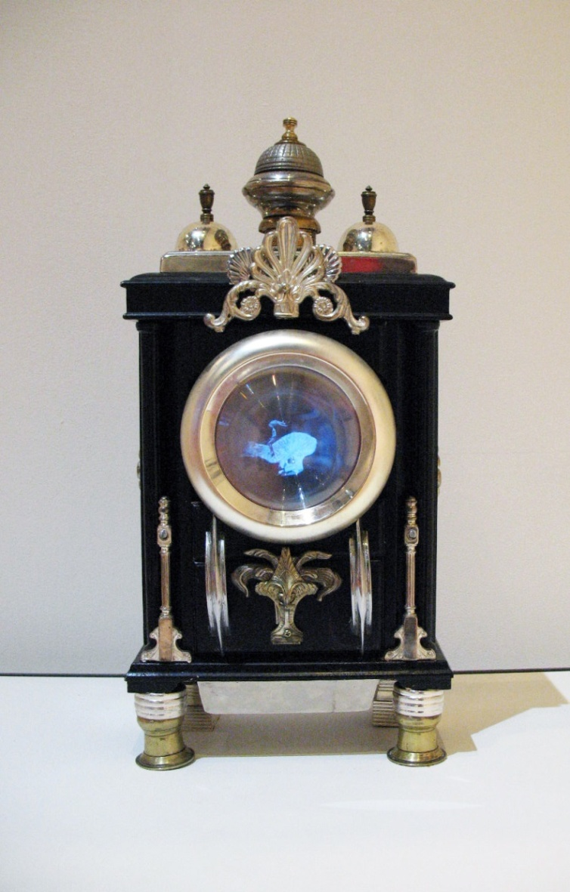
Steve Gompf, Mesa
Gompf earned his Bachelor of Fine Arts in photography and Master of Fine Arts in intermedia studies at Arizona State University. Gompf has a whimsical sense of humor and enjoys creating sculptures that he playfully describes as authentic vintage pieces of technology- even though he hand-makes each one. Each of his “devices” includes found objects as well as repeating video animations constructed from both new and vintage images.
www.teleseum.org
Salesman Sample Televisor, 1923 American mixed media and video

Slide 16
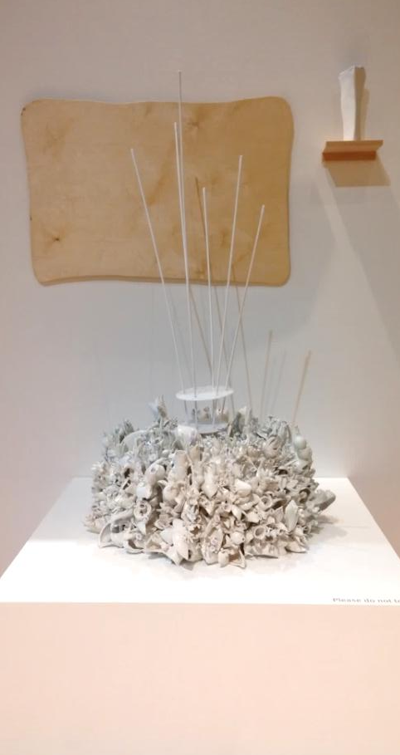
Susan Beiner, Phoenix
Beiner received a Bachelor of Fine Arts from Rutgers University in New Jersey and a Master of Fine Arts from the University of Michigan in Ann Arbor. She is an artist that is extremely interested in the environment.
“‘These landscapes present the confrontation between indoor lab plants and the endangered outdoor plants, and how we may no longer have the choice of bringing the natural environment indoors.”
www.susanbeinerceramics.com
In Versus
ceramics and mixed media

