Slide 1
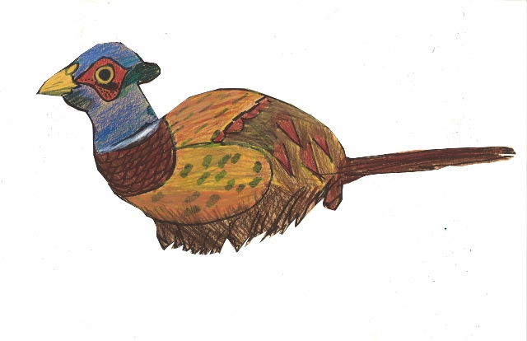
St. Thomas School Bird Drawings
by Hannah Salia
In conjunction with the Birds of a Feather exhibition at Tempe Center for the Arts

Slide 2
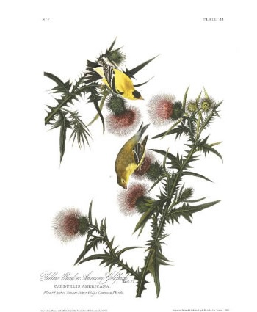
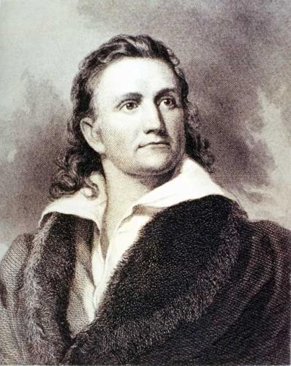
Who was John James Audubon?
John James Audubon American Goldfinch, illustration from “Birds of America”, 1827

Slide 3
John James Audubon (1785-1851)
American artist, naturalist and scientist.
Audubon is best known for his paintings and illustrations of animals, especially birds. He was born in Haiti (his father was a plantation owner) and later lived in France before emigrating to the United States. He traveled much of the new nation from the east coast all the way to Texas.
Audubon was also a self-taught scientist and is responsible for the discovery of 25 new species and 12 new sub species of birds in his day. He spent eighteen years of his life on his book “The Birds of America” which included 435 illustrated images.
John James Audubon Barn Owls, illustration from “Birds of America”, 1827

Slide 4
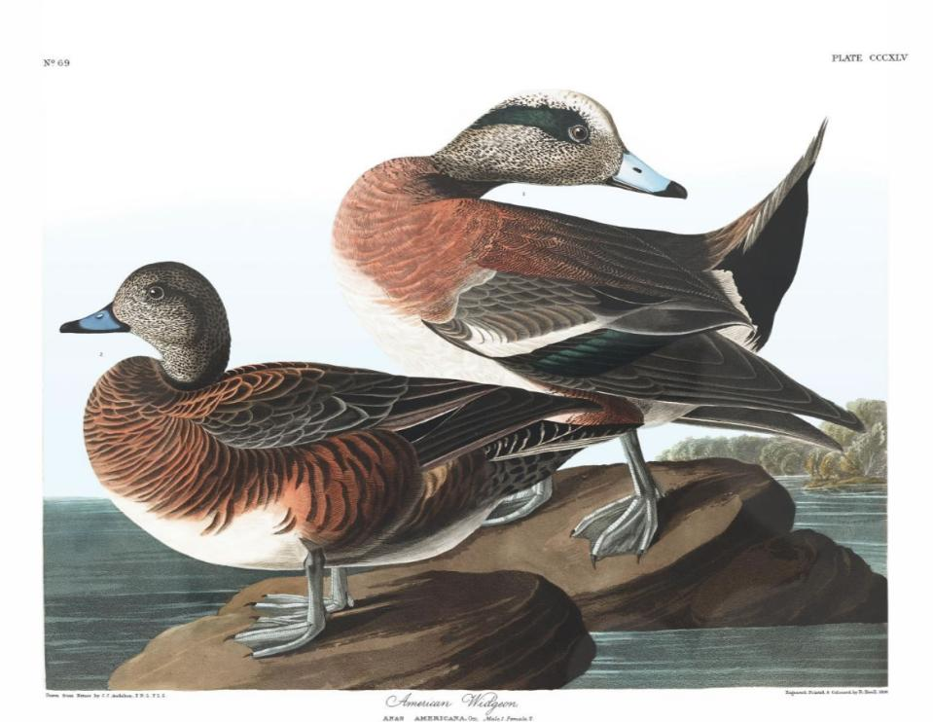
Today, the National Audubon Society, named after the artist is one of the largest environment conservation organizations in the nation. Across the U.S. there are 47 Audubon centers and more than 450 local chapters.
John James Audubon American Widgeon, illustration from “Birds of America”, 1827

Slide 5
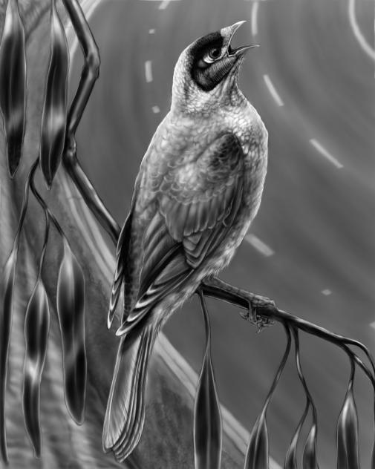
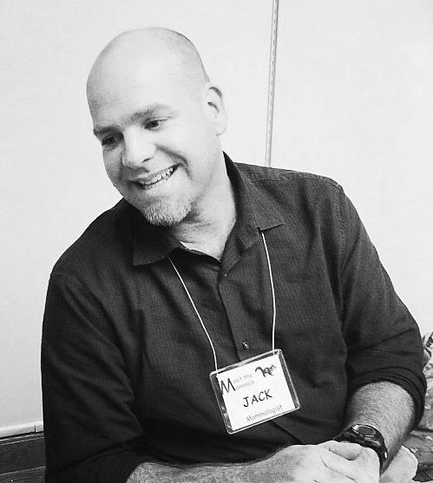
Who is Jack DeLap?
Jack DeLap Noisy Miner
digital drawing print

Slide 6
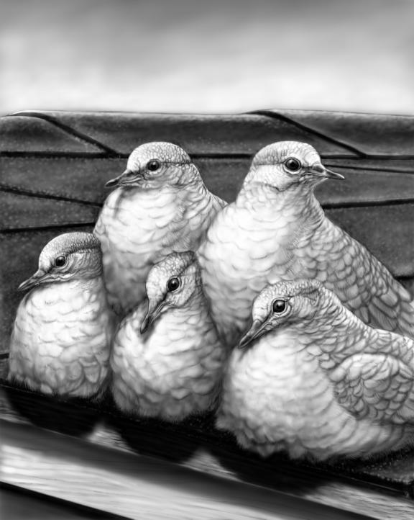
Jack DeLap, Seattle, WA
DeLap is a contemporary artist who was born and raised in Corona del Mar, CA. His interest in drawing birds and wildlife began at an early age. He spent much of his free time birding the local grasslands and marshes. He says “I produce images in various media including graphite, pen, ink, acrylic and oils. But the current work in its final form was created freehand using a digital tablet and stylus. My process involves field sketches, museum specimens and photographs to create an original composition that aims to capture aspects of the species’ natural history and physical form.” www.jackdelap.wordpress.com
Inca Doves Pyramiding to Stay Warm
digital drawing print

Slide 7
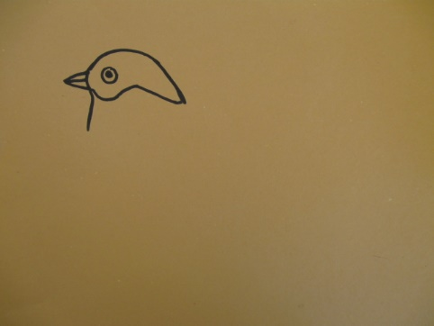
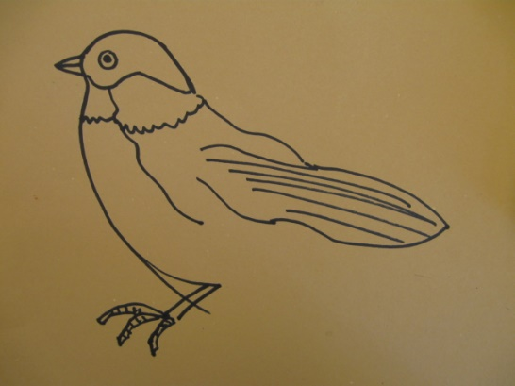
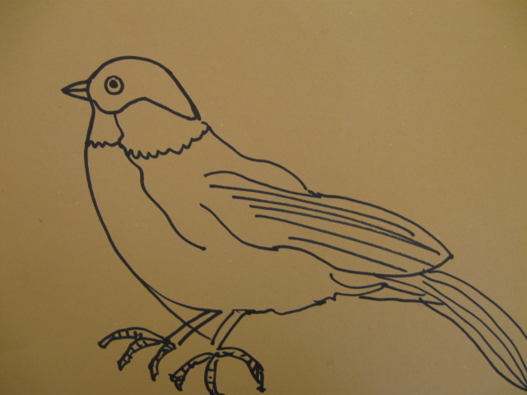
Drawing sample in process

Slide 8
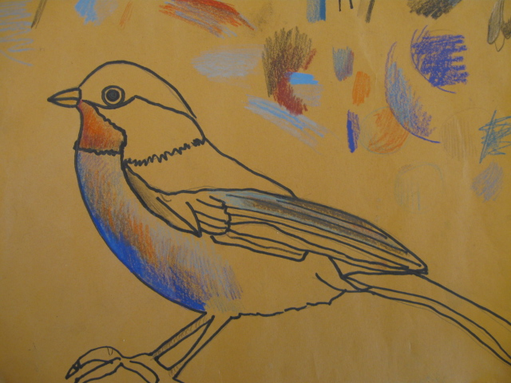
Colored pencil sample in process.

Slide 9
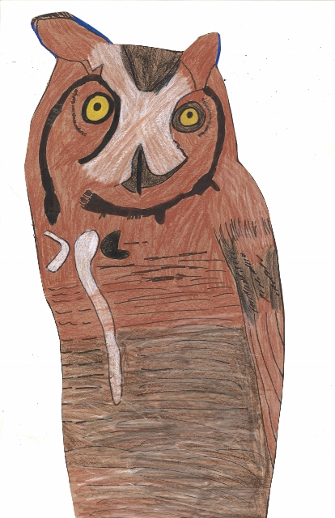
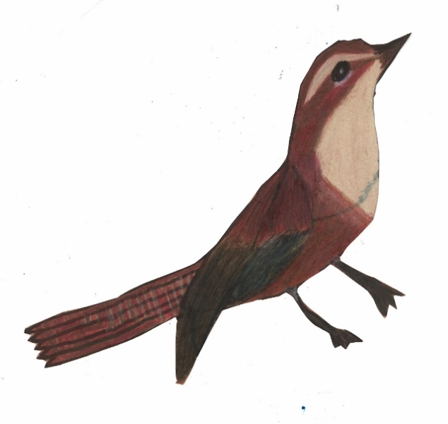
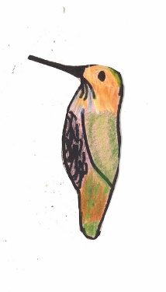
Completed student work.
Notes:
Lynette: Thanks, John and Athena, for sharing these lessons with us! Now, let’s hear Bryent explain how I teach the William Morris lesson.

Slide 10
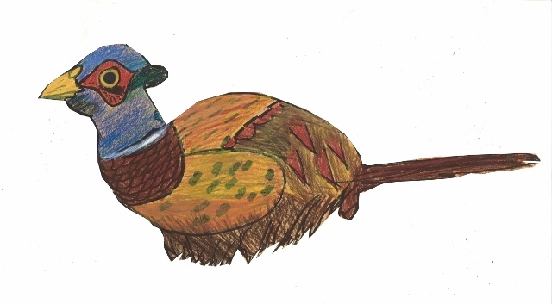
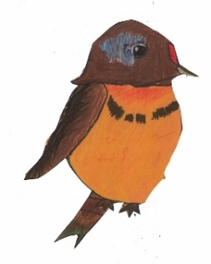
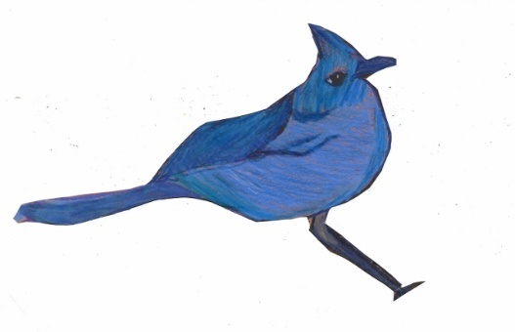
More completed student work.

Slide 11
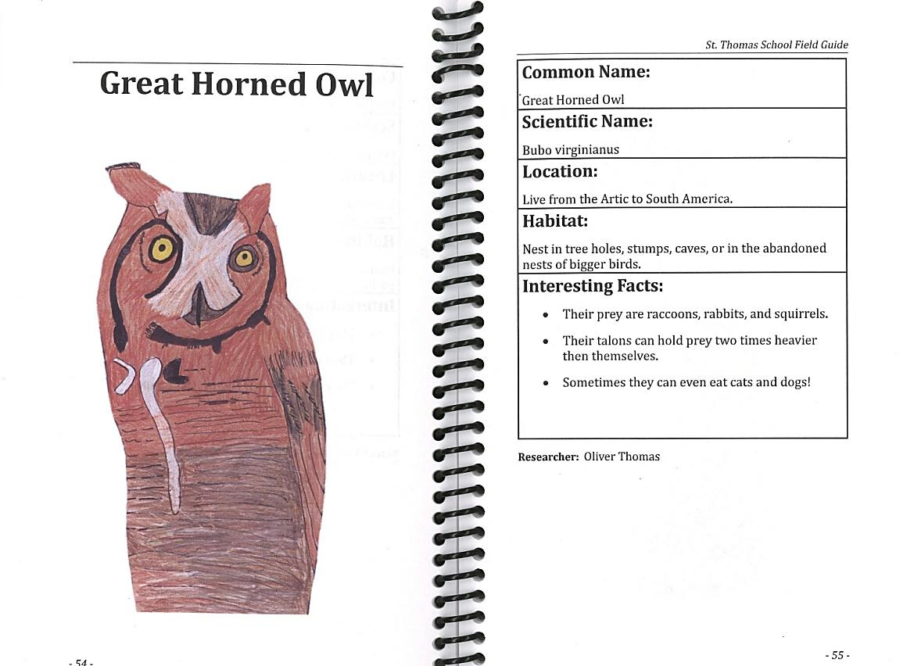
Example of 3rd grade student field guide.
Notes:
Lynette: Thanks, John and Athena, for sharing these lessons with us! Now, let’s hear Bryent explain how I teach the William Morris lesson.

Slide 12
Example of 3rd grade student field guide.

Slide 13
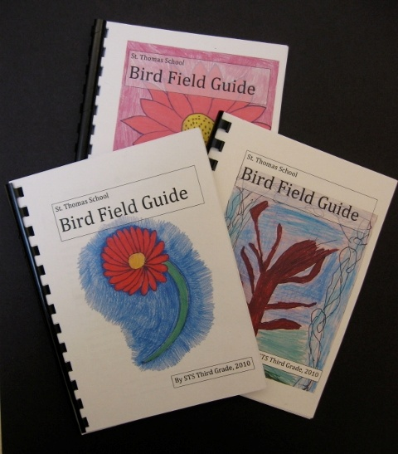
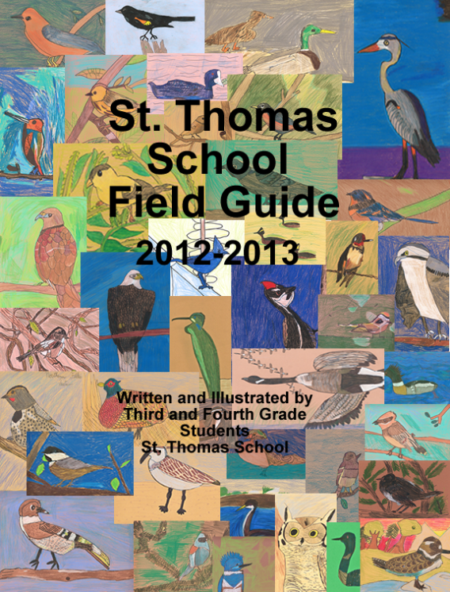
St. Thomas School Field Guides
Pacific Northwest Native Birds and Plants
Notes:
Lynette: Thanks, John and Athena, for sharing these lessons with us! Now, let’s hear Bryent explain how I teach the William Morris lesson.

Slide 14
Thank you:
Teacher Hannah Salia National Audubon Society Artist Jack DeLap Faculty and 3rd grade students at St. Thomas School, Medina WA

