Slide 1
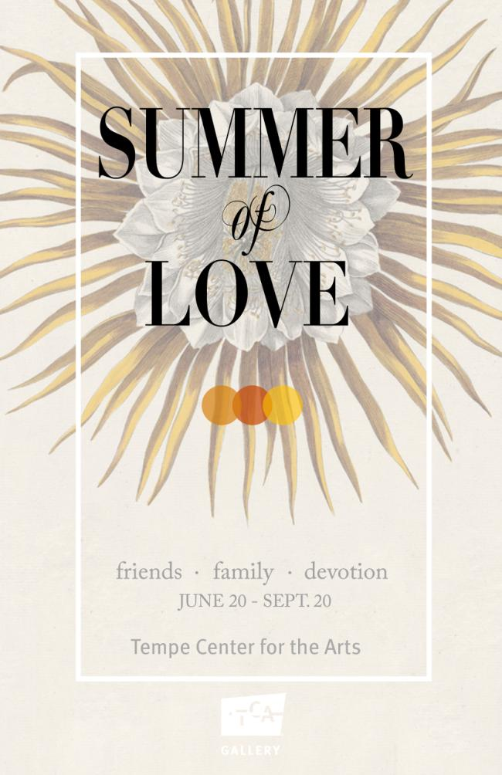
Exhibition Preview

Slide 2
The Gallery at the Tempe Center for the Arts honors the many faces and aspects of love with the exhibition, Summer of Love: Family, Friendship and Devotion.
The exhibition features colorful and endearing artworks about love created by local and national artists, the exhibition includes ceramic sculptures, botanical prints and drawings, original children’s book illustrations and contemporary paintings and installations. Summer of Love also showcases historical and contemporary displays about symbols of love from the Schilling Library at Desert Botanical Garden, Arizona Museum of Natural History, Tempe History Museum and Bobbie’s Flowers of Tempe.

Slide 3
Artists: Marco Albarran Gene Almendinger, Denise Currier, Esmeralda Delaney, Wendy Hodgson, Molly Idle, Sandra Luerhsen and Frank Ybarra. The exhibition also features teen artworks by Tempe-based students including Natalie Benjes, Eva Marino and Samantha Park from Desert Vista High School; Lenai Brown, Esther Cheng and Leeza Jordan from McClintock High School; Ashleigh Heinz, Sadera Nye and Anna Stadmiller from Corona del Sol High School; and Angela Cardoso-Silva, Julia Lira and Tamaki Mutsumoto from New School for the Arts and Academics.

Slide 4
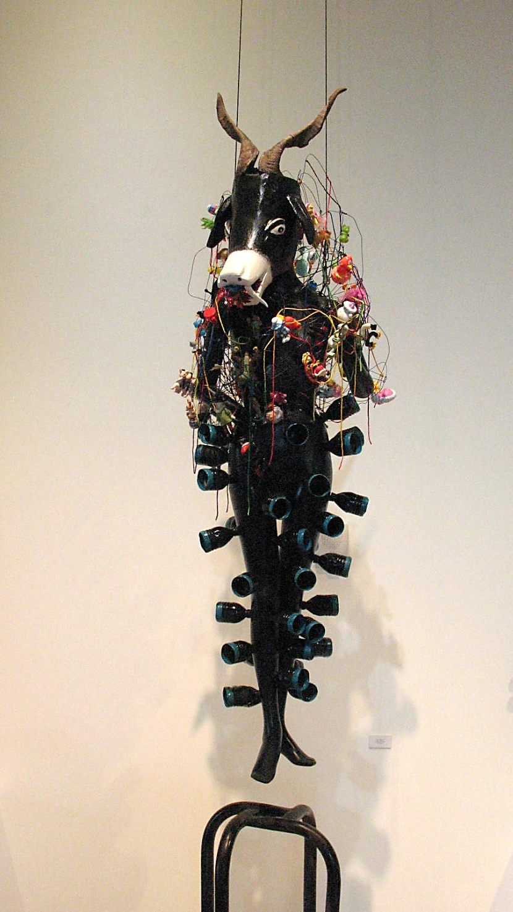
Marco Albarran
Commercial Break
mixed media

Slide 5
Marco Albarran, Tempe
Albarran was born in Mexico and later grew up in Yuma, AZ. Some of his earliest memories are about the stories and cultural traditions passed on to him and his siblings by his grandmother. He was also fascinated by the traditions passed on by generations of his indigenous ancestors such as corn field blessings, food offerings during Dia de los Muertos (Day of the Dead).
Albarran says the love of his family and culture was and continues to be the “fuel” for his art. Many of his artworks reflect multiple points of view, because as he says “knowledge does not belong to any one person, but everyone.... In the piece ‘Commercial Break,’ I bring together stories about duality from both Mayan and Hindu mythology. www.marcoalbarran.com

Slide 6
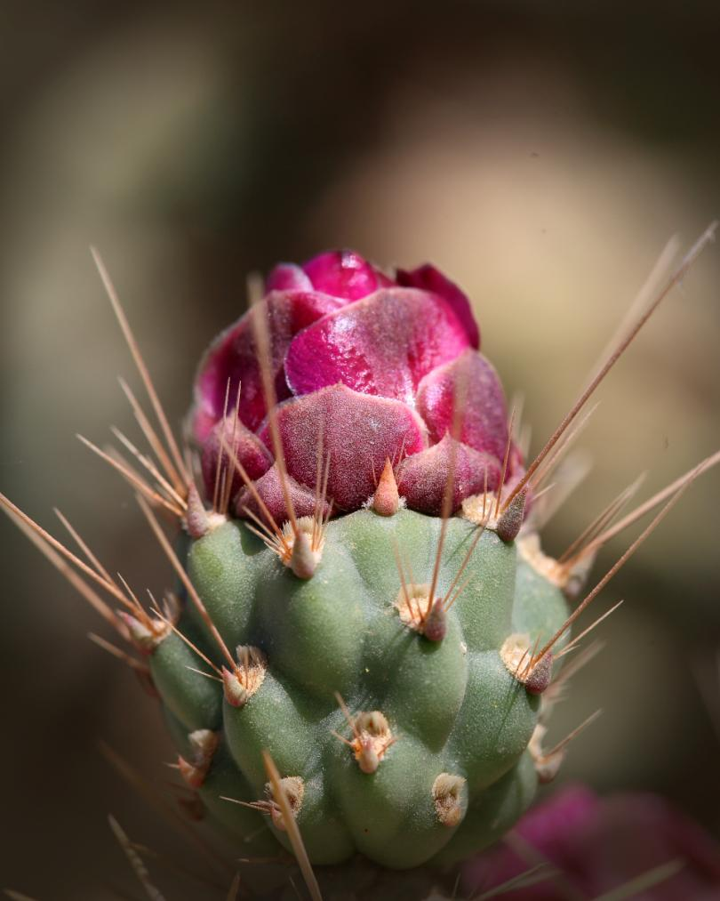
Gene Almendinger
Cholla, Cylindropuntia species
photograph

Slide 7
Gene Almendinger, Tempe
Almendinger lived the first 40 years of his life in the Minneapolis-St. Paul, MN area. As a youth, he was always interested in science. In 1980, he graduated from the University of Minnesota with a degree in electrical engineering. This task took him nine years to complete by going to school and working full time.
In 1981, Almendinger started working for Motorola in Arizona. There, he met another engineer who mentored his interest in photography. Encouraged by his mentor, he joined the Photographic Society of America (PSA). Also, soon after moving to Arizona, he entered a photography contest at the Desert Botanical Garden (DBG), where he met a very spirited volunteer who persuaded him to become a docent. Now, he leads tours of DBG and interprets the desert environment to visitors.

Slide 8
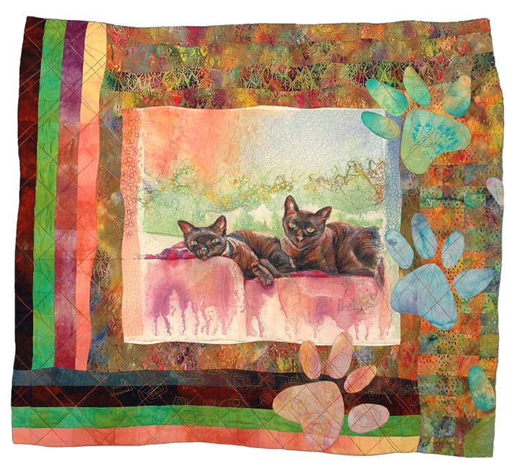
Denise A. Currier
Katz Cats
multimedia fiber quilt

Slide 9
Denise A. Currier, Mesa
Currier has lived in Mesa for more than thirty years. She started sewing at a young age and has been interested in fiber work ever since. She is also an accomplished graphic designer and over the years has worked on clothing ads and commercial window displays. Many of Currier’s quilts relate to her own loves of family, animals and nature. She is also an artist that likes the art making process as much as the end product.
Currier says: “Art seems to find me in a place of defined, self-taught creative play. I select themes inspired by everyday activities and images that fit into a series of dimensional art forms…. If I am happy with the journey and the final outcome, then I have accomplished success; I’m always adrenalized and excited about the next ARTrageous project!”
www.DeniseACurrier.com

Slide 10
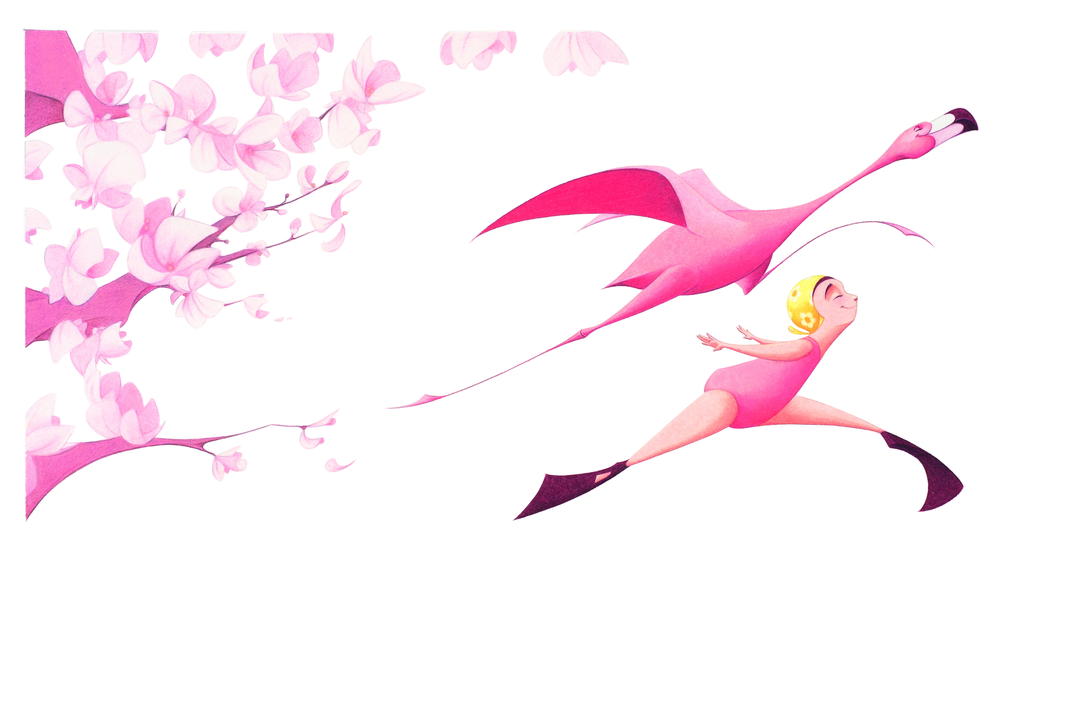
Molly Idle
Leap! (from the book Flora and the Flamingo)
Prismacolor pencil on Bristol paper

Slide 11
Molly Idle, Tempe
Idle began drawing at a young age. Upon graduating from Arizona State University with a Bachelor of Fine Arts in drawing, Idle accepted an offer to work for DreamWorks Feature Animation Studio as a final line animator. After five years, a number of film credits, and an incredibly good time, she left the studio and leapt into the world of children's book illustration. She now lives in Arizona with her husband, two sons and three cats. When not making mischief with her boys, or watching old black and white movies with a cat in her lap, Idle can be found at her desk scribbling away a plethora of profoundly whimsical projects.
“My illustrations and stories are inspired by relationships. As an illustrator I’m intrigued by relationships between shapes and lines, and interactions between colors. In my picture book, ‘Flora and the Flamingo,’ Flora and her graceful flamingo friend explore the trials and joys of friendship through an elaborate synchronized dance.
www.Idleillustration.com

Slide 12
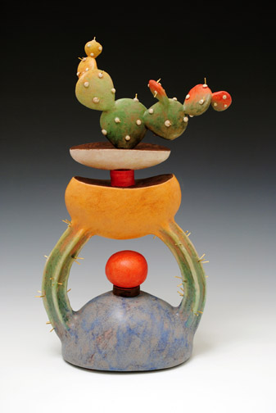
Sandra Luehrsen
Echinos Florum
earthenware, glazes, metallic luster, nichrome wire

Slide 13
Sandra Luehrsen, Tempe
Luehrsen was born in Chicago, Ill. Her ceramic art can be found in both national and international collections such as the Auckland Institute and Museum in New Zealand, the ASU Art Museum’s Ceramics Research Center, the Kamm Teapot Foundation in Sparta, NC.
Luerhsen describes her latest sculptures as inspired by her love of the southwest landscape and desert botanicals in particular. She says: “I came from Chicago to this wild place, Arizona, for a new beginning. I didn’t expect it but the exotic flora fascinated me right from the start. Inspired by the desert, I use red earthenware clay to create my own hybrids. At least two parts comprise many of my sculptures. They have a container and a plant. I blur the lines between the two; the container becomes the plant and the plant morphs into the container.
www.Sluehrstudios.com

Slide 14
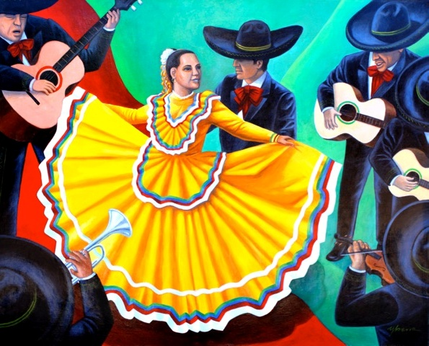
Frank Ybarra
Baila!
acrylic on canvas

Slide 15
Frank Ybarra, Phoenix
Ybarra studied graphic design at Arizona State University, but, left school to become a graphic designer. Today, he splits his time between freelance projects and creating studio prints and paintings.
Having grown up on the east side of Phoenix, Ybarra frequently uses personal memories from his childhood as subject matter. He also uses bright, bold colors in his compositions that are rooted in traditional Hispanic art and Americana.
Ybarra says “Art has always been a love of mine. Therefore my art depicts our desert lifestyle as well as family memories, traditions, and my Mexican cultural background. The art in this exhibition features Mexican folklorico dancers, which are reminiscent of my parent's lives, as well as every day life events that we sometimes take for granted. My family was always very supportive of my interests. I thank them for their love and support.”
www.Ybarraart.com

Slide 16
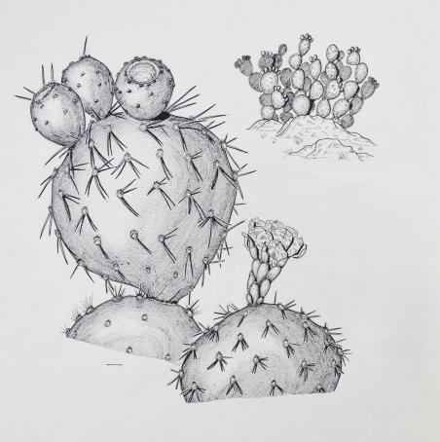
Wendy Hodgson
Prickly Pear
ink drawing
Loan courtesy of Arizona Natural History Museum, Mesa

Slide 17
Wendy Hodgson, Phoenix
Hodgson is Herbarium Curator, Research Botanist and botanical illustrator at the Desert Botanical Garden (DBG) in Phoenix, where she has worked for nearly forty years. Her area of research is floristics (a branch of botany that studies plants in specific regions) of the southwest United States and northern Mexico. She is especially interested in rare and native plants of Arizona.
Hodgson says “In a world where many of our senses have to continually be bombarded by bigger and brighter, I love the subtlety of desert plant beauty. They thrive under conditions that most plants would wilt in. They have evolved beautifully with our desert environs, and we need to stop and look at them for what they are, their tenacity and amazing beauty (along with all the critters that are associated with them).”
www.dbg.org

Slide 18
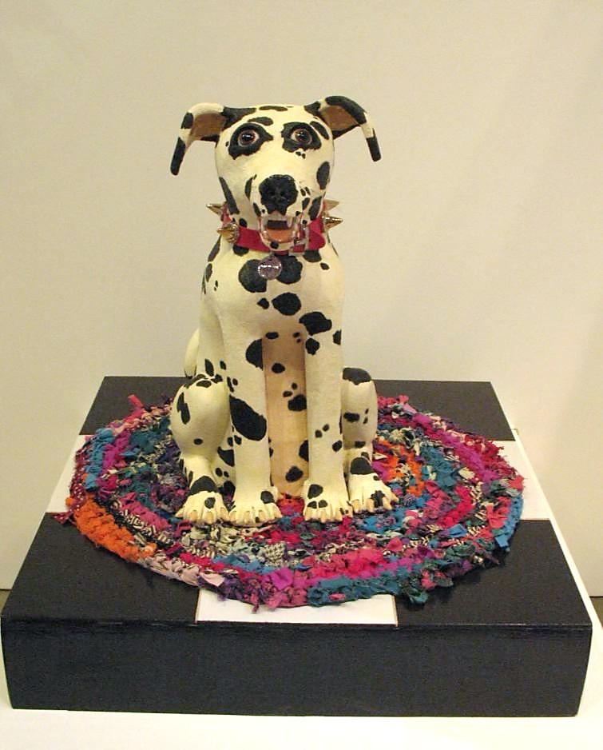
Esmeralda Delaney
Seurat
ceramic

Slide 19
Esmeralda DeLaney, Phoenix
Delaney has been creating art in clay all of her life. When not creating artwork, she has been an active teacher and workshop instructor at both the high school and college level. Currently she is a residential faculty member at the art department at Glendale Community College.
Delaney has been involved in numerous exhibitions both locally and nationally such as the Ceramics Research Center at the ASU Art Museum, Bragg’s Pie Factory and Halle Heart Center in Phoenix and Obsidian Gallery in Tucson. Her work is also part of collections such as the Portland Museum of Art in Maine and Sky Harbor Airport Museum in Phoenix.
Delaney says “My work is a mixture of humor and satire reflecting on the love one feels for their pets: their quirks and adoration they show us day-to-day.”

Slide 20
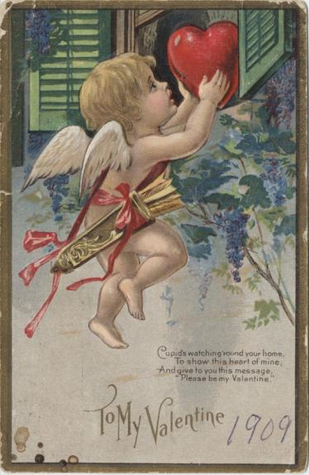
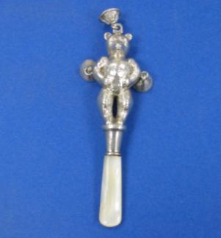
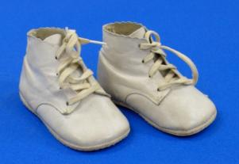
Photograph of Governor Howard Pyle and Family, circa 1950s
Historic Valentine Card, circa 1909 Baby Rattle & Boots
Loans courtesy of Tempe History Museum

Slide 21
Tempe History Museum
The Tempe History Museum is a center where the community comes together to explore Tempe’s past, share its present and imagine its future. The museum explores Tempe’s identity and builds connections between residents and their community. It seeks to provide insights for people making decisions relevant to contemporary and future life in an ever-changing society. The museum works together with Tempe’s diverse residents to preserve and tell their stories. The historical items on display in the Summer of Love exhibition depict family life and the mementos left behind by previous Tempe residents. The artifacts were hand selected by curator of collections Joshua Roffler.
www.tempe.gov/museum

Slide 22
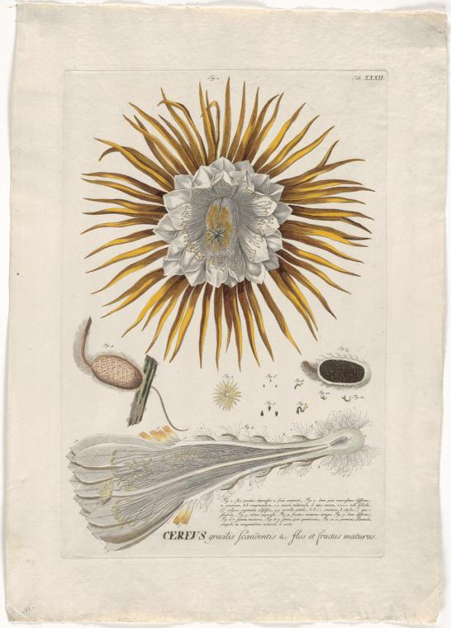
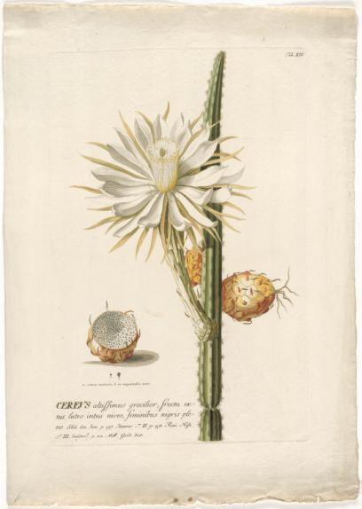
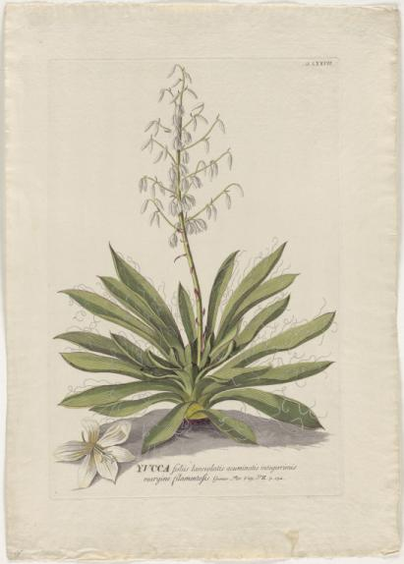
Queen of the Night Cereus gracilis
Queen of the Night Cereus altissimus gracilior
Yucca Yucca folüs lanceolatus
Hand Colored Engravings by Georg Dionysius Ehret
Published in: Plantae Selectae, by Christoph Jacob Trew
Augsburg, Germany, 1750-1773
Loans courtesy of the Schilling Library Archive at Desert Botanical Garden, Phoenix

Slide 23
Schilling Library Archives, Desert Botanical Garden
These illustrations represent work from the golden age of botanical art (1750-1850). The Schilling Library is an archive for a special collection of botanical art and rare books about desert plants. The library’s core collection of botanical books and journals supports the educational and research activities of the staff, volunteers, members and visitors of the Garden.
www.dbg.org

Slide 24
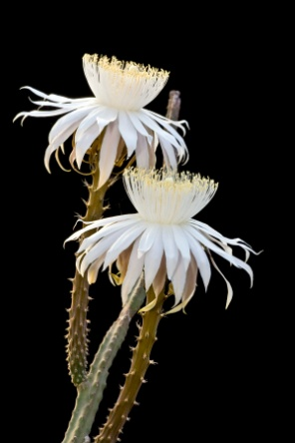
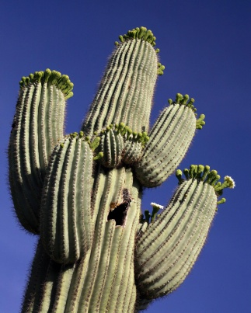
Desert Botanicals with Meaning People all over the world have always turned to their local plants for food, fuel, shelter, tools, music, games, medicine and art. From generation to generation, the people of the Sonoran Desert continue to find and pass on knowledge about these useful plants through story, song, ceremony and study. Examples include:
Arizona Queen of the Night Cactus: This cactus has thin, breakable, dead-looking stems and tends to grows unnoticed under bushes. Each of its huge, dramatic, white flowers appear for one summer night only. Cosmeticians have captured the essence of its strong scent in eau de parfum, bath and shower gel and hand and body lotion. People also collect its big, turnip-shaped root for use in medicine and food.
Saguaro: The waxy, white saguaro blossom is the Arizona State Flower. By law, only members of the Tohono O’odham tribe may harvest the ripe saguaro fruit growing on public lands. The nutritious fruit may be peeled and eaten fresh, or dried, or its juice boiled down into a syrup to make jam, drinks, and candy. Some of the syrup is fermented for ceremonial use to welcome the arrival of rain. The seeds are dried and made into cakes or ground into flour.

Slide 25
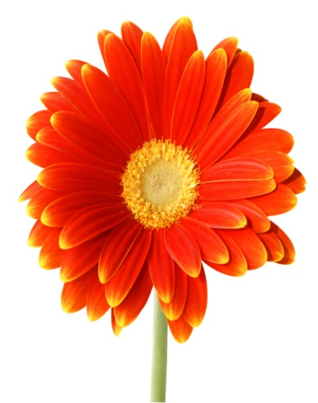
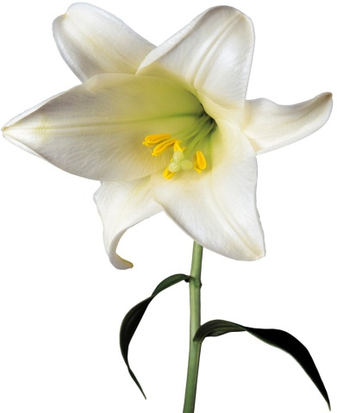
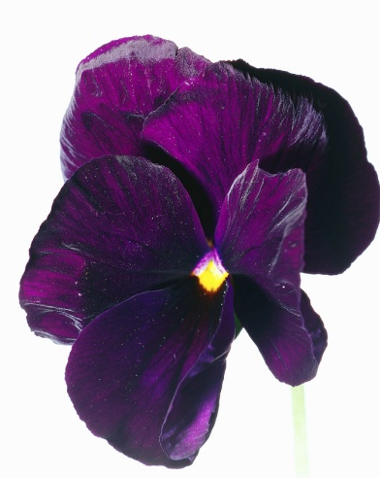
Victorian Flower Symbolism Plants and flowers have been used for food, medicine and ritual by people for thousands of years. In the mid 19th century, women and men alike found joy in the expression of love through flowers. Examples include:
Red Rose Romantic Love
Gerber Daisy Happiness
White Lily Innocence
Violet Faithfulness

Slide 26
Thank You
Arizona Natural History Museum
Bobbie Flowers of Tempe
Schilling Library at Desert Botanical Garden
Tempe History Museum

