Slide 1
ANIMAL CRACKERS
Exhibition Preview

Slide 2
The Tempe Center for the Art’s (TCA) 2013 summer family exhibition features fun and colorful works created by local and national artists that celebrate wild animals from across the world, the indigenous animals of Arizona and the pets we call friends. The title is inspired by one of America’s favorite cookies and has been synonymous for more than 100 years with children and good ole’ fashion fun.

Slide 3
ARTISTS
Barbara Burton
Anne Coe
Jeff Falk
Dick George
Christopher Jagmin
Carolyn Lavender
Christy Puetz
Joe Ray
Lauren Strohacker
Featuring photographs and animal paintings from the Phoenix Zoo.
Artists not shown in this presenation:
Luis Jimenez, Jane Rosen and Samuel T. Troxell

Slide 4
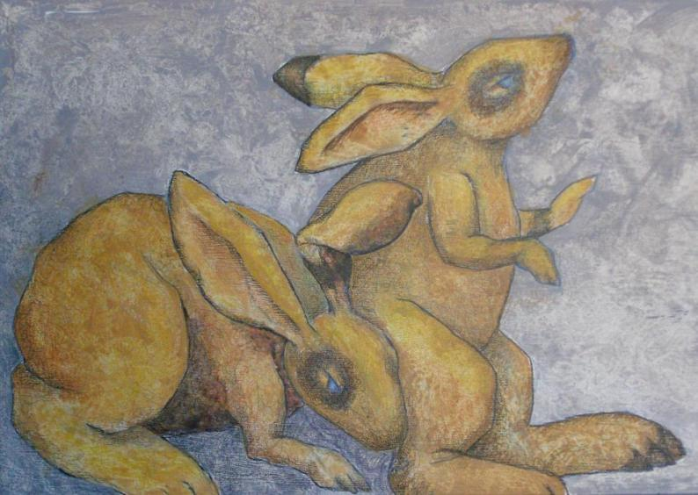
Barbara Burton
Detail of Corporate Training Center
acrylic and mixed media on cabinet door

Slide 5
Barbara Burton, Mesa Burton grew up in Pennsylvania and Connecticut and spent the majority of her youth running around fields and forests, picking wild blackberries, chasing pheasants and building tree forts. Burton earned a Bachelor of Science degree in Engineering from Arizona State University, but creating art is her passion and has been a lifelong pursuit.
“One time, to cheer me, someone bought me a pet rabbit. My only exposure to rabbits as a child was chasing them around fields in Pennsylvania.
“My rabbit hated me. People have explained to me that he probably just wasn’t socialized correctly. Still, I tried for over a year to bond with ‘Bunny.’ I spent hours trying to feed him goodies from my hand and chat with him. He eventually went to live with a friend who ‘understood rabbits.’ “I didn’t remember that episode until someone asked me why rabbits figured so prominently in my work. There’s no connection between the characters in my pieces and real live rabbits. In fact, sometimes I’m not sure I view them as rabbits.

Slide 6
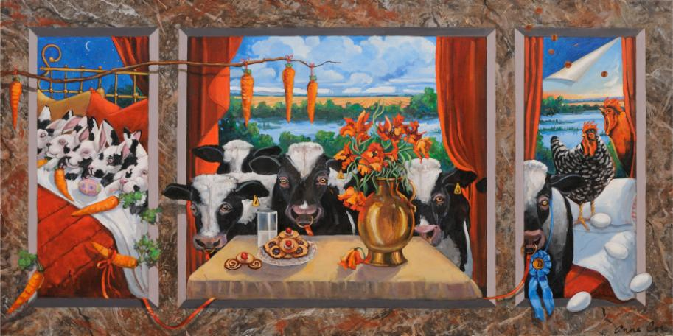
Anne Coe
Henny Penny the Sky Is Falling In
acrylic on canvas

Slide 7
Anne Coe, Apache Junction Coe is a fourth generation Arizonan and was raised on a ranch. She studied in both Europe and Latin America and earned bachelors and masters degrees from Arizona State University.
Coe has combined her artistic endeavors with involvement in environmental activism. She has focused her efforts on everything from the re-introduction of the Mexican wolf to the protection of thousands of acres of state land. Coe currently serves on the Board of The Superstition Area Land Trust, The Trust for Public Lands and the State Land Conservation Advisory Board.
“These works belong to a series I have been painting on memories and the way our mind accesses and manipulates them. ‘Henny Penny’ is basically a stream of consciousness narrative both ancient and contemporary. It is about the pleasures and comforts of life, shadowed by the basic fear of the end of all things. Most importantly, these works reflect my love and affection of all creatures.”
www.annecoe.com

Slide 8
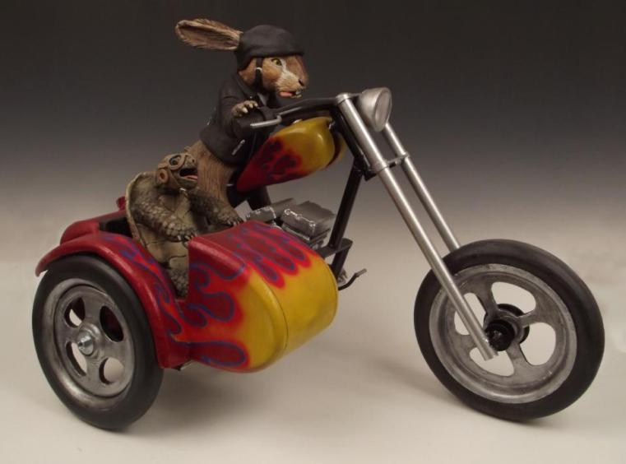
Jasen Evoy
The Tortoise and the Hare
mixed media

Slide 9
Jasen Evoy, Gilbert
Evoy is an Arizona native. He attended Corona del Sol High School where his art teacher, Carolyn Lavender (also in the exhibition), inspired him to challenge himself and develop his skills. He received an Associate of Arts degree in general studies from Mesa Community College and bachelors and masters degrees from Arizona State University. Ceramics eventually became his medium of choice, but painting still helps him in the completion of his sculptural works. Evoy has taught ceramics and art history at Marcos de Niza High School for more than 15 years and is currently the chair of the Fine Arts Department.
“I have always been very passionate about art. I used to paint quite a bit, and my paintings were always very serious; there was no humor, no puns, no play on words. For some reason, when I work in clay, I don’t feel the same need to be serious. As a result, my personal choice of subject matter has migrated to creating outrageous sculptures of animals in very unlikely scenarios. In these works, I am trying not to take myself too seriously and trying to connect with viewers through humor and surprise.”

Slide 10
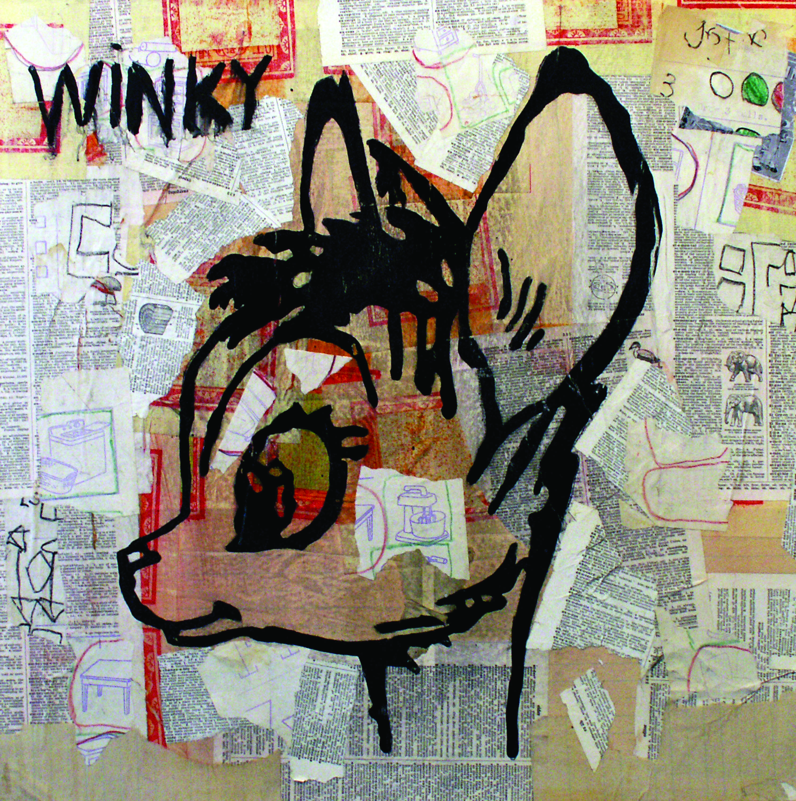
Jeff Falk
Winky
mixed media

Slide 11
Jeff Falk, Phoenix
Falk is a long-time Valley resident and artist and has seen first-hand the growth of the city and the art scene. He has studied art at Glendale Community College, Arizona State University and Phoenix College and has shown his work in more than 200 exhibitions in the United States, Canada and Mexico. Falk works in mixed media and finds inspiration from his experiences, especially those from childhood. Other influences include the post modernists of the late 1950s and early 1960s.
“My work in this show reflects the influence that animals have had on my life. Two of the images are from my childhood. One, titled LAIKA, is a remembrance of the Russian space dog who blasted off inside the satellite Sputnik II on Nov. 3, 1957. I have a memory of standing in my front yard, on a cold November night in Kansas, with my father. “The second work is called WINKY. In magazines in the late 1950s there was an ad for the Famous Artists Correspondence School. The instructions said to try and draw, freehand, the image that was in the ad and then mail your drawing into the school.”

Slide 12
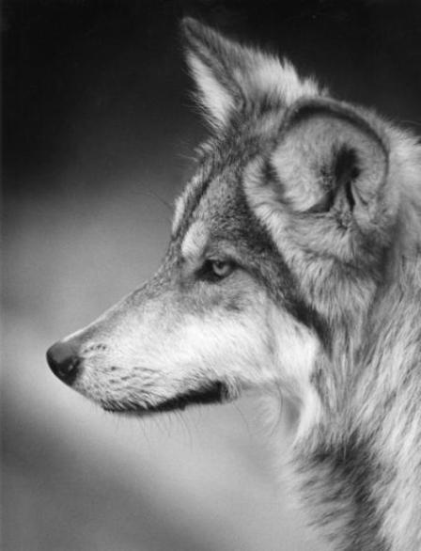
Dick George
Mexican Gray Wolf
photography

Slide 13
Dick George, Tempe
George is a local Renaissance man of sorts. Today he is an active art photographer and a volunteer at Tempe History Museum, but over his lifetime he also worked in a variety of roles including farm laborer, short order cook, jazz drummer, writer, teacher and historian. He earned graduate degrees in both English literature and photography.
For more than 24 years, George worked at the Phoenix Zoo as a writer, photographer and public relations manager. Some of the black and white animal portraits featured in the exhibition depict his long-time animal friends at the Phoenix Zoo.
“As a wildlife photographer, I tried to show viewers the grace and diversity I saw in animals.”

Slide 14
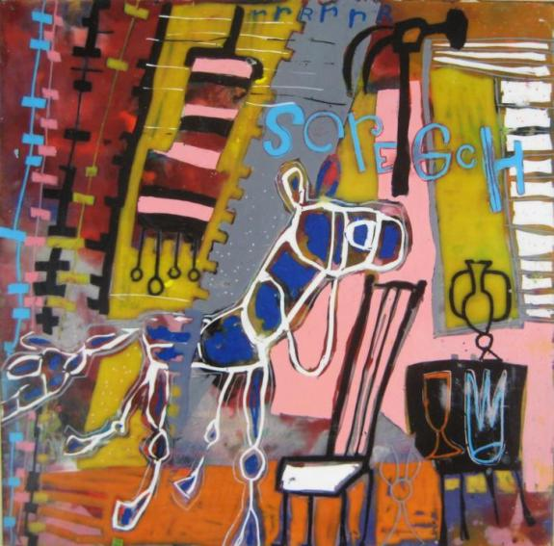
Christopher Jagmin
For Cen’ sis
encaustic and oil on wood

Slide 15
Christopher Jagmin, Phoenix
Jagmin up in South Bend, Ind., very close to the Potawatomi Park Zoo. The buffalo, elephant, tigers and, of course, the monkeys were always his favorites. They all inspired him to bring animals into his artwork. When the weather was nice, he would take his sketchbook and draw these beautiful beasts instead of going home.
Jagmin received a Bachelor of Science degree in fine arts from Indiana University. In his fine art, he focuses a lot of attention on creating encaustic paintings that are a combination of pigments and melted beeswax applied to wood panels.
“I love to tell stories and am influenced by Chinese scrolls, graffiti, Indian miniatures, comic books, along with fables and tall tales. Working with encaustics allows me to add and scrape away layers of wax and oil as I paint. These layers then merge together or form new images. Remnants and suggestions of the ‘discovered’ underlying imagery give an ‘historical’ richness to the work and start to tell a new story.”
www.jagminart.com

Slide 16
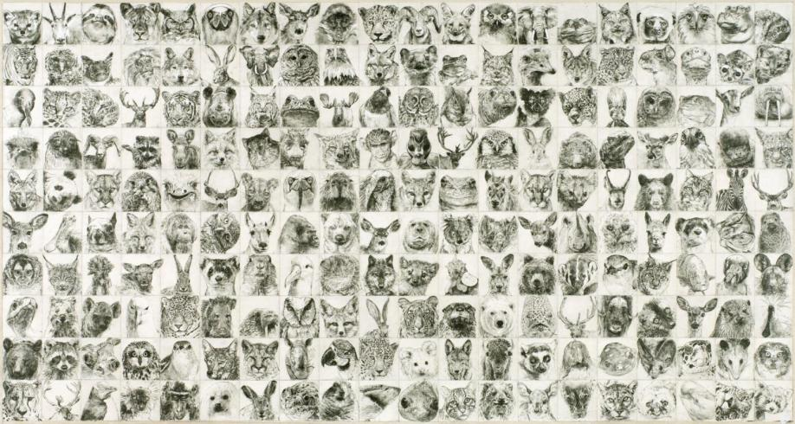
Carolyn Lavender
Portrait
graphite and gouache on canvas

Slide 17
Carolyn Lavender, Phoenix Lavender grew up in Kent, Wash., but her family moved to Arizona in 1977. She earned a Bachelor of Fine Arts degree in drawing and painting at Northern Arizona University and a Master of Fine Arts degree in drawing from Arizona State University. Much of Lavender’s work includes animal imagery such as bears, dogs, cats and wildlife. As a girl she rode horses and drew them often. Her current work features wildlife from the forest and was created through a collaging process with graphite, acrylics and gouache ink.
“It is my intention that animals get the same respect as people. In ‘Portrait,’ I rendered them accurately so that they are portraits of each individual animal. Each animal is making eye contact with the viewer the way people do in yearbook photos. When you stand in front of the piece there are 200 pairs of eyes looking at you. I am trying to advocate for their right to exist in natural spaces, but not with a blatant message.
Learn more about Lavender and her work in an April 2013 interview posted by exhibiting artist Christopher Jagmin at www.cultureseen.com.

Slide 18
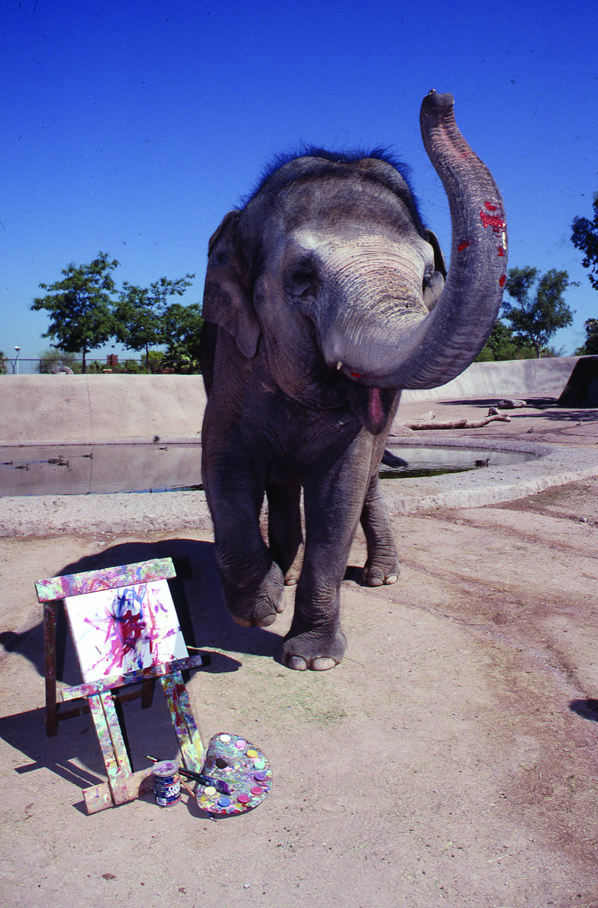
Ruby, the Asian Elephant
Ruby, an Asian elephant, arrived at the Phoenix Zoo in 1974 and quickly became one of its best known residents. Noticing her interest in ‘drawing’ with a stick in the sand, her keepers gave her a paint brush, paint and a canvas.
For more than 20 years, Ruby’s paintings inspired guests to think more deeply about animal behavior, creativity and fun.

Slide 19
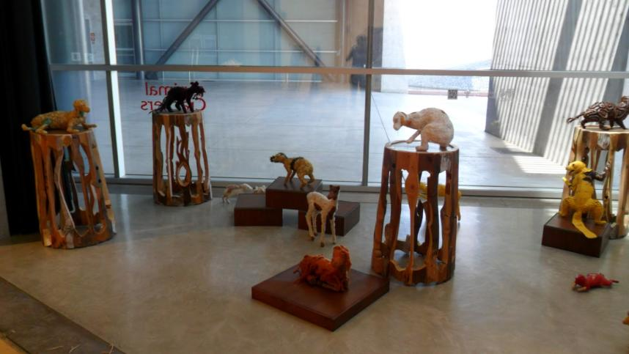
Christy Puetz
Mind Forest
foam, glass, steel, fabric and paint

Slide 20
“The inspired concepts behind my installation entitled ‘Mind Forest’ are based on creatures from around the world and their living environments. The majority of the animals are either lesser known or have unique ways of moving through space, camouflaging themselves or defending themselves when faced with danger.
“My current direction focuses on three dimensional, animal-based forms covered in materials like silk pods, leather, paint, felted wool and glass beads. The animals appear to be frozen and holding their breath, waiting for the viewer to pass by, only to exhale when alone again.”
www.xtyart.com
Christy Puetz, Phoenix
Puetz received a Bachelor of Fine Arts degree in Fiber Arts from the University of North Dakota. As well as producing and exhibiting her artwork around the country, she is involved in the local arts and education community. She is a freelance teaching artist in schools and organizations and currently serves as Program Director and Artist-in-Residence for Beads of Courage, Inc., a non profit organization that creates arts-in-medicine programming for children coping with cancer and other serious illnesses.

Slide 21
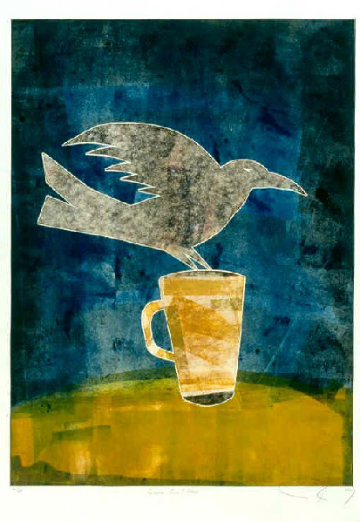
Joe Ray
Cuervo con Coffee
mono silkscreen print

Slide 22
Joe Ray, Phoenix
Ray is a local painter, printmaker, writer and marketing specialist and has been an active member of the local Hispanic arts community since the early 1980s. He was born in Sonora, Mexico, and has lived in Arizona since the age of three. He grew up on the Colorado River Indian Tribes Reservation near Parker and resided there prior to moving to the Phoenix area to attend Arizona State University. Ray’s ongoing work is about identity, spirituality and communication. He often uses recognizable imagery such as roosters, angels, mermaids, Mexican wrestlers and hearts mixed with spontaneous splashes of bright colors to tell stories about love, life and art.
“Birds are messengers. At least ‘bird people’ are, like Plumaje del Cuervo, he's a messenger between God and man, as well as everything in between (earth and sky). However, these messengers aren't always serious. They have a humorous, playful and mischievous side to them.
“The image of a bird by itself is usually a crow or a raven. They're shape shifters. Messengers. Sometimes they need a little coffee to remind them that they are also part human.”
www.joeray.com

Slide 23
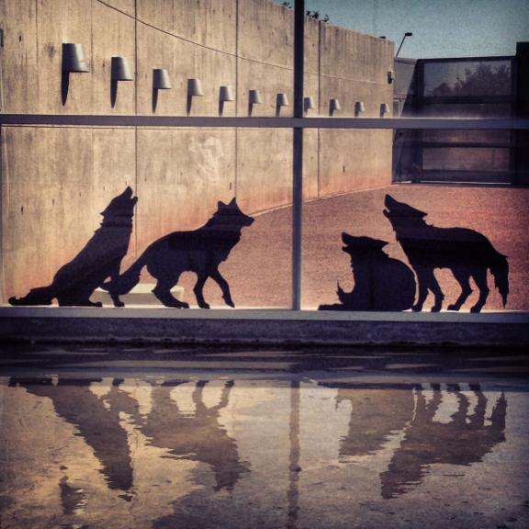
Lauren Strohacker
no(where) now(here)
vinyl installation

Slide 24
Lauren Strohacker, Scottsdale
Strohacker says that even as a child, animals and the “wild” played an important part in her life – so much so that her parents painted an animal mural in her room. She has been a strong advocate for animals and the environment and the ideas have merged into her artwork. In recent years her focus has been on local wildlife such as Mexican Gray Wolves as seen in this exhibition. No(where), Now(here) is an ongoing project she has taken to Flagstaff, Tucson and Tempe. The installations are designed to incite awareness about the Mexican Gray Wolf, which remains an endangered species.
“I layer animal imagery with urban space, creating visual cohabitations. By emphasizing local species with a graphic design aesthetic, my installations serve as a form of advertising for animals. a creative re-introduction to their shape, their size and their disappearance from our everyday. I trust in the words of environmentalist and activist David Brower when he wrote, ‘Truth and beauty can still win battles. We need more art, more passion, more wit in defense of the Earth.’ ” www.animalrevival.org

Slide 25
The Animal Crackers education curriculum unit was made possible by a grant from
Friends of Tempe Center for the Arts

