Slide 1
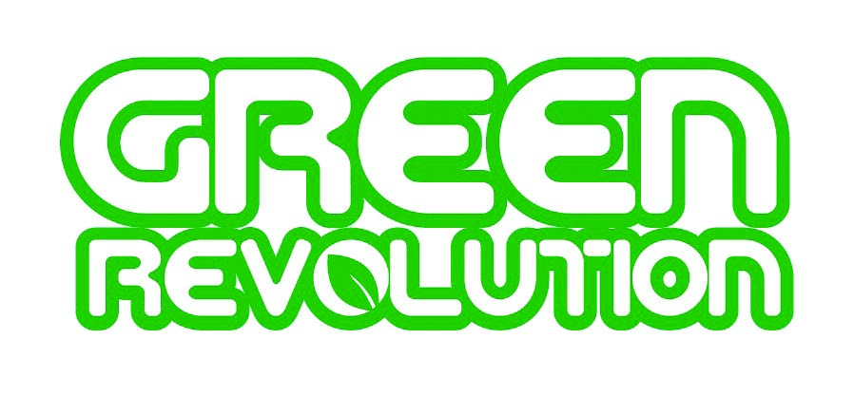



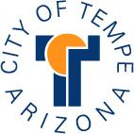

Exhibition Preview

Slide 2
Tempe is one of the lucky few to play host to Green Revolution, a green-themed exhibition from the Smithsonian. This version is based on an exhibition originally created by the Chicago Museum of Science and Industry and its Black Creativity Council and is made available by the Smithsonian Institution Traveling Exhibition Service. The Tempe exhibition is a collaborative project that combines the arts and sciences while teaching community members about “going green” in Arizona.

Slide 3
Artists
Julie Anand, Phoenix
Joan Baron, Scottsdale
Dan Collins, Tempe
Mitch Fry, Scottsdale
Kyle Jordre, Phoenix
Laurie Lundquist, Tempe
Stacy Marko, Tempe
Christy Puetz, Phoenix
Lisa Sipe, Bend, Ore.
Samuel Troxell, Gilbert
Sherrie Zeitlin, Phoenix
The exhibition also features student art by the
2012 Arizona State University Art and Ecology class and
Desert Vista High School painting program.

Slide 4
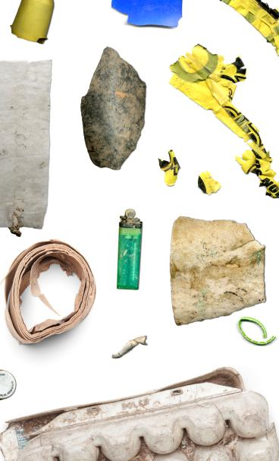
Julie Anand studied ecology,
evolutionary biology and geosciences
at the University of Arizona and received a master of Fine Arts degree in photography at the University of New Mexico. Her Material Histories series was created by taking long walks and gathering artifacts encountered along the way. Some of the items were found on walks along the Tempe canals and sidewalks. Anand photographs
the objects and adds them to a larger collage. Her work in the Green Revolution exhibition is included in a grouping with her Art and Ecology class at Arizona State University.
Railroad Tracks, [9th-10th streets, Tempe, Ariz.]
archival inkjet print on bamboo paper

Slide 5
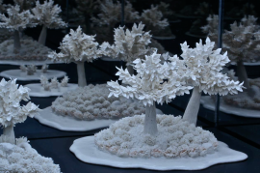
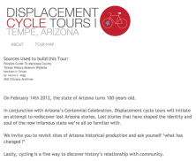
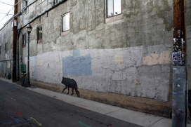
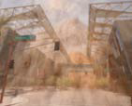
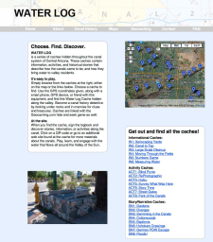
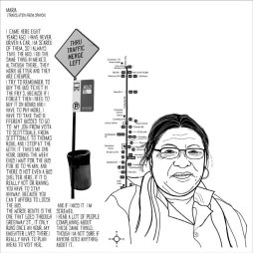
Art & Ecology, ASU
This display includes works created in 2012 in conjunction with in an Art & Ecology course at Arizona State University led by associate professor of photography Julie Anand which was developed with fellow School of Art professor and art historian, Dr. Claudia Mesch.
In addition to readings, field trips and slide lectures on artists who engage with environmental issues, artists respond with self-directed independent projects. Today all of these artists have finished degrees at ASU and are working on their own careers.
Artists: 1) Christopher Torres, 2) Matthew Garcia, 3) Lauren Strohacker, 4) Sean Deckert, 5) Nic Weissinger and
6) Teresa Miró.
1
2
3
4
6
5

Slide 6
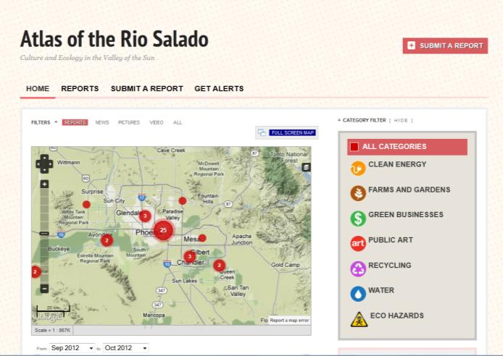
Dan Collins is currently Professor of Intermedia Studies at ASU, Co-Director of the Deep Creek summer art program and Co-Director of the PRISM Lab, an ASU Partnership for Research in Spatial Modeling. Collins said of his work, “I wanted to create a true ‘participatory map’ that captured the aspirations, struggles and successes of individuals and groups who are working to develop a more sustainable urban environment. The resulting map, ‘Atlas of the Rio Salado,’ is an evolving portrait of our shared landscape.”
http://riosalado.crowdmap.com

Slide 7
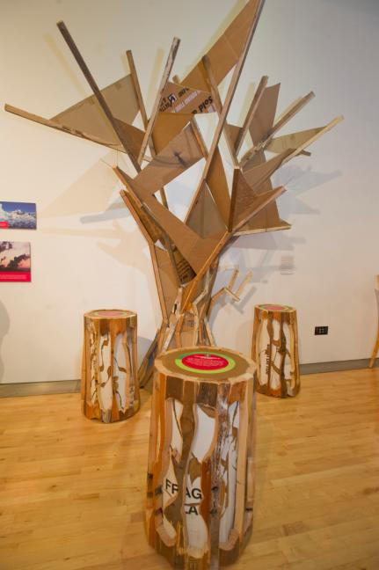
Mitch Fry’s interest in art began at an early age. His father was a professional artist and his proximity to Chicago enabled him to take classes at the Art Institute. Today, Fry works as an artist as well as a designer and manufacturer of commercial and retail furnishings.
“In my art, repurposed and recycled materials always have been at the forefront of my vision and a deciding factor in my material choices.
www.mitchfry.com
Photo by Michael Ging

Slide 8
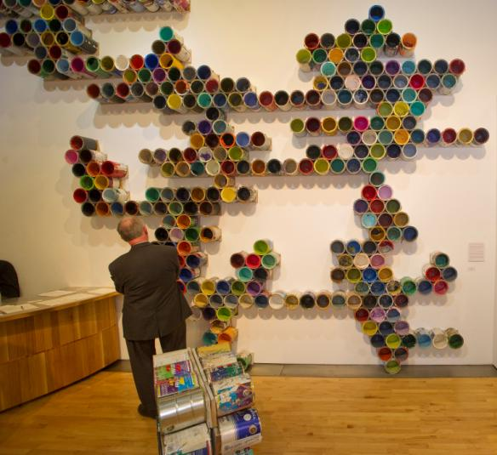
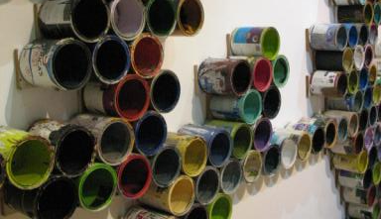
Kyle Jordre began his career and spent almost 10 years as a middle school social studies teacher. He eventually sought a career change. It was while renovating his house that he discovered the possibilities of being an artist. He needed a piece of art for his walls, so he painted one himself with some leftover paint. The experience took him and his career in a new direction.
“I consider myself a green artist, using the ‘oops’ paint (paint that has been mis-tinted) from paint and hardware stores, as well as old paint buckets, lids and stirrers.”
Photo by Michael Ging

Slide 9
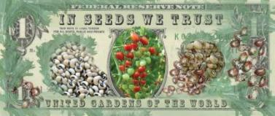
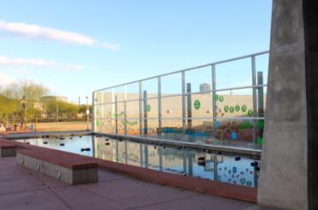
This collaborative installation was created by artists Joan Baron and Laurie Lundquist. Both are active artists and environmentalists, and the two have shared a friendship and creative bond for several years.
In Seeds We Trust is an installation that invites viewers to consider seeds as important forms of currency. The team partnered with Native Seeds/SEARCH in Tucson, a seed bank and learning center dedicated to the preservation and promotion of the greater Southwest's agricultural heritage.
“Planting seeds is a universal act. The resulting plants play a major role in maintaining biodiversity and balance within our ecosystems. Seed saving and sharing provides us with a potent connection to a fresh, seasonally grown, healthy
food source.”
www.joanbaron.com
www.laurielundquist.com

Slide 10
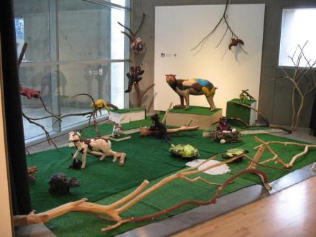
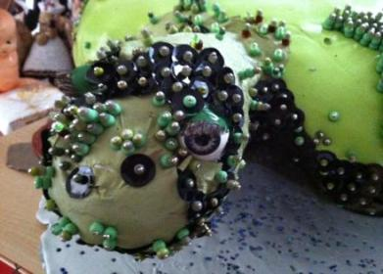
Mind Forest Installation (and detail)
foam, glass, steel, fabric and paint
Christy Puetz
“The inspired concepts behind my installation, entitled ‘Mind Forest,’ are based on creatures from around the world and their living environments… . The work is very tactile, colorful and engaging. My animal-based forms are covered in materials like silk pods, leather, paint, felted wool and glass beads. The artificial forest is covered in Astroturf with many twisting tree branches… . The animals appear to be frozen and holding their breath, waiting for the viewer to pass by, only to exhale when alone again.” www.xtyart.com
http://influxaz.com

Slide 11
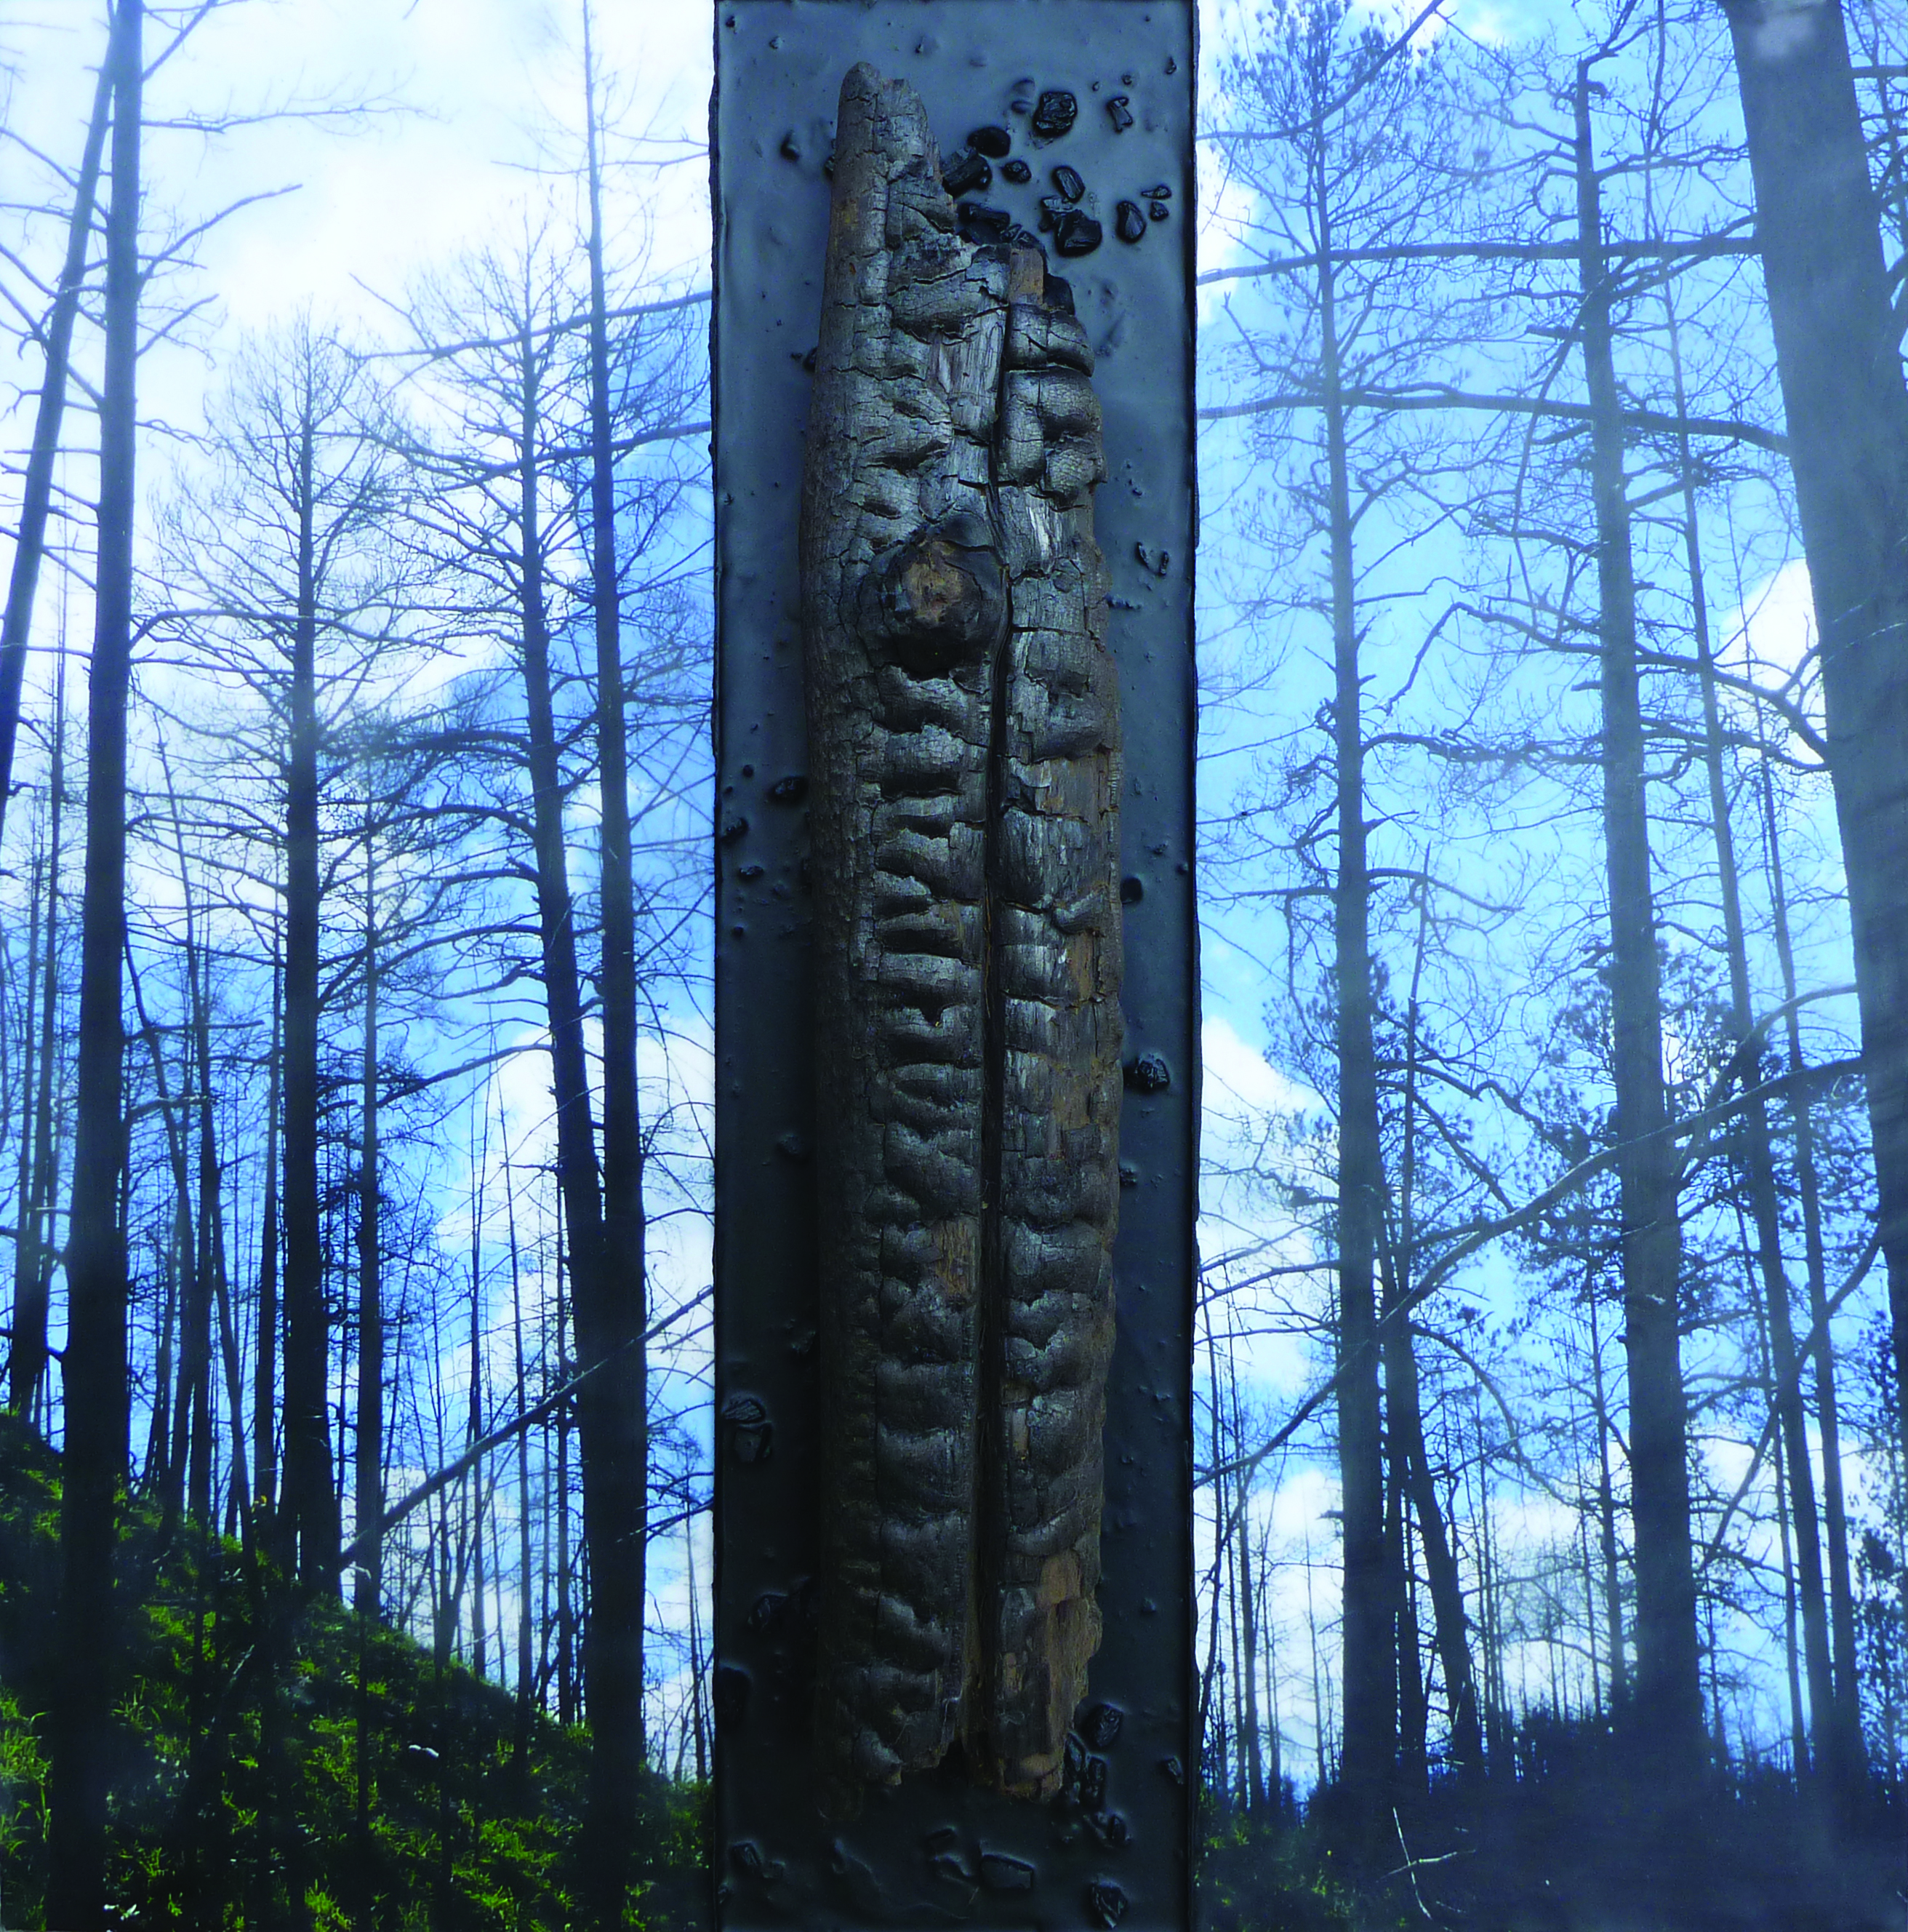
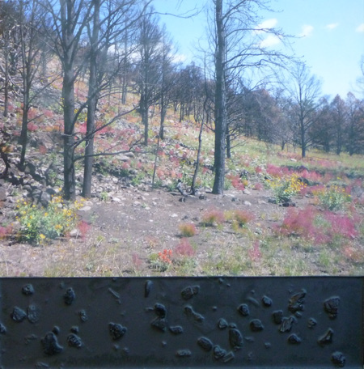
Geographies of Memory
encaustic, photography and tree bark
Disparate Species
encaustic, photography, rock and tree bark
Today, Lisa Marie Sipe lives with her husband in Bend, Ore., where they are avid hikers, and she continues to work as a graphic designer and a fine artist.
“The destructive force that burned through areas of Arizona and New Mexico to create the largest wildfire in Arizona history scorched the land my husband grew up on in the White Mountains of Arizona. The Wallow fire didn’t take family photo albums or ranch structures, but the scars it etched into the landscape now will be the backdrop for all new memories.
www.lisamariesipe.com

Slide 12
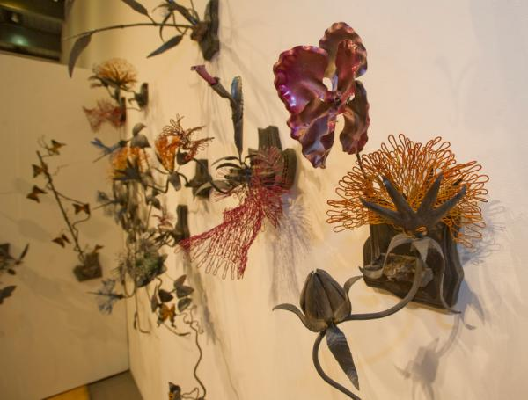
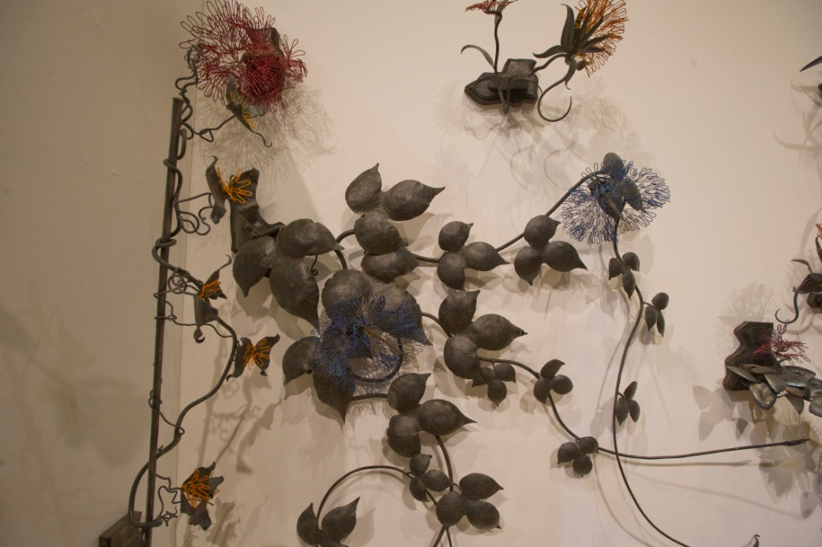
Samuel Troxell grew up surrounded by nature in the bluff lands along the Mississippi River. Later in life he traveled the world from the Arctic Circle to the Andes Mountains, seeing nature in all its power. Portions of Troxell’s metal sculptures include remnants of the rubber dam from Tempe Town Lake, which he used primarily for structural support.
“Metal by nature is tough and resilient and only by understanding its nature can I learn to work with it, not against it. Recycling metal and other materials has forced me and my work to be varied
and resourceful.
www.talonforge.com
Photos by Michael Ging
Blossoms and Blooms
iron, steel, rubber dam remnants and powder coating

Slide 13
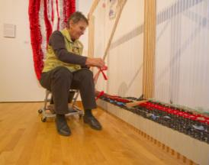
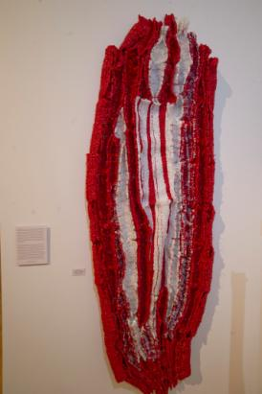
Sherrie Zeitlin has been working as an artist and educator in the local community for more than
30 years. She continues to serve children and adults through her efforts with the Art Resource Center, a non profit organization located in Tempe that collects reusable items from individuals and industries and offers them free of charge to schools and other non profit entities for the purpose of making art.
“Our streets are littered with plastic; the bags fly through the air on windy days and end up in our canals, fields and lakes. It is my hope that by presenting these items in a different light people will start to think of plastic bags in a new way. I want everyone to realize that we use way too much plastic and that it is necessary to rethink our usage. Most importantly, we need to take a reusable bag with us to any store we frequent.”
www.artresourcecenter.org
Photos by Michael Ging
Homage to the Crazy In Us All
monofilament, surplus telephone wire, surplus bio-hazardous waste bags, dry cleaning bags

Slide 14
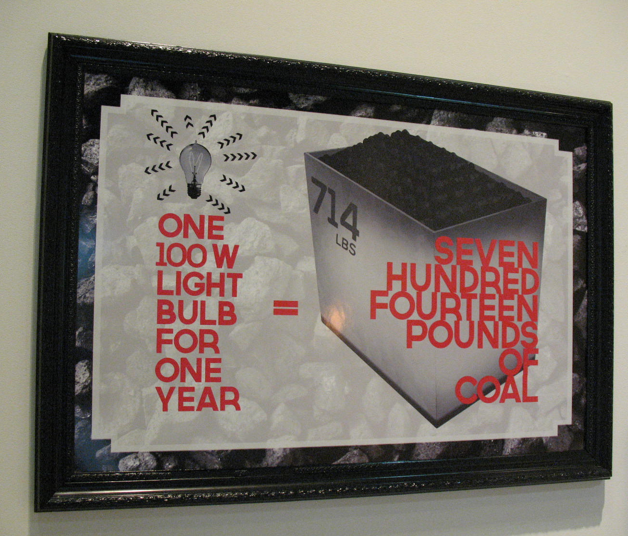
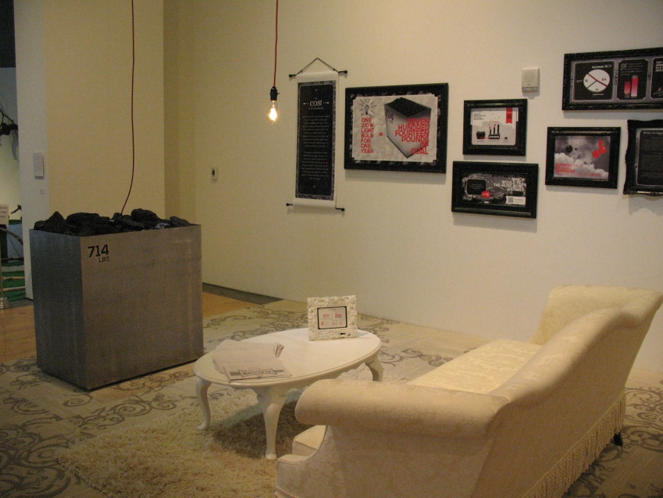
Light Bulbs 101
One of the three main greenhouse gases, carbon dioxide (CO2), is emitted whenever a light is turned on. However, artificial light is an indispensable necessity of modern life. Consumers can make good choices in the types of bulbs they use to light their homes so that they can have light while minimizing their negative environmental impact.
This installation was created by the architectural team at ARCHITEKTON of Tempe.
http://www.architekton.com/

Slide 15
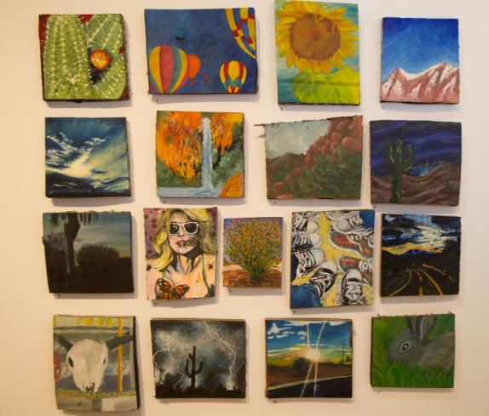
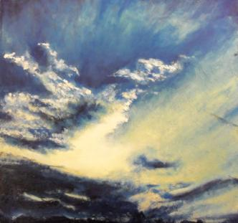
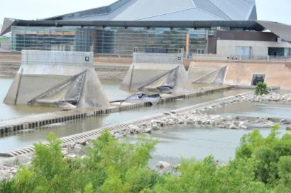
Desert Vista High School
Tempe Union High School District
Following the dam burst of the Tempe Town Lake in 2010, local artists and schools were offered pieces of the old rubber dam to create recycled artworks. Stacy Marko, a local artist and instructor at Desert Vista High School, took the opportunity to let her painting students explore the use of alternative materials in art and work with small pieces of “Tempe history.” Marko and her students completed these paintings in 2012 with an overall theme focusing on the Arizona landscape.
Photo by Michael Ging
Eva Marino

Slide 16
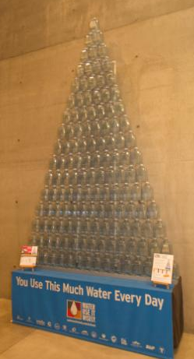
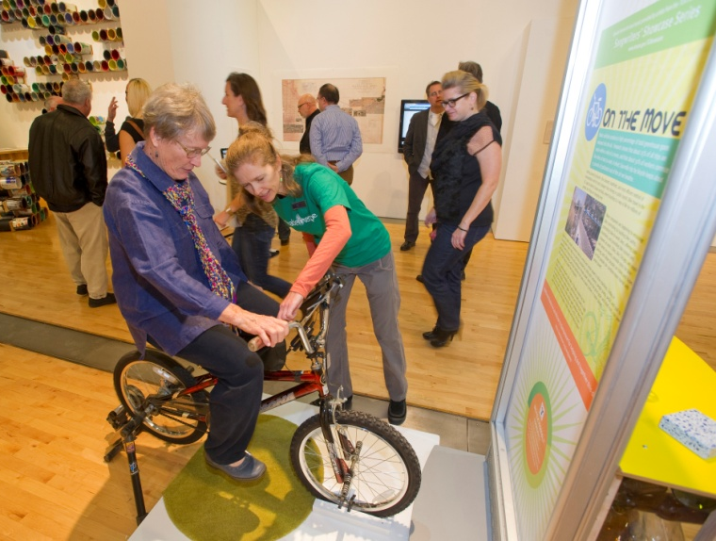
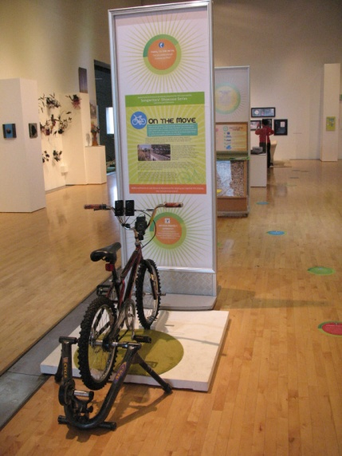
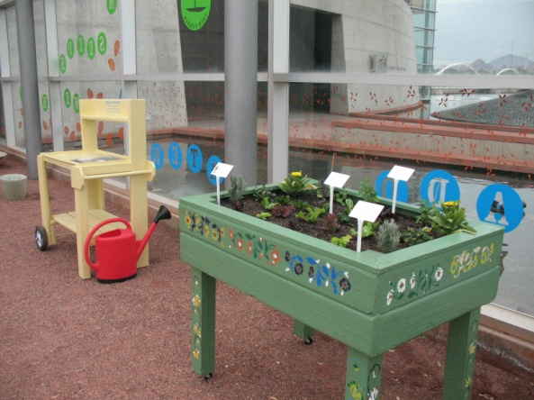
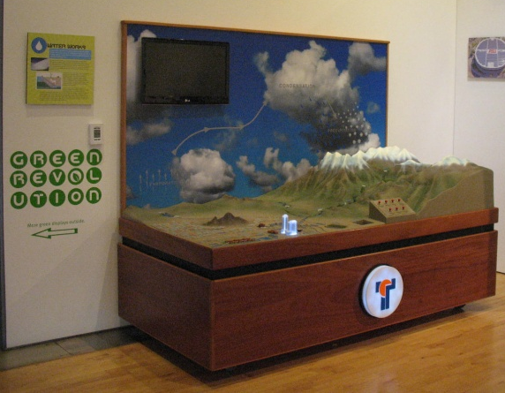
Photo by Michael Ging
Other displays from TCA’s Green Revolution
Photo by Michael Ging

Slide 17
Thank you to the following organizations for grant support:
Salt River Project (SRP) and Friends of TCA
Also thank you to exhibition partners:
Architekton, ASU School of Art, ASU School of Sustainability,
Tempe History Museum, Tempe Public Library, Tempe Public Art, Tempe Water Utilities, Tempe Recycles, Tempe Public Works,
Art Resource Center, Tempe Union High School District,
First Solar, Tempe Farmer’s Market, Childsplay and many
other artists, organizations and individuals.

